Slide 1
ALZ-NET (4709) eCRF Training
All Forms
Kathleen Donahue – Senior Clinical Data Manager
Autumn Rolack – Clinical Data Manager
January 2025

Slide 2
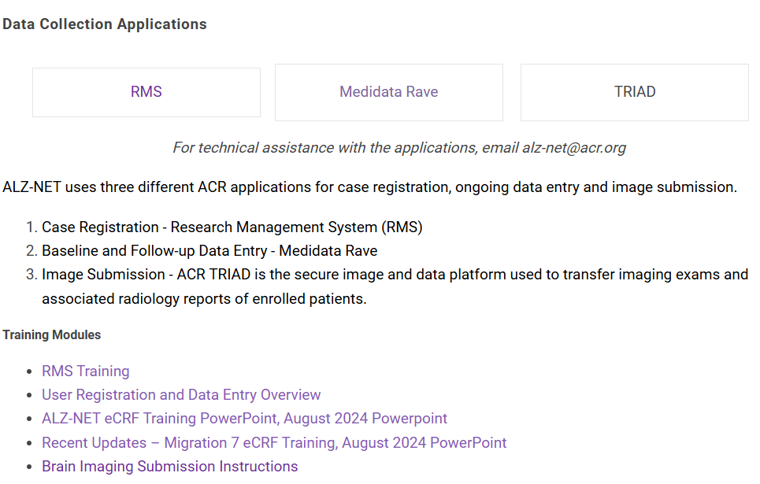
First things first…
Prior to entering data into the eCRFs, a patient must be enrolled, and Rave access must be granted.
Please review the RMS and the Medidata Rave trainings located on ALZ-NET.org

Slide 3
General data entry guidelines
Complete ALL forms within the data collection timepoint folder within 30 days of reporting period end date.
Pay attention to the reporting period start and stop dates and only report on what occurred during that time period.
Answer ALL questions on a form.
  Note: a response of “unknown” may be queried for clarification.
Read instructions at the top of the page.
Click on ? Icon for HelpText.
Always fully answer the query (i.e., providing any necessary explanation) and update the corresponding field on the form.

Slide 4
General data entry guidelines
Fields are generally flagged as nonconformant (red triangle) because the date is in the incorrect format or there are too many characters entered into a specify line.
Prior to the initiation of Aducanumab, Lecanemab and Donanemab, an MRI and either an Amyloid PET/CT or CSF collection is expected.
  Please report imaging on the Diagnostic Testing form and the Clinical Imaging Submission form as appropriate.
  Please report CSF collection Diagnostic Testing form as appropriate.

Slide 5
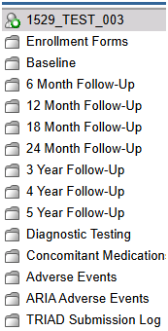
Folder Structure in Rave
Enrollment Forms
Baseline
Follow-up
Patient Level

Slide 6

Enrollment Forms folder

Slide 7
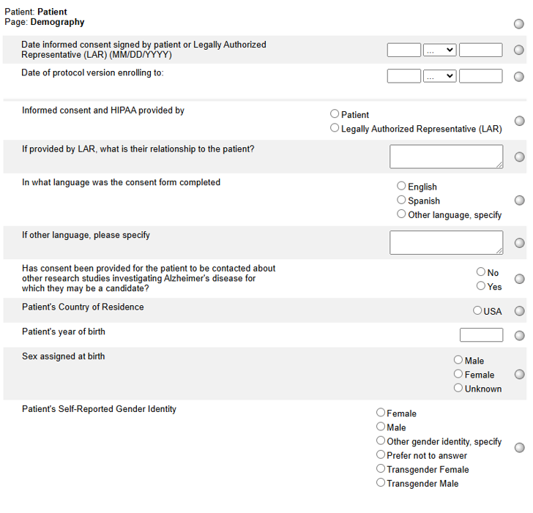
Demography
When a patient is registered to ALZ-NET via the RMS some of the data is automatically loaded into the Demography form in Rave.
**Sites cannot update this eCRF**

Slide 8
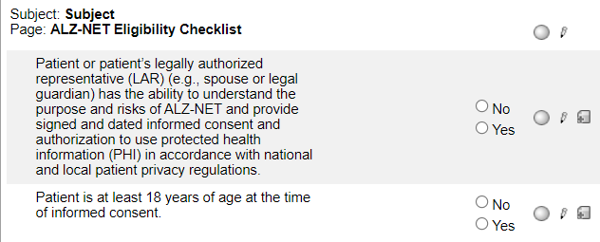
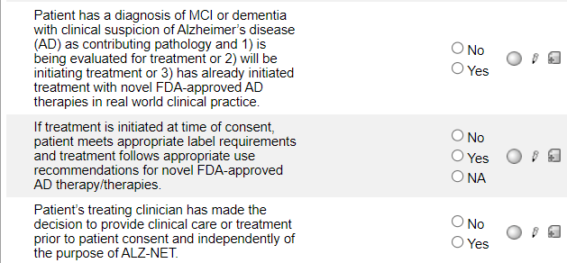
ALZ-NET Eligibility Checklist
When a patient is registered, the responses to the inclusion criteria are automatically loaded into the ALZ-NET Eligibility Checklist form in Rave.
**Sites cannot update this eCRF**

Slide 9
Folder Structure in Rave
Enrollment Forms folder
Baseline folder
Follow-up folder
Patient Level folders

Slide 10
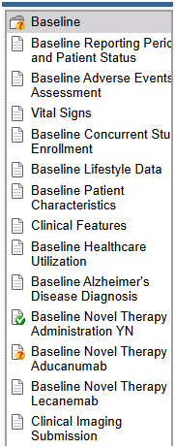
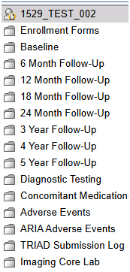


Baseline folder

Slide 11
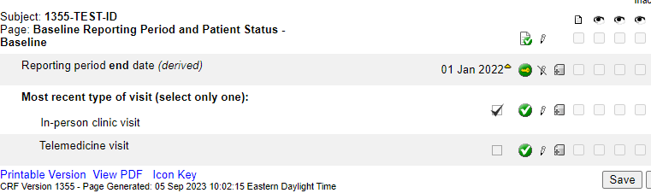
Baseline Reporting Period and Patient Status
Complete this form prior to completing any other forms within the folder.
The derived end date is the date of the patient’s enrollment to the registry and cannot be changed.
Indicate the most recent type of visit.

Slide 12
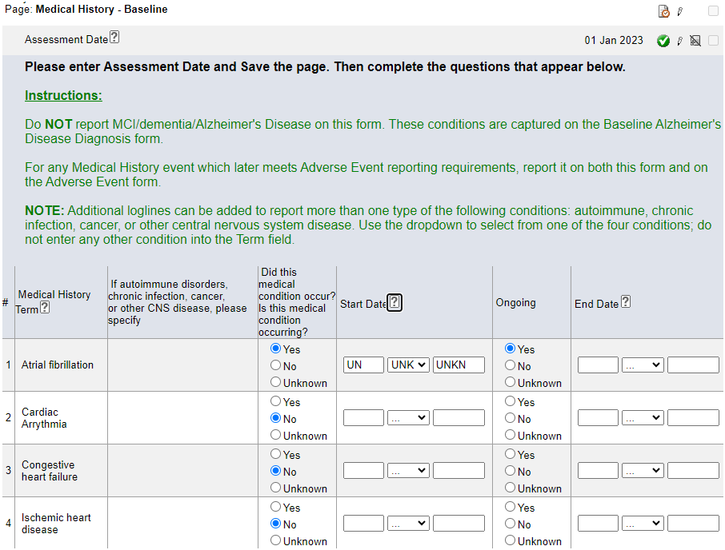
Medical History
Always enter this form prior to entering data on the Concomitant Medications form.
Enter the Assessment Date and hit Save. The rest of the form will open to allow for data entry.
NOTE: The Assessment Date will generally be the date of the most recent assessment up to and including the day of enrollment to ALZ-NET
Pay close attention to the Instructions.

Slide 13
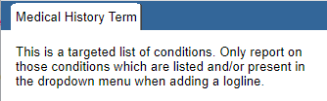
Medical History
The diagnoses of MCI/AD is not reported on this form; it is reported on the Baseline Alzheimer's Disease Diagnosis form.
Only report on those targeted conditions listed. Refer to the NOTE: and Help Text for clarification.

Slide 14
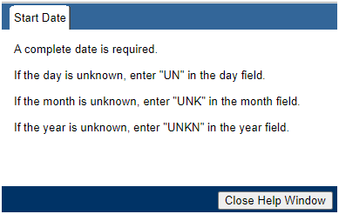
Medical History
Always report as much of any date as is known.
As a very last resort, fully unknown Start Dates can be reported. Click on the ? icon for HelpText on the format required.

Slide 15
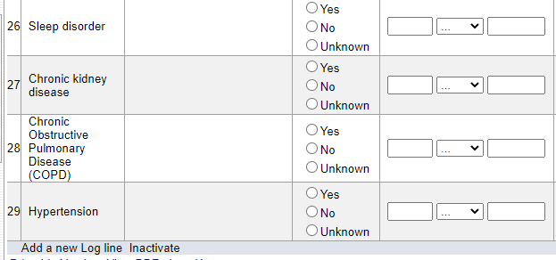
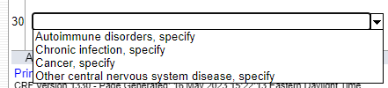
Medical History
To report on additional types of autoimmune disorders, chronic infections, cancer, or other CNS disease, use the Add a new Log line feature and select from the drop down.
Note – complete the ‘specify’ for each additional condition added.
Do not enter any other conditions into the additional log lines.

Slide 16
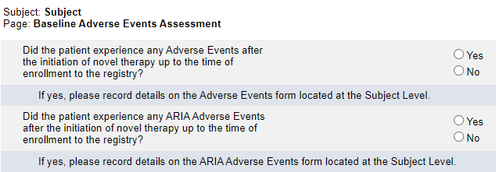
Baseline Adverse Events Assessment
Note the timeline.
If Yes is reported to either question, complete a log line on the Adverse Events or ARIA Adverse Events form located at the Subject Level.

Slide 17
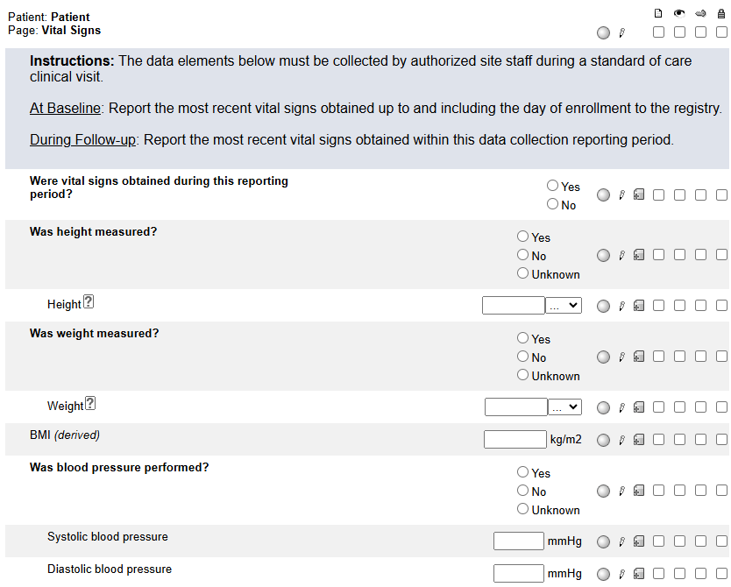
Vital Signs
At Baseline, report the most recent vital signs obtained – up to and including the day of enrollment to the registry.

Slide 18
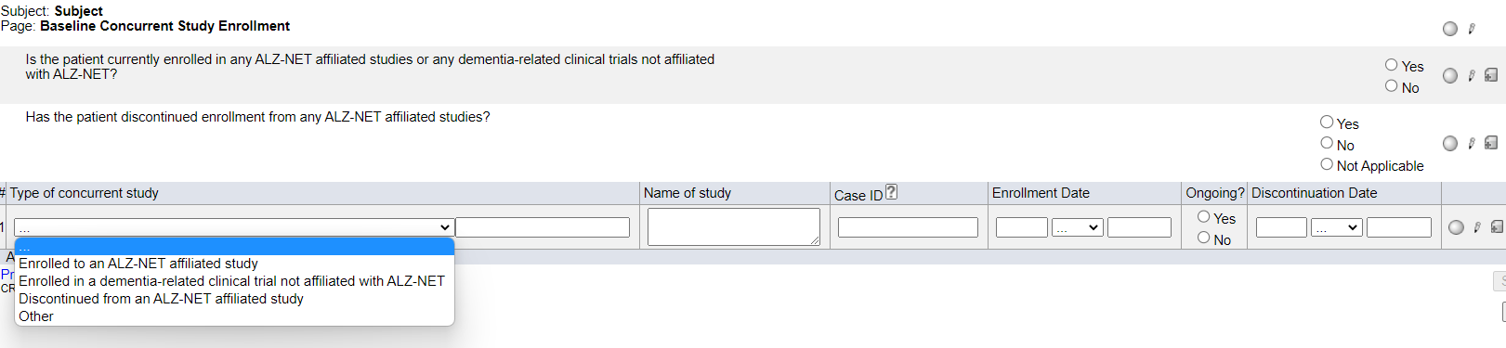

Baseline Concurrent Study Enrollment
If either of the two leading questions are answered Yes, complete a log line for each study to which the patient enrolled or discontinued.
Do NOT report ALZ-NET as a concurrent study. If Case ID is not known, enter UNKNOWN.

Slide 19
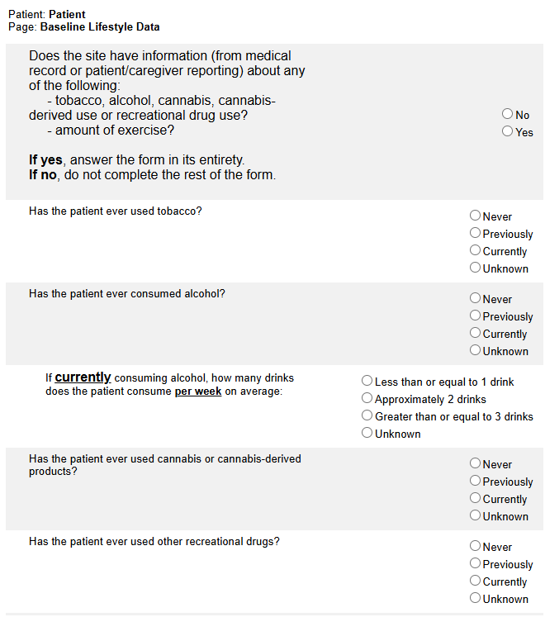
Baseline Lifestyle Data
Answer the lead question.
If the response is Yes, the rest of the form must be completed.
If the response is No, the rest of the form must not be completed.
Prior to reporting all answers as “unknown”, please reach out to the informant/care partner for any additional information.

Slide 20
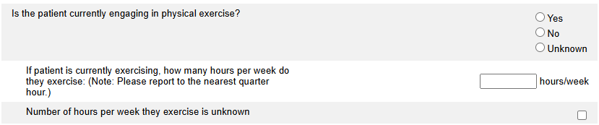
Baseline Lifestyle Data
If “Is the patient currently engaging in physical exercise?” is answered as Yes, indicate either the number of hours/week or use the checkbox to indicate that the number of hours per week is unknown.
Do NOT click on the unknown checkbox if the patient does not engage in exercise.

Slide 21
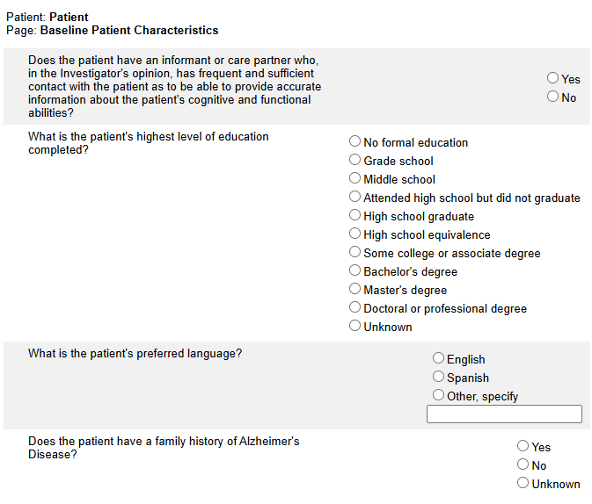
Baseline Patient Characteristics
Answer all questions.
Prior to reporting all answers as “unknown”, please reach out to the informant/care partner for any additional information.

Slide 22
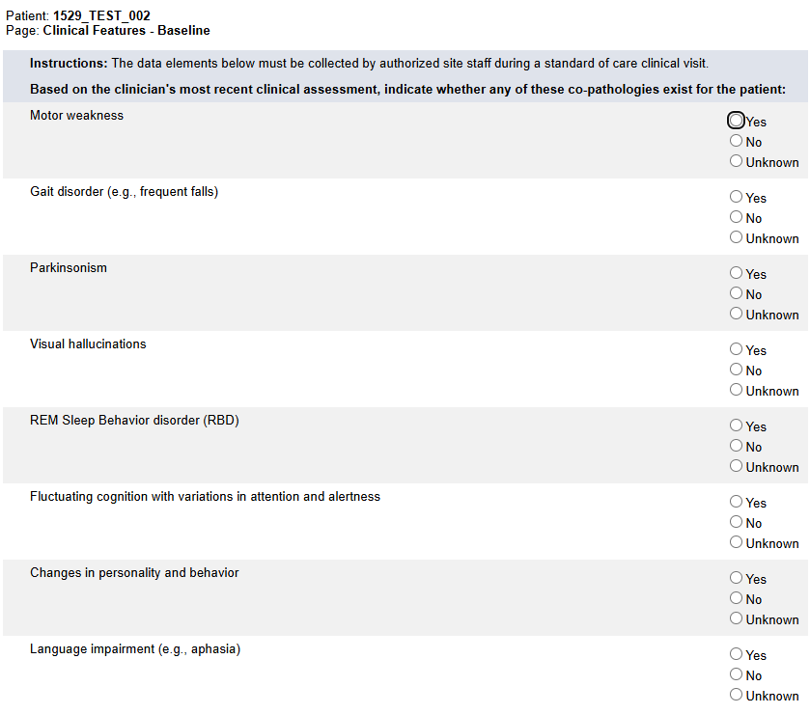
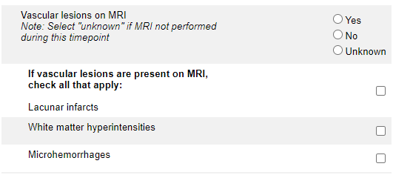
Clinical Features
See Note: under “Vascular lesions on MRI” question:
Answer Yes if an MRI was performed within the timepoint and vascular lesions were present
Answer No if an MRI was performed within the timepoint and vascular lesions were NOT present.
Answer Unknown if an MRI was NOT performed within the timepoint.
If an MRI was performed within the timepoint, report it on the Clinical Imaging Submission form.

Slide 23
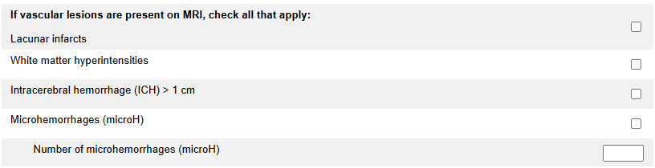
Clinical Features
If a microhemorrhage was present, check the box and indicate the total number of microhemorrhages observed

Slide 24
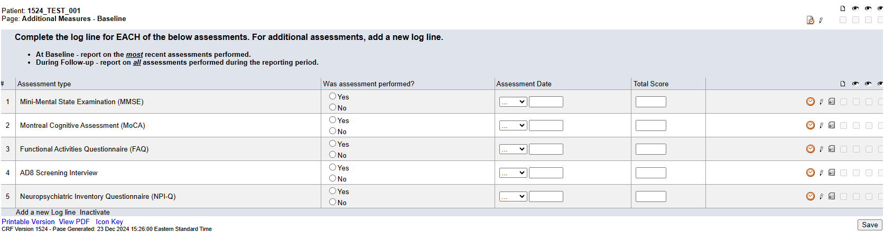
Additional Measures
For each assessment type, indicate whether or not it was performed. If the assessment was performed, complete the log line in its entirety. See instructions for Baseline and Follow-up reporting.
If additional assessments were performed, use the “Add a new Log line” feature.

Slide 25
Additional Measures
For ALZ-NET, it is expected that either the MMSE or the MoCA and the FAQ were performed. If they were not performed, please provide a reason why not when responding to the automated Site from System query.

Slide 26
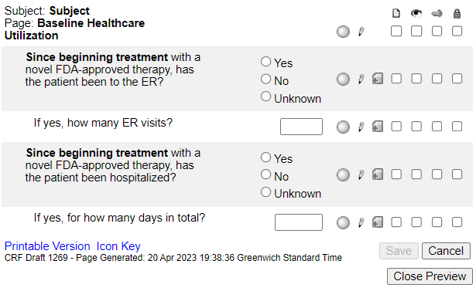
Baseline Healthcare Utilization
The form only becomes visible and available for data entry when “Has the patient received any doses of a novel FDA-approved AD therapy prior to their enrollment in the registry?” on the Baseline Novel Therapy Administration YN has been answered Yes.
Note that hospitalization constitutes an SAE and must be reported as such.

Slide 27
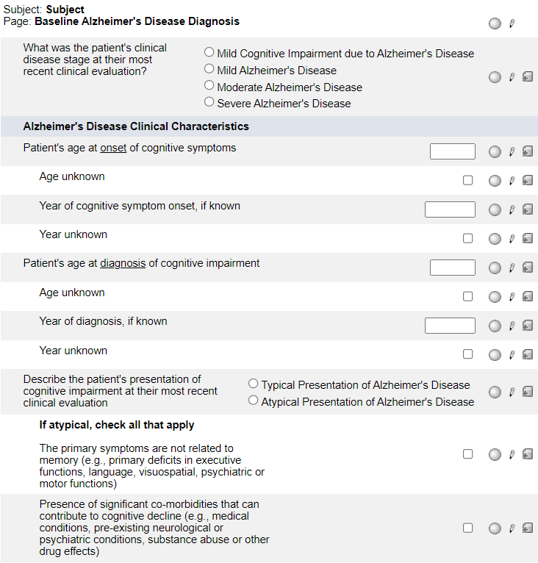
Baseline Alzheimer's Disease Diagnosis
For both onset of cognitive symptoms and diagnosis of cognitive impairment –
enter either the actual age or check the age unknown checkbox
AND
enter either the actual year or check the year unknown checkbox.

Slide 28
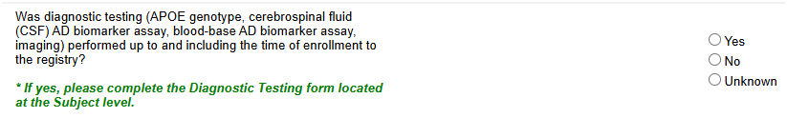
Baseline Alzheimer's Disease Diagnosis
Answer Yes, No or Unknown.
  If Yes, complete the Diagnostic Testing form located at the Subject level.

Slide 29
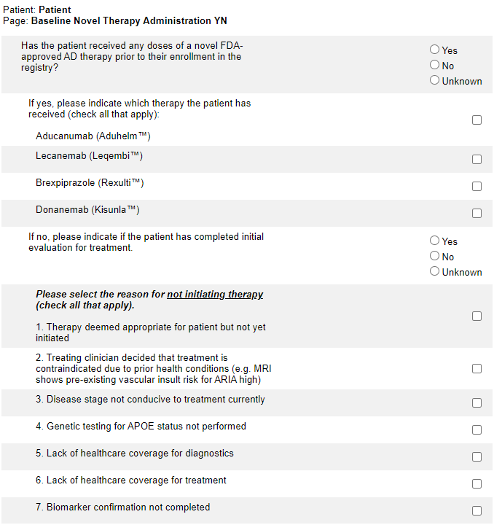
Baseline Novel Therapy Administration YN
If the patient is on novel therapy, answer Yes, check the checkbox of the novel therapy taken, and hit Save.
The list of novel therapies will be updated as new therapies become available.
Note that the timeframe is prior to the patient’s enrollment to ALZ-NET.

Slide 30
Baseline Novel Therapy Administration YN
If the first question is answered No, indicate if the patient has completed the initial evaluation for treatment.
If the initial evaluation has not been completed, select No and hit Save.

Slide 31
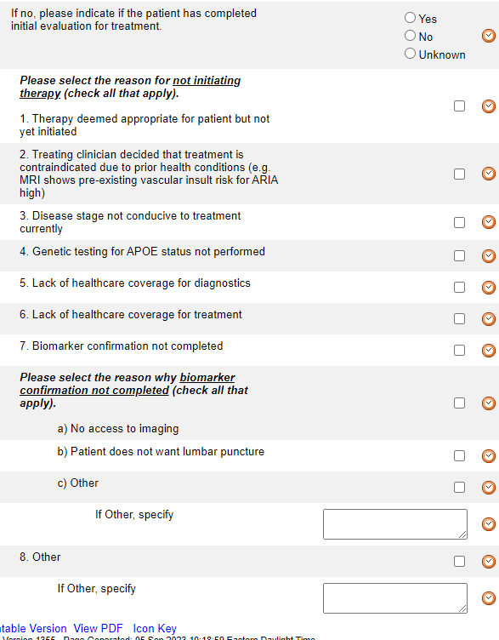
Baseline Novel Therapy Administration YN
If the initial evaluation has been completed, select Yes and indicate the reasons for not initiating therapy and hit Save.
Note that there are 8 general choices (numbered 1-8) and 3 biomarker-specific choices (lettered a-c)
If Other is selected for either, please specify.

Slide 32
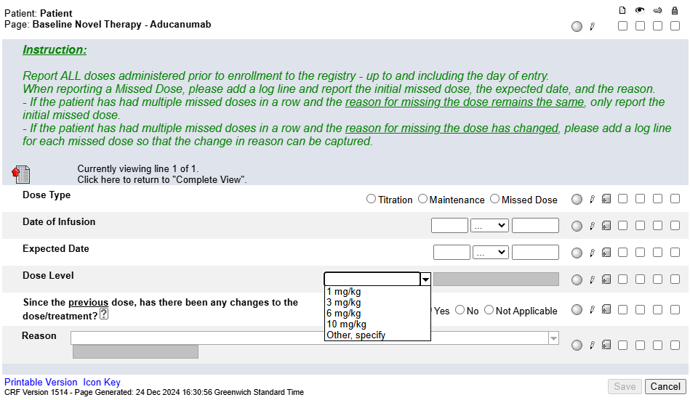
Baseline Novel Therapy - Aducanumab
This form only becomes visible and available for data entry when Aducanumab is selected on the Baseline Novel Therapy Administration YN form.
Complete a log line for each dose taken prior to enrollment to the registry – up to and including the day of entry.

Slide 33
Baseline Novel Therapy - Aducanumab
Pay close attention to the Instructions when reporting a Missed Dose.
When reporting a Missed Dose, enter the Expected Date, answer Yes to “Since the previous dose, has there been any changes to the dose/treatment?” and provide a Reason.

Slide 34

Baseline Novel Therapy - Aducanumab
Note: this form is a “portrait log” style. It can be opened by clicking on the header in the log line and closed by clicking on “Complete View”.
Dose Level – do not report the actual calculated dose but the dose level as per the drug label.
See Help Text for clarification on when to use Not Applicable.

Slide 35
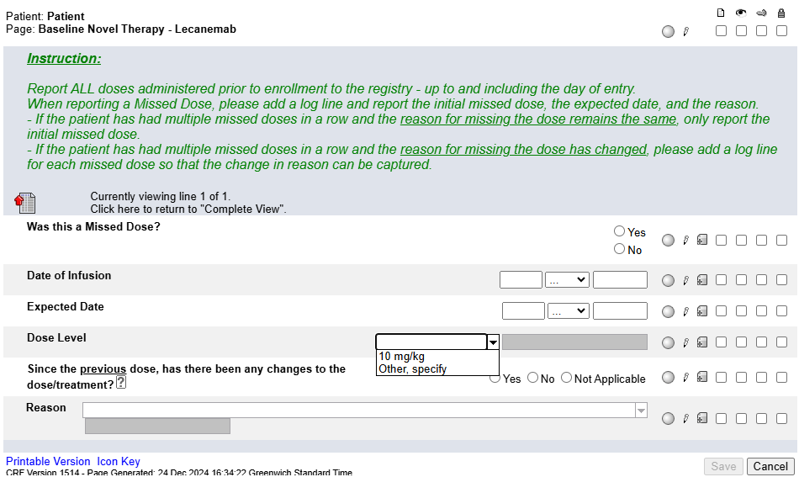
Baseline Novel Therapy - Lecanemab
This form only becomes visible and available for data entry when Lecanemab is selected on the Baseline Novel Therapy Administration YN form.
Complete a log line for each dose taken prior to enrollment to the registry – up to and including the day of entry.

Slide 36
Baseline Novel Therapy - Lecanemab
Pay close attention to the Instructions when reporting a Missed Dose.
When reporting a Missed Dose, enter the Expected Date, answer Yes to “Since the previous dose, has there been any changes to the dose/treatment?” and provide a Reason.

Slide 37

Baseline Novel Therapy - Lecanemab
Note: this form is a “portrait log” style. It can be opened by clicking on the header in the log line and closed by clicking on “Complete View”.
Dose Level – do not report the actual calculated dose but the dose level as per the drug label.
See Help Text for clarification on when to use Not Applicable.

Slide 38
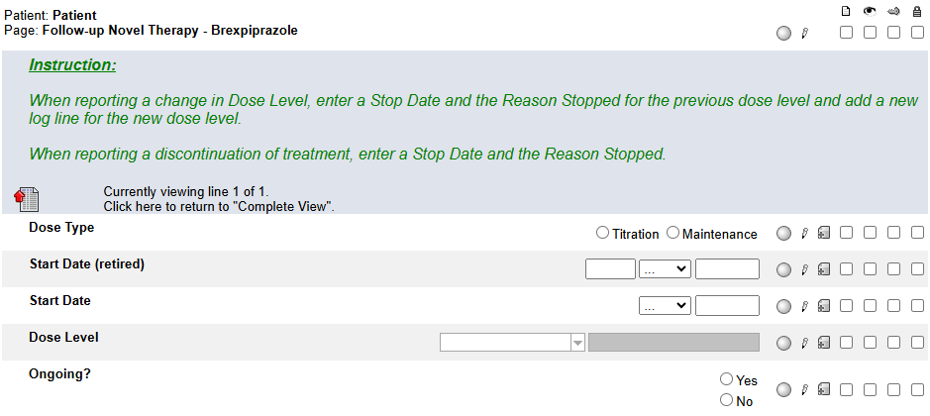
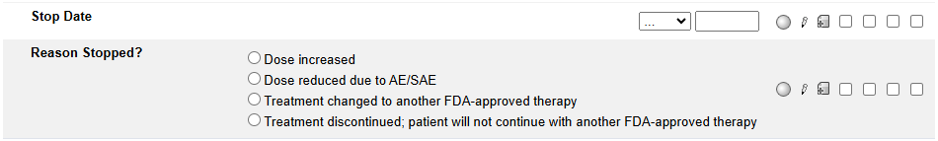
Baseline Novel Therapy - Brexpiprazole
This form only becomes visible and available for data entry when Brexpiprazole is selected on the Baseline Novel Therapy Administration YN form.
Pay close attention to the Instructions. Report new Dose Levels and changes to Dose Levels. Do not report each individual dose.
Note: this form is a “portrait log” style. It can be opened by clicking on the header in the log line and closed by clicking on “Complete View”.

Slide 39
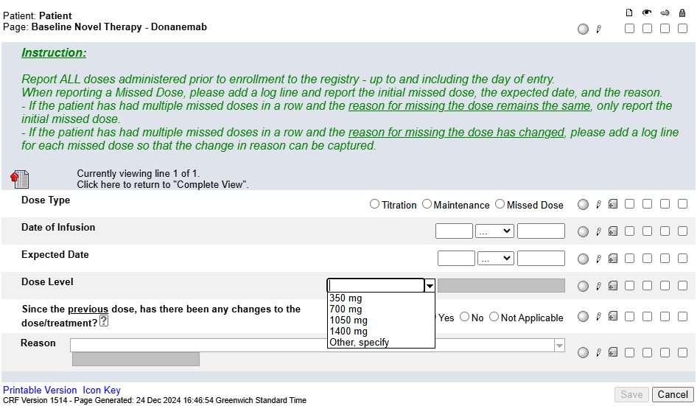
Baseline Novel Therapy – Donanemab
This form only becomes visible and available for data entry when Donanemab is selected on the Baseline Novel Therapy Administration YN form.
Complete a log line for each dose taken prior to enrollment to the registry – up to and including the day of entry.

Slide 40
Baseline Novel Therapy – Donanemab
Pay close attention to the Instructions when reporting a Missed Dose.
When reporting a Missed Dose, enter the Expected Date, answer Yes to “Since the previous dose, has there been any changes to the dose/treatment?” and provide a Reason.

Slide 41
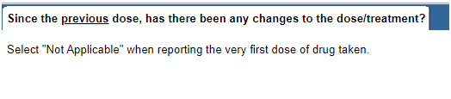
Baseline Novel Therapy – Donanemab
This form is a “portrait log” style. It can be opened by clicking on the header in the log line and closed by clicking on “Complete View”.
See HelpText for clarification on when to use Not Applicable.

Slide 42
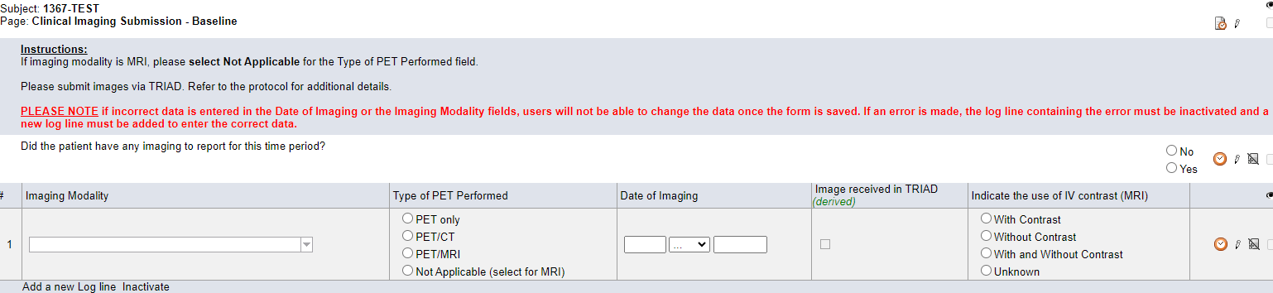
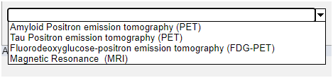
Clinical Imaging Submission
Baseline: Report the most recent imaging performed prior to the initiation of novel therapy and/or with the 12 months prior to the enrollment to the registry.
Follow-up: Report all imaging performed (within the corresponding date collection window).

Slide 43
Clinical Imaging Submission
Enter a log line for each image submitted.
If the modality is MRI, select Not Applicable for Type of PET Performed.
Only enter details about contrast if modality is MRI.

Slide 44
Clinical Imaging Submission
Imaging is an important part of ALZ-NET. Please report each image performed and submit both imaging and reports to TRIAD. When queried for image submission, respond with why the image was not submitted (e.g., site does not have access to TRIAD, site can submit reports only, etc.).

Slide 45
Folder Structure in Rave
Enrollment Forms
Baseline
Follow-up
Patient Level

Slide 46

Follow-Up folders
Complete the Follow-up Reporting Period and Patient Status form to roll-out the remaining follow-up forms.
NOTE:
You may see an inactivated Baseline Reporting Period and Patient Status form as the first form in the follow-up folders. Ignore this form!

Slide 47
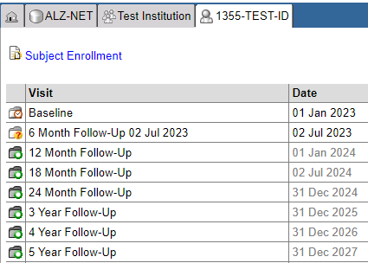
Patient Home Page
All Follow-Up folders become visible as soon as the patient is enrolled to the registry.
However, each Follow-Up folder only becomes accessible for data entry at the END of the data collection time point. Until that point, the date in the Date column is grayed out and the folder, while visible, cannot be opened.

Slide 48
Patient Home Page
Once a folder is accessible, the END date of the data collection time point is appended to the name of the folder, the date in the Date column is no longer grayed out, and the folder can be opened.

Slide 49
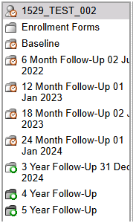
Folder Navigation
Note, too, that the appended date will be visible for each accessible folder within the Folder Navigation panel.

Slide 50
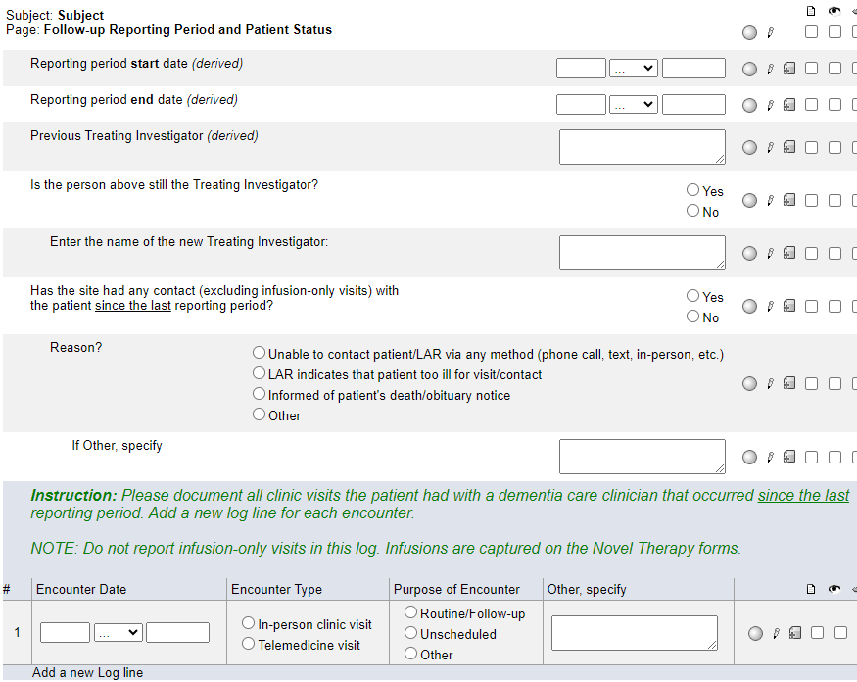
Follow-up Reporting Period and Patient Status
During follow-up, this is the only form which appears when a folder is first opened.
The derived start date is one day after the end date of the previous data collection time point.
The derived end date is derived from the registration date plus the corresponding data collection time point (6 month, 12 month, 24 month etc.)
  These derived dates cannot be changed.

Slide 51
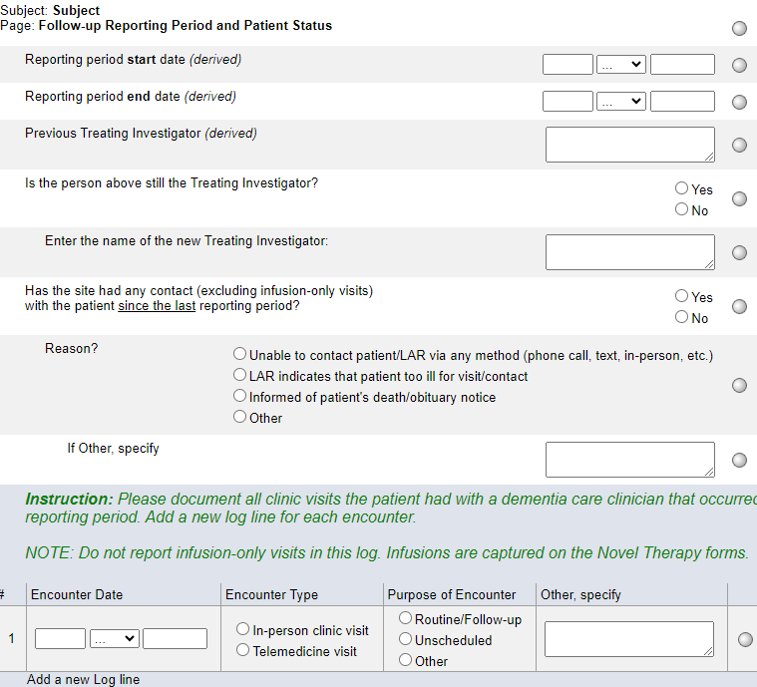
Follow-up Reporting Period and Patient Status
Beginning at the 6-month data collection time point, the Treating Investigator reported at the time of registration will be derived to the Previous Treating Investigator (derived) field.
Answer “Is the person above still the Treating Investigator?”
If Yes, the previous Treating Investigator will be derived forward to the next data collection time point.
If No, enter the name of the new Treating Investigator into the open text box. This new Treating Investigator will be derived forward to the next data collection time point.

Slide 52
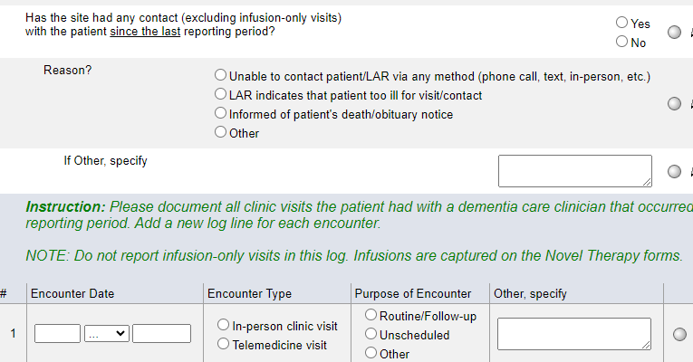
Follow-up Reporting Period and Patient Status
Answer “Has the site had any contact (excluding infusion-only visits) with the patient since the last reporting period?
If Yes, complete a log line for each in-person clinic or telemedicine visit.
  NOTE: Infusion-only visits do not need to be reported as a log line. Infusion visits are captured on the Novel Therapy forms.
If No, indicate the reason.

Slide 53
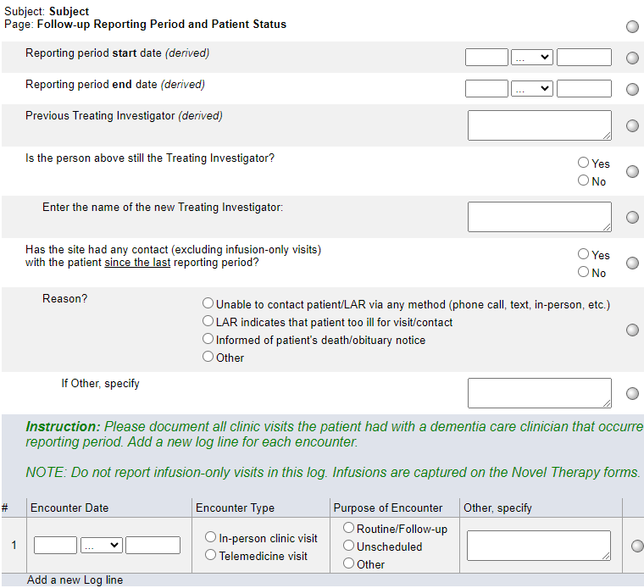
Follow-up Reporting Period and Patient Status
If the site has been unable to contact the patient and the patient is considered lost to follow-up. please use the Add Event feature to select and complete the Lost to Follow-up form.
**Refer to protocol section 11.8.2 for the definition of Lost to Follow-up.**
If it’s reported that there has been no contact and the Reason is “death/obituary notice”, the Death Detail form will become visible and available for data entry at the Subject Level.

Slide 54
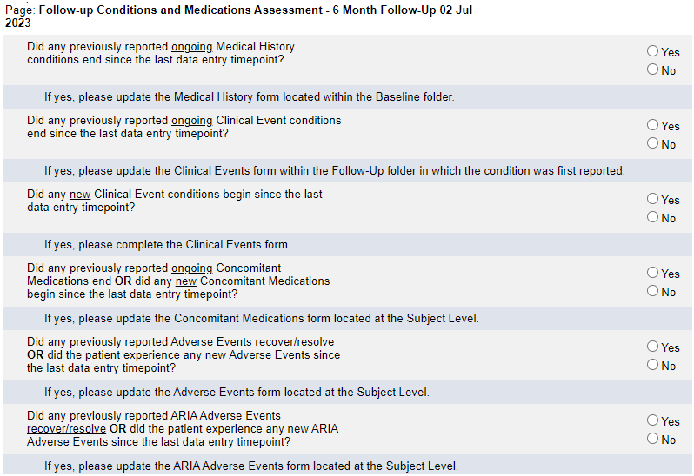
Follow-up Conditions and Medications Assessment
Complete this form in its entirety and for each Yes response, follow the instructions indicated under the question.

Slide 55
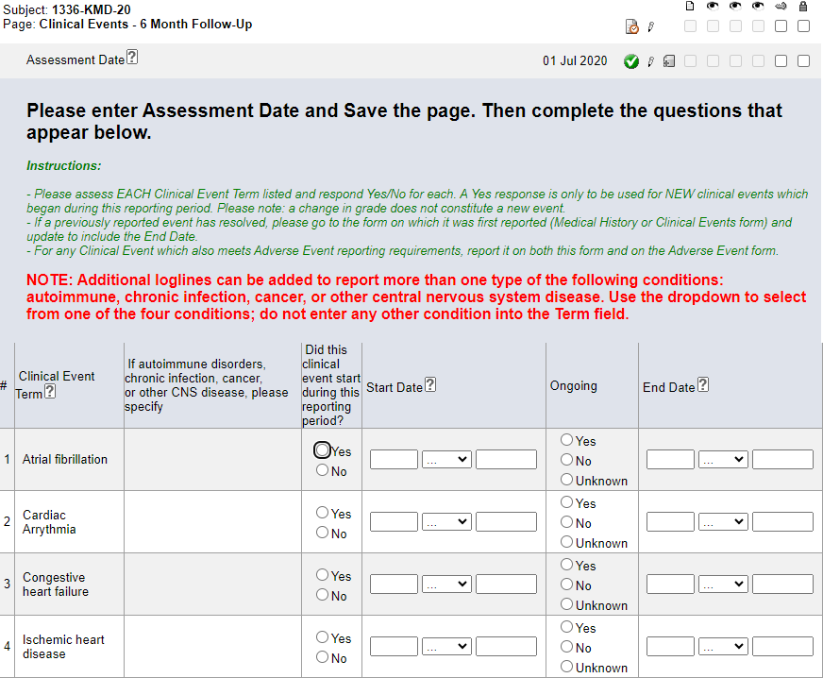
Clinical Events
This form only roll outs when “Did any new Clinical Event conditions begin since the last data entry timepoint?” on the Follow-up Conditions and Medications Assessment form is answered Yes.
Always enter this form prior to entering data on the Concomitant Medications form.
Enter the Assessment Date and hit Save. The rest of the form will open to allow for data entry.

Slide 56
Clinical Events
If the Clinical Events form does not roll-out, please do the following:
On the corresponding Follow-
up Conditions and Medications Assessment form, ‘Toggle’ the answer to this question.
That is, change the answer to No and hit Save. Then, change the answer back to Yes and hit Save.
This should ‘trigger’ the programming and the Clinical Events form will roll-out.

Slide 57
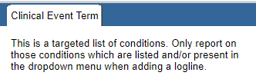
Clinical Events
Pay close attention to the Instructions in the header in Rave.
Only report on those targeted conditions listed. Refer to the NOTE: and Help Text for clarification.
The diagnosis of MCI/AD is not reported on this form; it is reported on the Alzheimer's Disease Diagnosis form.

Slide 58
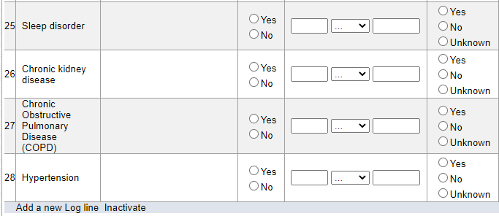
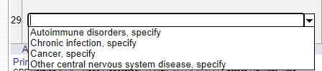
Clinical Events
To report on additional types of autoimmune disorders, chronic infections, cancer, or other CNS disease, use the Add log line feature and select from the drop down.
Do not enter any other conditions into the additional log lines.
Note – complete the ‘specify’ for each additional condition added.

Slide 59
Vital Signs
During Follow-up, report the most recent vital signs obtained within the data collection reporting period.

Slide 60
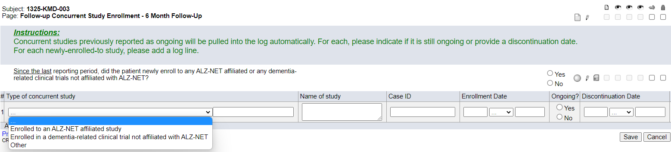
Follow-up Concurrent Study Enrollment
Any concurrent studies to which the patient enrolled to previously and were indicated as ongoing, will automatically be pulled forward into this form. Update the log line for each study pulled in.
If the patient newly enrolled to a study, use the “Add a new Log Line” feature and complete a log line for each new study.
Do NOT report ALZ-NET as a concurrent study.

Slide 61
Follow-up Concurrent Study Enrollment
If previously reported “Ongoing” studies are not being ‘pulled forward’, please do the following:
On the corresponding Follow-up Reporting Period and Patient Status form, ‘toggle’ the answer to this question.
That is, if you originally entered No, change the answer to Yes and hit Save. Then, change the answer back to No and hit Save.
This should ‘trigger’ the programming and the Ongoing studies will be ‘pulled forward’ into the current Follow-up Concurrent Study Enrollment form.

Slide 62
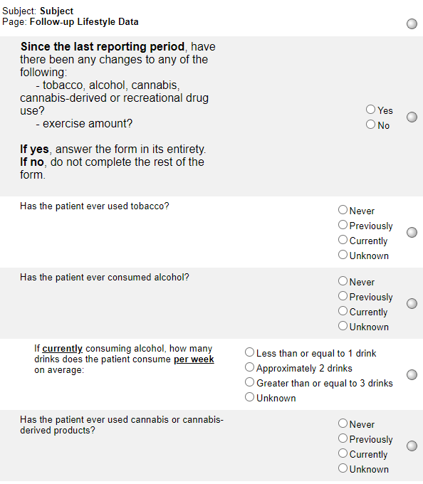
Follow-up Lifestyle Data
This form asks about any changes since the last reporting period. For accurate reporting, compare to how the Lifestyle Data form was completed during the previous reporting period.
If the first question is answered Yes, complete the rest of the form.
If the first question is answered No, do not complete the rest of the form.

Slide 63
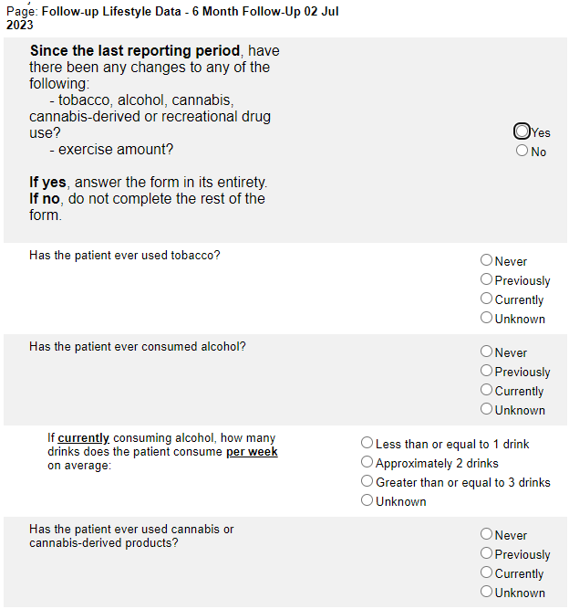

Follow-up Lifestyle Data
If “Is the patient currently engaging in physical exercise?” is answered as Yes, indicate either the number of hours/week or use the checkbox to indicate that the number of hours per week is unknown.

Slide 64

Clinical Features
See Note: under “Vascular lesions on MRI” question:
Answer Yes if an MRI was performed within the timepoint and vascular lesions were present
Answer No if an MRI was performed within the timepoint and vascular lesions were NOT present.
Answer Unknown if an MRI was NOT performed within the timepoint.

Slide 65
Clinical Features
If a microhemorrhage was present, check the box and indicate the total number of microhemorrhages observed.
If an MRI was performed within the timepoint, report it on the Clinical Imaging Submission form.

Slide 66
Additional Measures
For each assessment type, indicate whether or not it was performed. If the assessment was performed, complete the log line in its entirety. See instructions for Baseline and Follow-up reporting.
If additional assessments were performed, use the “Add a new Log line” feature.

Slide 67
Additional Measures
For ALZ-NET, it is expected that either the MMSE or the MoCA and the FAQ were performed. If they were not performed, please provide a reason why not when responding to the automated Site from System query.

Slide 68

Follow-up Healthcare Utilization
Complete this form in its entirety.
Note that the timeframe is since the last reporting period.
Note that hospitalization constitutes an SAE and must be reported as such.

Slide 69

Follow-up Alzheimer's Disease Diagnosis
Complete this form in its entirety.
Note that the timeframe is the patient’s most recent clinical evaluation.
Answer Yes, No or Unknown.
  If Yes, complete the new Diagnostic Testing form located at the Subject level.

Slide 70

Follow-up Novel Therapy Administration YN
Answer Yes, No, or Unknown to the first question.
Note that this question is asking if novel therapies were initiated prior to this data collection time point.
Answer Yes, No, or Unknown to the second question.
Note that the timeframe is since the last data entry timepoint.
If answered Yes, selected the type of novel therapy(ies) and hit Save.
  The list of novel therapies will be updated as new therapies become available.

Slide 71
Follow-up Novel Therapy Administration YN
The circled question is only required to be completed if novel therapy was not initiated previously and if novel therapy was not received since the last data entry timepoint.

Slide 72

Follow-up Novel Therapy Administration YN
If the initial evaluation has been completed, select Yes and indicate the reasons for not initiating therapy and hit Save.
Note that there are 8 general choices (numbered 1-8) and 3 biomarker specific choices (lettered a-c)
If Other is selected, please specify.

Slide 73

Follow-up Novel Therapy - Aducanumab
This form only becomes visible and available for data entry when Aducanumab is selected on the Follow-up Novel Therapy Administration YN form.
Complete a log line for each dose taken during the reporting period.

Slide 74
Follow-up Novel Therapy - Aducanumab
Pay close attention to the Instructions when reporting a Missed Dose.
When reporting a Missed Dose, enter the Expected Date, answer Yes to “Since the previous dose, has there been any changes to the dose/treatment?” and provide a Reason.

Slide 75
Follow-up Novel Therapy - Aducanumab
Note: this form is a “portrait log” style. It can be opened by clicking on the header in the log line and closed by clicking on “Complete View”.
Dose Level – do not report the actual calculated dose but the dose level as per the drug label.
See Help Text for clarification on when to use Not Applicable.

Slide 76

Follow-up Novel Therapy - Lecanemab
This form only becomes visible and available for data entry when Lecanemab is selected on the Follow-up Novel Therapy Administration YN form.
Complete a log line for each dose taken during the reporting period.

Slide 77
Follow-up Novel Therapy - Lecanemab
Pay close attention to the Instructions when reporting a Missed Dose.
When reporting a Missed Dose, enter the Expected Date, answer Yes to “Since the previous dose, has there been any changes to the dose/treatment?” and provide a Reason.

Slide 78

Follow-up Novel Therapy - Lecanemab
Note: this form is a “portrait log” style. It can be opened by clicking on the header in the log line and closed by clicking on “Complete View”.
See Help Text for clarification on when to use Not Applicable.

Slide 79
Follow-up Novel Therapy - Brexpiprazole
This form only becomes visible and available for data entry when Brexpiprazole is selected on the Follow-up Novel Therapy Administration YN form.
Any dose levels previously reported as Ongoing are automatically pulled forward into this form. Update the log line (Ongoing? or Stop Date) for each dose pulled forward. Add a new log line to report any new dose levels.
Pay close attention to the Instructions. Report new Dose Levels and changes to Dose Levels. Do not report each individual dose.
Note: this form is a “portrait log” style. It can be opened by clicking on the header in the log line and closed by clicking on “Complete View”.

Slide 80

Follow-up Novel Therapy – Donanemab
This form only becomes visible and available for data entry when Donanemab is selected on the Follow-up Novel Therapy Administration YN form.
Complete a log line for each dose taken during the data collection timepoint as indicated on the corresponding Follow-up Reporting Period and Patient Status form.

Slide 81
Follow-up Novel Therapy – Donanemab
Pay close attention to the Instructions when reporting a Missed Dose.
When reporting a Missed Dose, enter the Expected Date, answer Yes to “Since the previous dose, has there been any changes to the dose/treatment?” and provide a Reason.

Slide 82
Follow-up Novel Therapy – Donanemab
Note: this form is a “portrait log” style. It can be opened by clicking on the header in the log line and closed by clicking on “Complete View”.
See Help Text for clarification on when to use Not Applicable.

Slide 83
Clinical Imaging Submission
Enter a log line for each image submitted.
If the modality is MRI, select Not Applicable for Type of PET Performed.
Only enter details about contrast if modality is MRI.

Slide 84
Clinical Imaging Submission
Imaging is an important part of ALZ-NET. Please report each image performed and submit both imaging and reports to TRIAD. When queried for image submission, respond with why the image was not submitted (e.g., site does not have access to TRIAD, site can submit reports only, etc.).

Slide 85
Folder Structure in Rave
Enrollment Forms
Baseline
Follow-up
Patient Level

Slide 86






Patient Level folders
Each patient level folder has a single form within it.

Slide 87

Diagnostic Testing
Add and complete a log line for each diagnostic test to be reported.

Slide 88

Diagnostic Testing
If diagnostic testing type is APOE genotype, enter Date performed and APOE result

Slide 89
Diagnostic Testing
If diagnostic testing type is APOE genotype, enter Date performed and APOE result

Slide 90
Diagnostic Testing
If diagnostic testing type is APOE genotype, enter Date performed and APOE result

Slide 91



Concomitant Medications
Pay close attention to the Instructions.
Always complete this form after completing the Medical History, Clinical Events, Adverse Events, and/or ARIA Adverse Events forms.
After entering the Indication, hit Save. Then select the appropriate condition for which the medication is used.

Slide 92
Concomitant Medications
If the drug reported is used for a condition on the Medical History, Clinical Events, Adverse Events, and/or ARIA Adverse Events forms, do NOT use an Indication of “Other (condition)”.
Always report as much of a date as is known!
As a very last resort, fully unknown Start Dates can be reported. Click on the ? icon for HelpText.

Slide 93

Adverse Events
Adverse events for ALZ-NET are in relation to the initiation of novel therapy or enrollment to the registry – whichever is first.
Refer to protocol sections 16.1 and 16.2 for the AE and SAE reporting criteria. This information can also be found on Slide 32 of the ALZ-NET Protocol Training Module on alz-net.org.

Slide 94
Adverse Events
Always enter this form prior to entering data on the Concomitant Medications form.
Pay close attention to the Instructions.
Note: this form is a “portrait log” style. It can be opened by clicking on the header in the log line and closed by clicking on “Complete View”.

Slide 95

ARIA Adverse Events
ARIA adverse events for ALZ-NET are in relation to the initiation of novel therapy or enrollment to the registry – whichever is first.
Always enter this form prior to entering data on the Concomitant Medications form.

Slide 96
ARIA Adverse Events
Pay close attention to the Instructions.
Note: this form is a “portrait log” style. It can be opened by clicking on the header in the log line and closed by clicking on “Complete View”.

Slide 97

ARIA Adverse Events Signs and Symptoms
When a Symptomatic ARIA is reported on the ARIA Adverse Events form, this form rolls out to capture any associated signs and symptoms.
Note that each ARIA Adverse Events Signs and Symptoms form is ‘linked’ to a specific logline on the ARIA Adverse Events form.

Slide 98

ARIA Adverse Events Signs and Symptoms
Report ALL associated signs and symptoms for each symptomatic ARIA AE.
For each of the 7 signs/symptoms listed, indicate if it occurred and complete the rest of the log line as appropriate.
Add a new log line to report additional instances of the 7 signs/symptoms listed and/or to report any other symptoms.

Slide 99


Death Details
The Death Details form becomes visible and available for data entry when the Outcome is reported as Fatal on the Adverse Events or ARIA Adverse Events form. It will be at the Subject Level.

Slide 100

TRIAD Submission Log
This form is view-only to the Site.
It summarizes all the imaging files uploaded to TRIAD for the patient.

Slide 101

Add Event forms
Forms that are completed for specific protocol events can be added at any time point by using the Add Event feature located at the bottom of each patient’s homepage.

Slide 102

Withdrawal of Consent
Pay close attention to the Instructions.
In the future, ALZ-NET plans to have additional optional components to which a patient may consent. The Level of withdrawal choices will be updated as these other registry-related activities become available.
Note that the Demography form captures whether or not the patient previously consented to being contacted for other research opportunities.

Slide 103

Optional Components Reconsent
Pay close attention to the Instructions.
In the future, ALZ-NET plans to have additional optional components to which a patient may consent. The choices for “Which component?” will be updated as these other registry-related activities become available.
Note that the components to which the patient has reconsented must align with those components previously reported as withdrawn from on the Withdrawal of Consent form.

Slide 104

Lost to Follow-up
Patients will be considered lost to follow-up if they miss 3 consecutive data collection timepoints.
Complete this form only after the three contact attempts and the determination have been made.
**Refer to protocol section 11.8.2 for additional information***

Slide 105

Protocol Deviation
Complete a new log line for each Protocol Deviation.
Complete each log line in its entirety.

Slide 106
Please send any data related questions to:
alznet-data@acr.org

Slide 107
Thank You!

