Slide 1
ALZ-NET (4709) eCRF Training
All Forms
Kathleen Donahue – Senior Clinical Data Manager
Autumn Rolack – Clinical Data Manager
June 2025

Slide 2
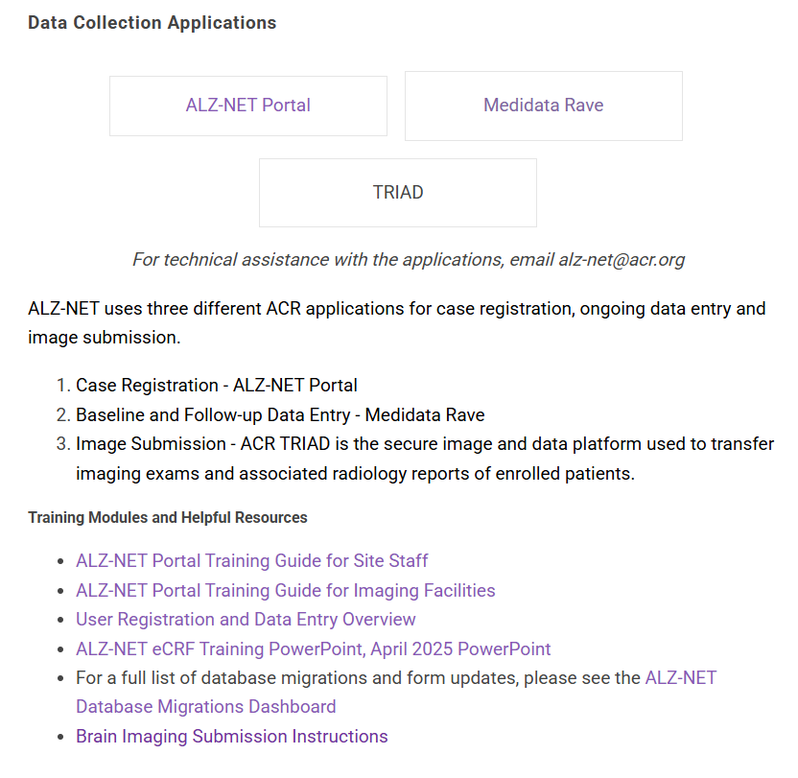
First things first…
Prior to entering data into the eCRFs, a patient must be enrolled, and Rave access must be granted.
Please review the ALZ-NET Portal and the Medidata Rave trainings located on ALZ-NET.org

Slide 3
General data entry guidelines
Complete ALL forms within the data collection timepoint folder within 30 days of the reporting period end date.
Pay attention to the reporting period start and stop dates and only report on what occurred during that time period.
Answer ALL questions on a form.
NOTE: a response of “unknown” may be queried for clarification.
Read instructions at the top of each form.
Click on ? Icon for HelpText.
Always fully answer the query (i.e., providing any necessary explanation) and update the corresponding field on the form.

Slide 4
General data entry guidelines
Fields are generally flagged as nonconformant (red triangle) because the date is in the incorrect format, there are too many characters entered into a specify line, or the specify line was entered blank.
Prior to the INITIAL initiation of Aducanumab, Lecanemab and Donanemab, an MRI and either an Amyloid PET/CT or CSF collection is expected.
Please report imaging on Diagnostic Testing form (see specific instructions on this form).
Please report CSF collection on the Diagnostic Testing form as appropriate.
Please report ALL imaging on the Imaging Log on the ALZ-NET Portal.

Slide 5
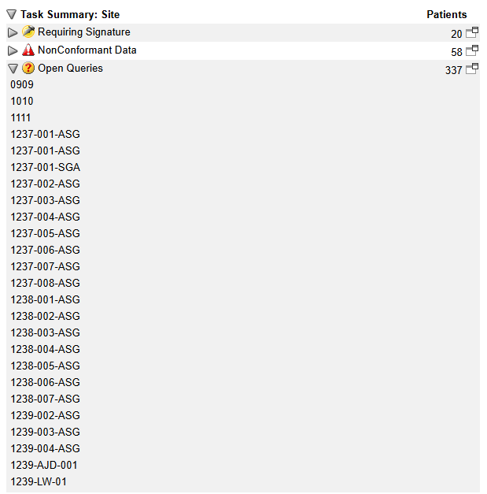
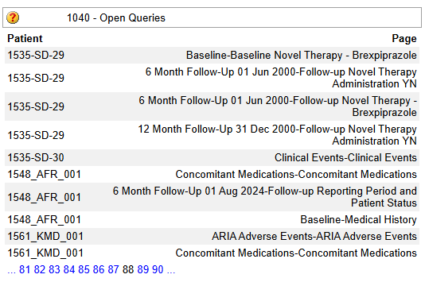
Task Summary
In Rave, use the Task Summary to stay on top of data issues in real time.
Located on the right-hand site of the homepage for each site/each patient, it shows which patients have nonconformant data, open queries, or overdue data.
Click on the number in the upper right-hand corner within each category to drill down to the patient and form level.
Click on the form to be brought directly to it to review and address the issue.

Slide 6
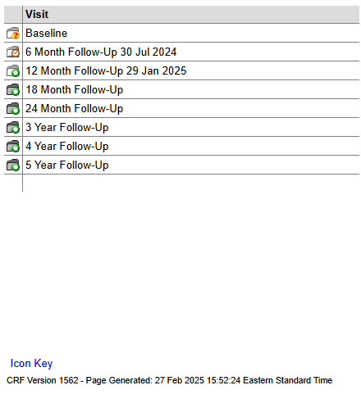
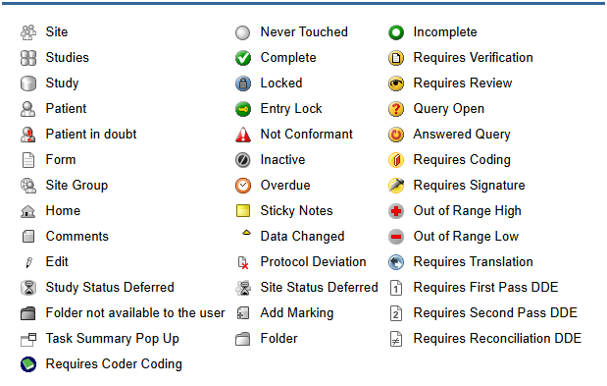
Icon Key
Each page in Rave, includes an Icon Key.
Once clicked, a key opens which provides the definitions of all the various icons use in Rave.

Slide 7
Icon Key
Some of the most common and most helpful icons are:
Complete
Incomplete
Not Conformant
Overdue
Query Open
Answered Query

Slide 8
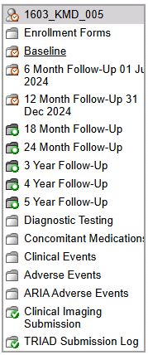
Folder Structure in Rave
Enrollment
Baseline
Follow-up
Patient Level

Slide 9
Enrollment Forms folder

Slide 10
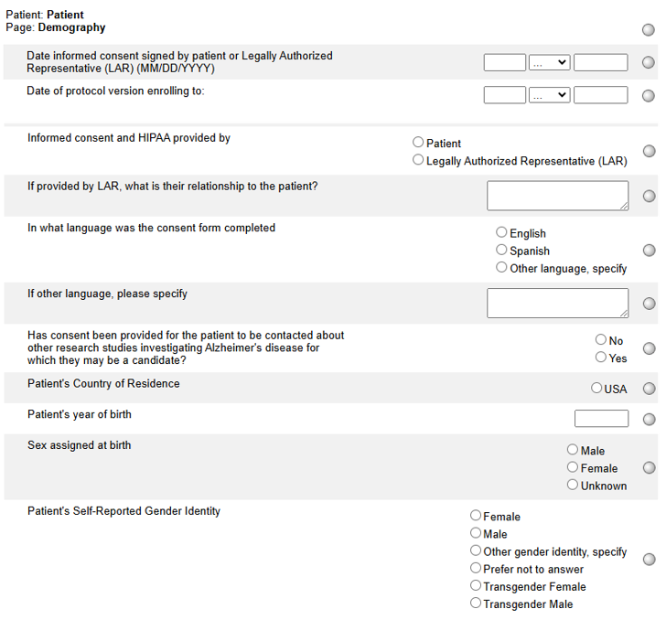
Demography
When a patient is registered to ALZ-NET via the ALZ-NET Portal, some of the data is automatically loaded into the Demography form in Rave.
**Sites cannot update this eCRF**

Slide 11
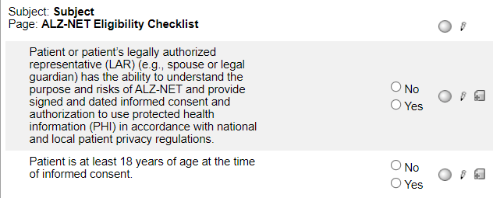
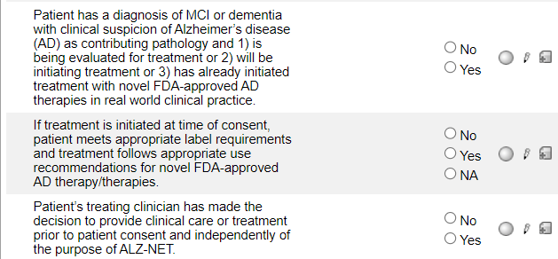
ALZ-NET Eligibility Checklist
When a patient is registered, the responses to the inclusion criteria are automatically loaded into the ALZ-NET Eligibility Checklist form in Rave.
**Sites cannot update this eCRF**

Slide 12
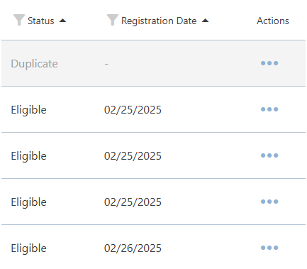
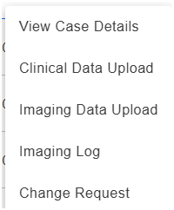
Changes to Enrollment forms
If an error was made on any of the enrollment forms, a Change Request must be submitted.
On the ALZ-NET Portal, go to the Case List and find the patient who needs the update.
Under Actions on the far right of the row, click on the 3 dots (…) and select Change Request.

Slide 13
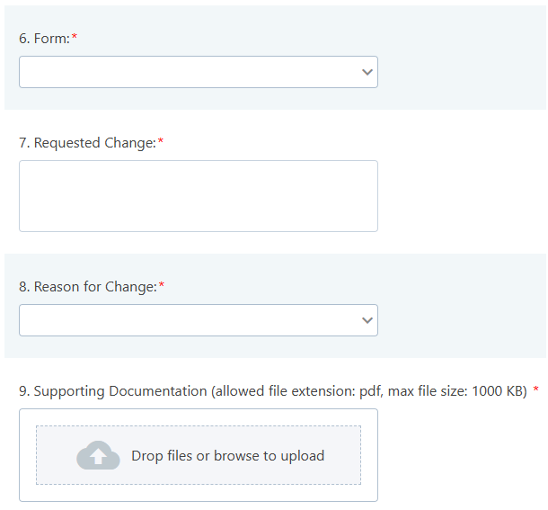
Changes to Enrollment forms
Complete ALL fields
Add as much detail as possible in the Requested Change field.
Upload Supporting Documentation

Slide 14
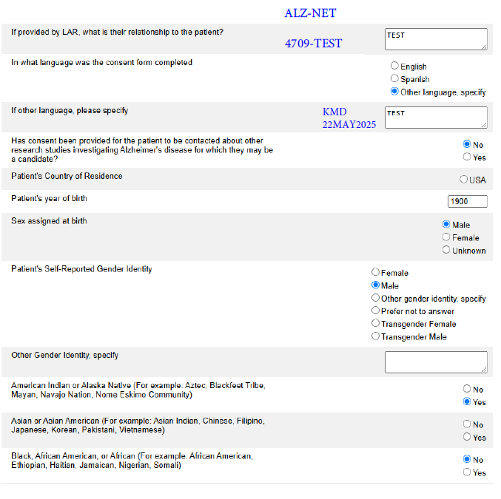
Supporting Documentation
Print/save a PDF of the patient’s original questions with responses.
Cross out the incorrect response and write in the correct response.
Add your initials and date.
Ensure that the study name and patient ID are visible

Slide 15
Folder Structure in Rave
Enrollment
Baseline
Follow-up
Patient Level

Slide 16
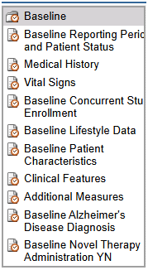
Baseline Folder

Slide 17
Baseline Reporting Period and Patient Status
Complete this form prior to completing any other forms within the folder.
The derived end date is the date of the patient’s enrollment to the registry and cannot be changed.
Indicate the most recent type of visit.

Slide 18
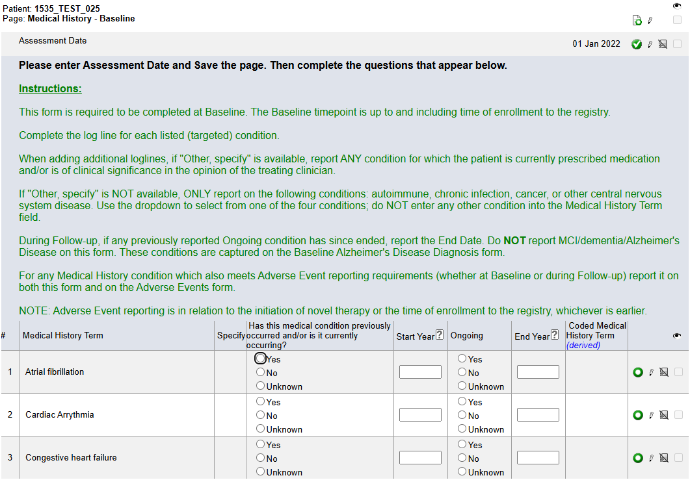
Medical History
Always enter this form prior to entering data on the Concomitant Medications form.
Enter the Assessment Date and hit Save. The rest of the form will open to allow for data entry.
NOTE: The Assessment Date will generally be the date of the most recent assessment up to and including the day of enrollment to ALZ-NET
Pay close attention to the Instructions.

Slide 19
Medical History
Patients who enrolled prior to Migration 8 Phase IV (13FEB2025) will have the original list of 29 Medical History Terms and will follow the circled instruction when adding an additional log line.

Slide 20
Medical History
Patients who enrolled after Migration 8 Phase IV (13FEB2025) will have the new list of 18 Medical History Terms and will follow the circled instruction when adding an additional log line.

Slide 21
Medical History
The diagnoses of MCI/AD is not reported on this form; it is reported on the Baseline Alzheimer's Disease Diagnosis form.

Slide 22
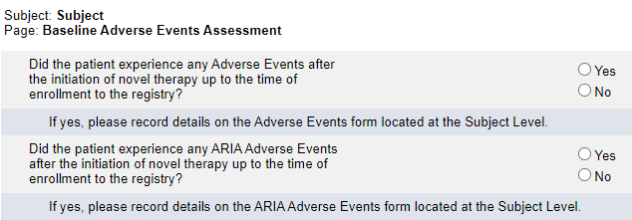
Baseline Adverse Events Assessment
Note the timeline.
If Yes is reported to either question, complete a log line on the Adverse Events or ARIA Adverse Events form located at the Subject Level.

Slide 23
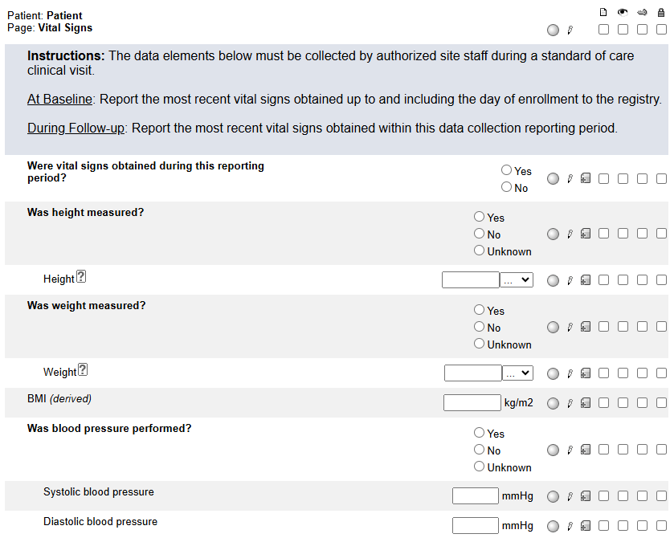
Vital Signs
Pay close attention to the instructions in relationship to data collection reporting period.
Answer the first question –
If the response is Yes, the rest of the form must be completed.
If the response is No, the rest of the form must not be completed.

Slide 24
Baseline Concurrent Study Enrollment
If either of the two leading questions are answered Yes, complete a log line for each study to which the patient enrolled or discontinued.
Do NOT report ALZ-NET as a concurrent study. If Case ID is not known, enter UNKNOWN.

Slide 25
Baseline Concurrent Study Enrollment
Any studies that are reported as ongoing (Ongoing? = Yes) will be pulled forward to the 6 Month Follow-up timepoint.

Slide 26
Baseline Lifestyle Data
Answer the lead question
If the response is Yes, the rest of the form must be completed.
If the response is No, the rest of the form must not be completed.
Prior to reporting all answers as “unknown”, please reach out to the informant/care partner for any additional information.

Slide 27
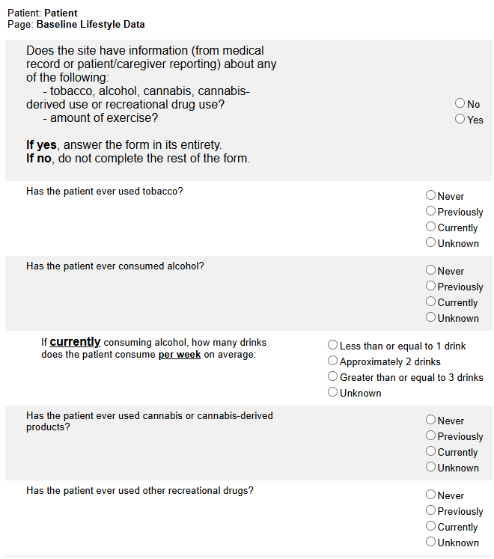
Baseline Lifestyle Data
If “Is the patient currently engaging in physical exercise?” is answered as Yes, indicate either the number of hours/week or use the checkbox to indicate that the number of hours per week is unknown.
Do not click on the unknown checkbox if the patient does not engage in exercise.

Slide 28
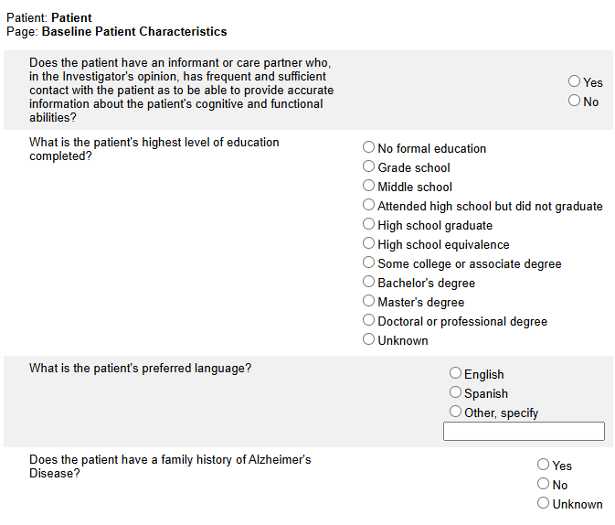
Baseline Patient Characteristics
Answer all questions.
Prior to reporting all answers as “unknown”, please reach out to the informant/care partner for any additional information.

Slide 29
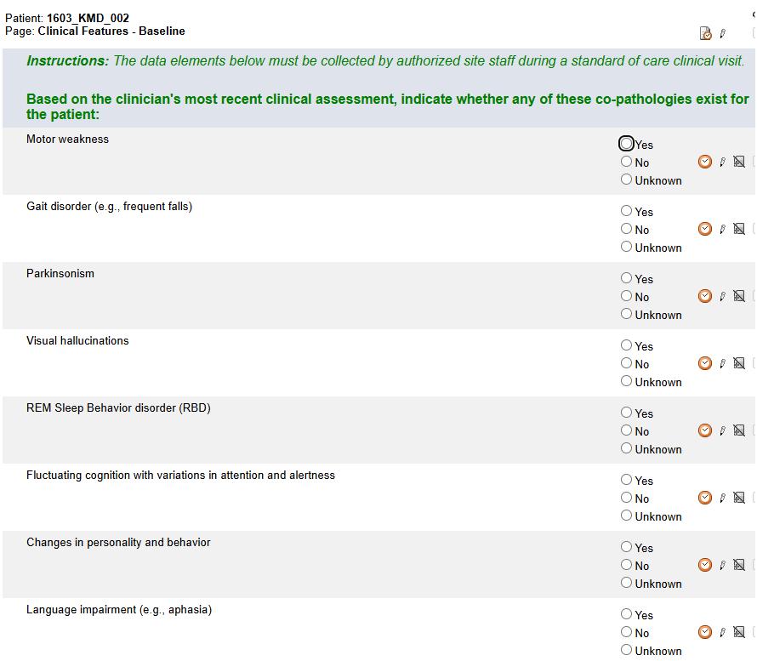
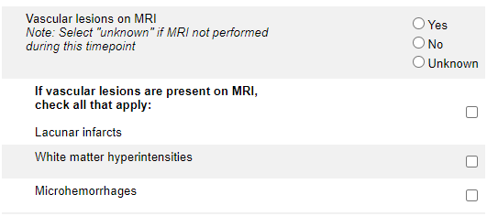
Clinical Features
See Note: under “Vascular lesions on MRI” question:
Answer Yes if an MRI was performed within the timepoint and vascular lesions were present.
Answer No if an MRI was performed within the timepoint and vascular lesions were not present.
Answer Unknown if an MRI was not performed within the timepoint.

Slide 30
Clinical Features
If an MRI was performed, report it on the Imaging Log on the ALZ-NET Portal. Depending on the purpose of the MRI, it may also need to be reported on the Diagnostic Testing form.
If Microhemorrhages (microH) is selected, report either the actual number of microhemorrhages or check the box for “Number unknown”. Do not complete both.

Slide 31
Clinical Features
If the microhemorrhage occurred after the initiation of aducanumab, lecanemab, or donanemab, it constitutes an ARIA and must be reported on the ARIA Adverse Event form.

Slide 32
Additional Measures
For each assessment type, indicate whether or not it was performed. If the assessment was performed, complete the log line in its entirety. See instructions for Baseline and Follow-up reporting.
If additional assessments were performed, use the “Add a new Log line” feature.

Slide 33
Additional Measures
For ALZ-NET, it is expected that either the MMSE or the MoCA and the FAQ were performed. If they were not performed, please provide a reason why not when responding to the automated Site from System query.

Slide 34
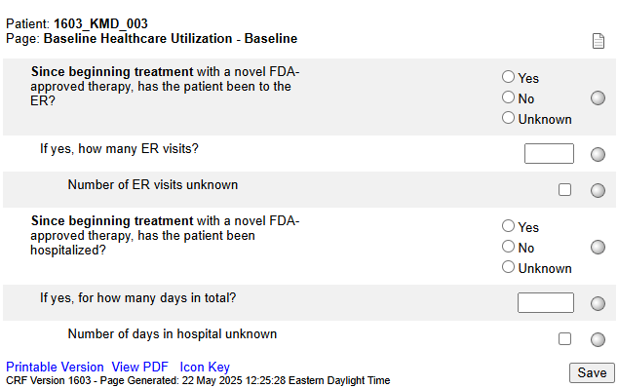
Baseline Healthcare Utilization
The form only becomes visible and available for data entry when “Has the patient received any doses of a novel FDA-approved AD therapy prior to their enrollment in the registry?” on the Baseline Novel Therapy Administration YN form has been answered Yes.

Slide 35
Baseline Healthcare Utilization
If ER visits or hospitalization occurred, enter either the number of visits/days or check the unknown checkbox, not both.
Note that hospitalization constitutes an SAE and must be reported as such.

Slide 36
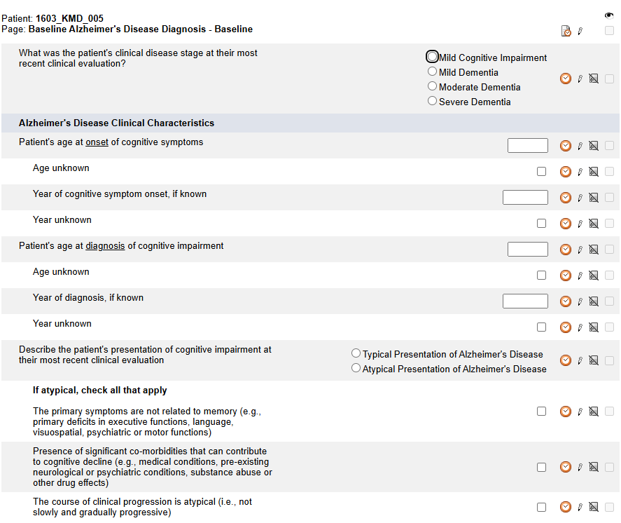
Baseline Alzheimer's Disease Diagnosis
0
For both onset of cognitive symptoms and diagnosis of cognitive impairment –
enter either the actual age or check the age unknown checkbox
AND
enter either the actual year or check the year unknown checkbox.

Slide 37
Baseline Alzheimer's Disease Diagnosis
Answer Yes, No or Unknown.
If Yes, complete the Diagnostic Testing form located at the Subject level.

Slide 38
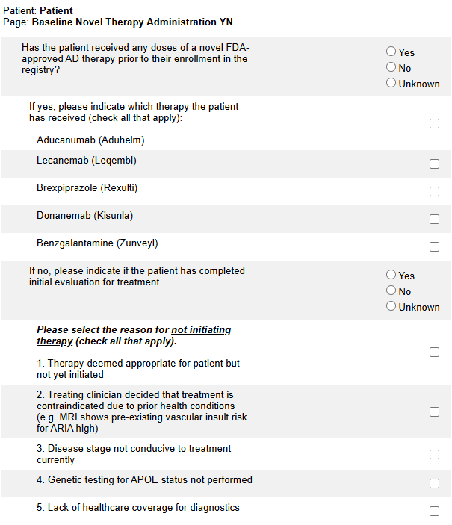
Baseline Novel Therapy Administration YN
If the patient is on novel therapy, answer Yes, check the checkbox of the novel therapy taken, and hit Save.
The list of novel therapies will be updated as new therapies become available.
Note that the timeframe is prior to the patient’s enrollment to ALZ-NET.

Slide 39
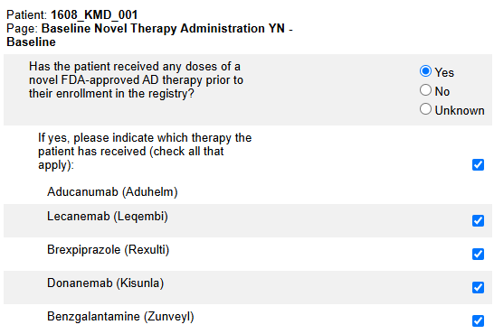
Baseline Novel Therapy Administration YN
For each drug selected, a drug-specific form will populate within the corresponding folder.

Slide 40
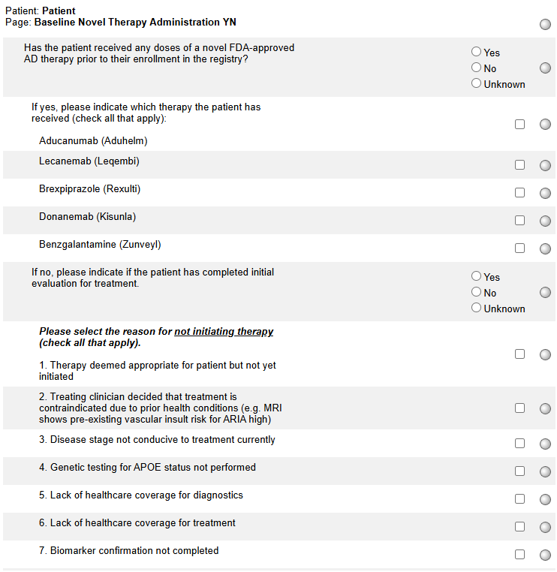
Baseline Novel Therapy Administration YN
Prior to the INITIAL initiation of Aducanumab, Lecanemab and Donanemab, an MRI and either an Amyloid PET/CT or CSF collection is expected.
Please report imaging on Diagnostic Testing form (see specific instructions on this form).
Please report CSF collection on the Diagnostic Testing form as appropriate.
Please report ALL imaging on the Imaging Log on the ALZ-NET Portal.

Slide 41
Baseline Novel Therapy Administration YN
If the first question is answered No, indicate if the patient has completed the initial evaluation for treatment.
If the initial evaluation has not been completed, select No and hit Save.

Slide 42
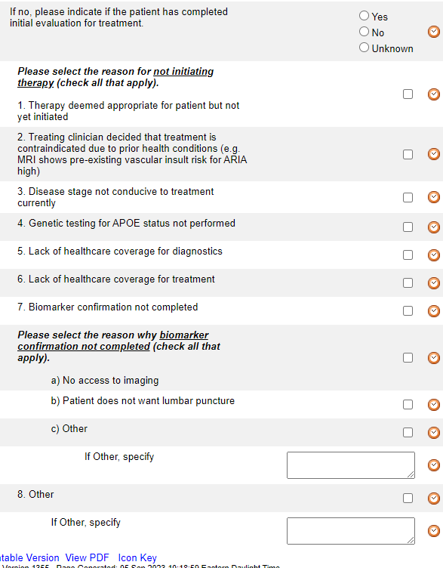
Baseline Novel Therapy Administration YN
If the initial evaluation has been completed, select Yes and indicate the reasons for not initiating therapy and hit Save.
Note that there are 8 general choices (numbered 1-8) and 3 biomarker-specific choices (lettered a-c)
If Other is selected for either, please specify.

Slide 43
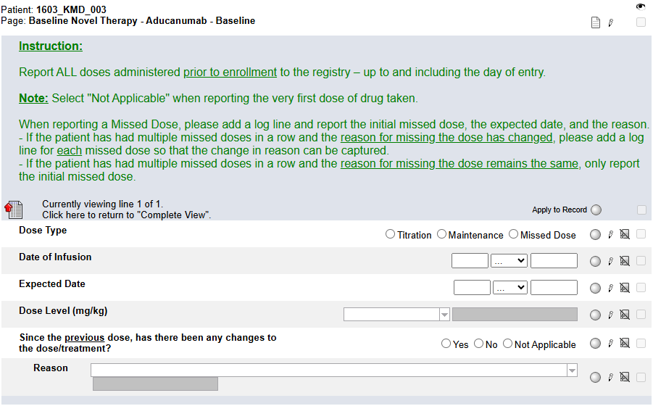
Baseline Novel Therapy - Aducanumab
This form only becomes visible and available for data entry when Aducanumab is selected on the Baseline Novel Therapy Administration YN form.
Complete a log line for each dose taken prior to enrollment to the registry – up to and including the day of entry.
Select Not Applicable when reporting the very first dose.

Slide 44
Baseline Novel Therapy - Aducanumab
Pay close attention to the Instructions when reporting a Missed Dose.
When reporting a Missed Dose, enter the Expected Date, answer Yes to “Since the previous dose, has there been any changes to the dose/treatment?” and provide a Reason.

Slide 45
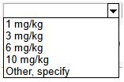
Baseline Novel Therapy - Aducanumab
Note: this form is a “portrait log” style. It can be opened by clicking on the header in the log line and closed by clicking on “Complete View”.
Report the dose level (mg/kg) as per the drug label. Do not report the actual calculated dose.

Slide 46
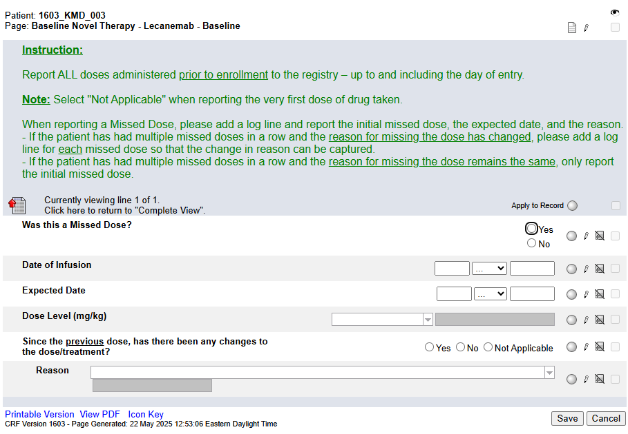
Baseline Novel Therapy - Lecanemab
This form only becomes visible and available for data entry when Lecanemab is selected on the Baseline Novel Therapy Administration YN form.
Complete a log line for each dose taken prior to enrollment to the registry – up to and including the day of entry.
Select Not Applicable when reporting the very first dose.

Slide 47
Baseline Novel Therapy - Lecanemab
Pay close attention to the Instructions when reporting a Missed Dose.
When reporting a Missed Dose, enter the Expected Date, answer Yes to “Since the previous dose, has there been any changes to the dose/treatment?” and provide a Reason.

Slide 48
Baseline Novel Therapy - Lecanemab
Note: this form is a “portrait log” style. It can be opened by clicking on the header in the log line and closed by clicking on “Complete View”.
Report the dose level (mg/kg) as per the drug label. Do not report the actual calculated dose.

Slide 49
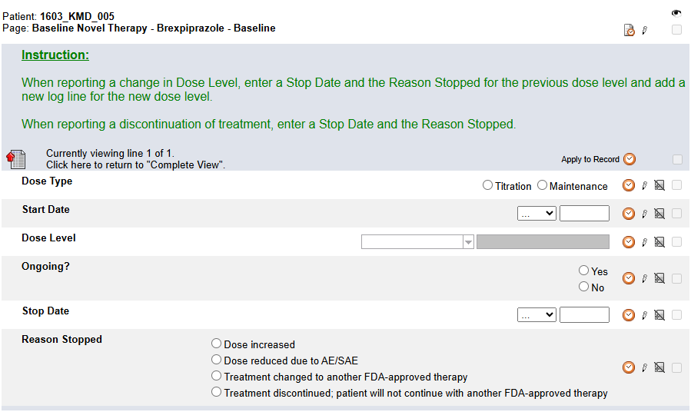
Baseline Novel Therapy - Brexpiprazole
This form only becomes visible and available for data entry when Brexpiprazole is selected on the Baseline Novel Therapy Administration YN form.
Pay close attention to the Instructions. Report new Dose Levels and changes to Dose Levels. Do not report each individual dose.
Note: this form is a “portrait log” style. It can be opened by clicking on the header in the log line and closed by clicking on “Complete View”.

Slide 50
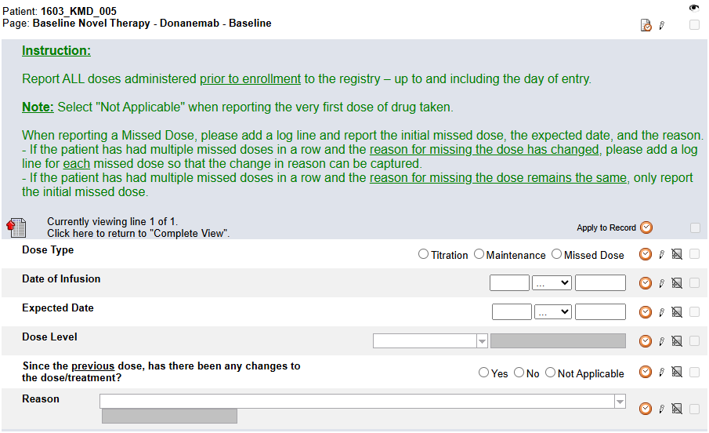
Baseline Novel Therapy – Donanemab
This form only becomes visible and available for data entry when Donanemab is selected on the Baseline Novel Therapy Administration YN form.
Complete a log line for each dose taken prior to enrollment to the registry – up to and including the day of entry.
Select Not Applicable when reporting the very first dose.

Slide 51
Baseline Novel Therapy – Donanemab
Pay close attention to the Instructions when reporting a Missed Dose.
When reporting a Missed Dose, enter the Expected Date, answer Yes to “Since the previous dose, has there been any changes to the dose/treatment?” and provide a Reason.

Slide 52
Baseline Novel Therapy – Donanemab
This form is a “portrait log” style. It can be opened by clicking on the header in the log line and closed by clicking on “Complete View”.

Slide 53
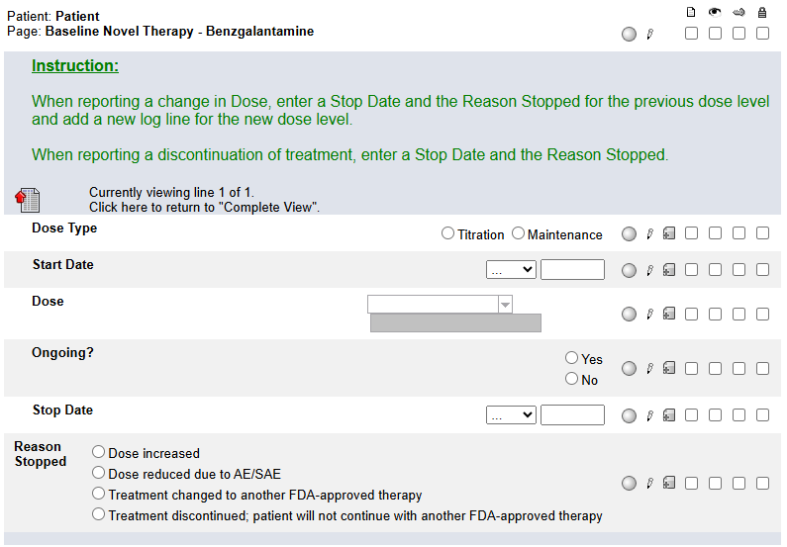
Baseline Novel Therapy - Benzgalantamine
This form only becomes visible and available for data entry when Benzgalantamine is selected on the Baseline Novel Therapy Administration YN form.
Pay close attention to the Instructions. Report new Dose Levels and changes to Dose Levels. Do not report each individual dose.
Note: this form is a “portrait log” style. It can be opened by clicking on the header in the log line and closed by clicking on “Complete View”.

Slide 54
Folder Structure in Rave
Enrollment
Baseline
Follow-up
Patient Level

Slide 55
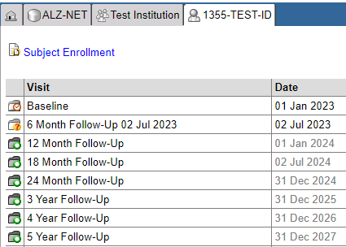
Patient Home Page
All Follow-Up folders become visible as soon as the patient is enrolled to the registry.
However, each Follow-Up folder only becomes accessible for data entry at the END of the data collection time point. Until that point, the date in the Date column is grayed out and the folder, while visible, cannot be opened.

Slide 56
Patient Home Page
Once a folder is accessible, the END date of the data collection time point is appended to the name of the folder, the date in the Date column is no longer grayed out, and the folder can be opened.

Slide 57
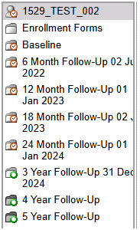
Folder Navigation
Note, too, that the appended date will be visible for each accessible folder within the Folder Navigation panel.

Slide 58
Follow-up Folders
During Follow-up, the only form which appears when a folder is first opened is the Follow-up Reporting and Patient Status form.
NOTE:
You may see an inactivated Baseline Reporting Period and Patient Status form as the first form in the follow-up folders. Ignore this form!

Slide 59
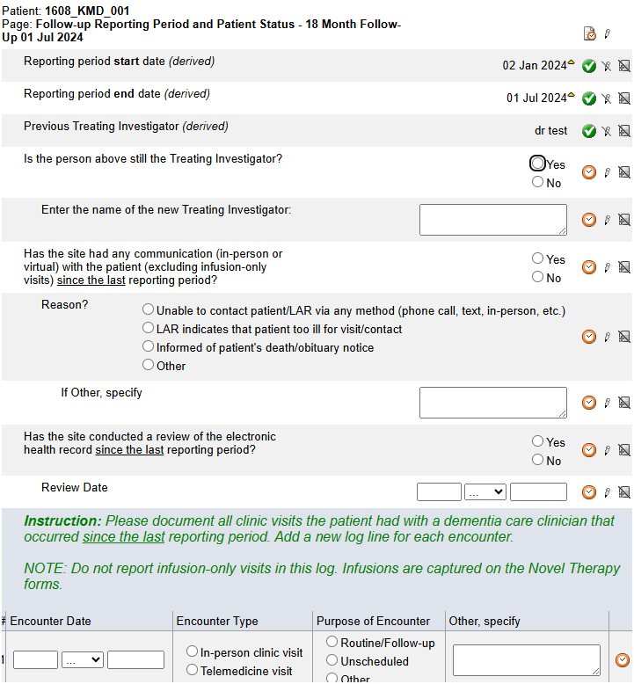
Follow-up Reporting Period and Patient Status
The derived start date is one day after the end date of the previous data collection time point.
The derived end date is derived from the registration date plus the corresponding data collection time point (6 month, 12 month, 24 month etc.)
These derived dates cannot be changed.

Slide 60
Follow-up Reporting Period and Patient Status
Beginning at the 6-month data collection time point, the Treating Investigator reported at the time of registration will be derived to the Previous Treating Investigator (derived) field.
Answer “Is the person above still the Treating Investigator?”
If Yes, the previous Treating Investigator will be derived forward to the next data collection time point.
If No, enter the name of the new Treating Investigator into the open text box. This new Treating Investigator will be derived forward to the next data collection time point.

Slide 61
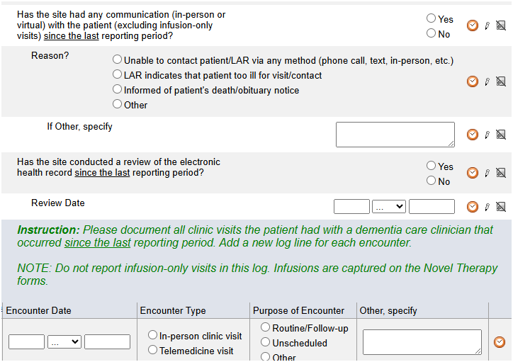
Follow-up Reporting Period and Patient Status
Answer “Has the site had any contact (excluding infusion-only visits) with the patient since the last reporting period?
If Yes, complete a log line for each in-person clinic or telemedicine visit.
NOTE: Infusion-only visits do not need to be reported as a log line. Infusion visits are captured on the Novel Therapy forms.
If No, indicate the reason.

Slide 62
Follow-up Reporting Period and Patient Status
If the site has been unable to contact the patient and the patient is considered lost to follow-up. please use the Add Event feature to select and complete the Lost to Follow-up form.
**Refer to protocol section 11.8.2 for the definition of Lost to Follow-up.**
If it’s reported that there has been no contact and the Reason is “death/obituary notice”, the Death Detail form will become visible and available for data entry at the Subject Level.

Slide 63
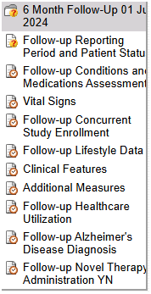
Follow-up Folder
Once the Follow-up Reporting Period and Patient Status form is completed and saved, the remaining follow-up forms will populate within the folder.

Slide 64
Follow-up Folder
The majority of the Follow-up forms are the same as those in the Baseline folder – just with “Follow-up” rather than “Baseline” in the title.
Follow-up forms should always be completed in relation to the appropriate Follow-up data collection reporting period.
NOTE: Only those forms which are only in Follow-up or different from their Baseline counterparts will be discussed in this section.

Slide 65
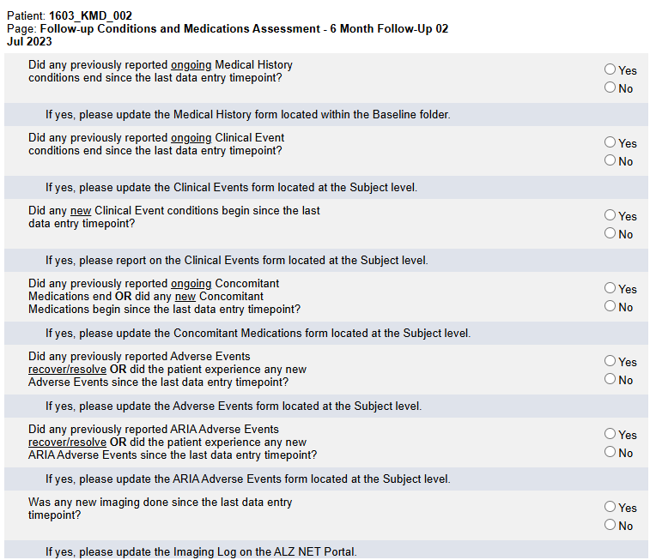
Follow-up and Medications Assessment
Complete this form in its entirety and for each Yes response, follow the instructions indicated under the question.

Slide 66
Follow-up Concurrent Study Enrollment
Any concurrent studies to which the patient enrolled to previously and were indicated as ongoing, will automatically be pulled forward into this form. Answer “Ongoing?” for each study pulled in.
If the patient newly enrolled to a study, use the “Add a new Log Line” feature and complete a log line for each new study.
Do NOT report ALZ-NET as a concurrent study.

Slide 67
Follow-up Concurrent Study Enrollment
If previously reported “Ongoing” studies are not being ‘pulled forward’, please do the following:
On the corresponding Follow-up Reporting Period and Patient Status form, ‘toggle’ the answer to this question.
That is, if you originally entered No, change the answer to Yes and hit Save. Then, change the answer back to No and hit Save.
This should ‘trigger’ the programming and the Ongoing studies will be ‘pulled forward’ into the current Follow-up Concurrent Study Enrollment form.

Slide 68
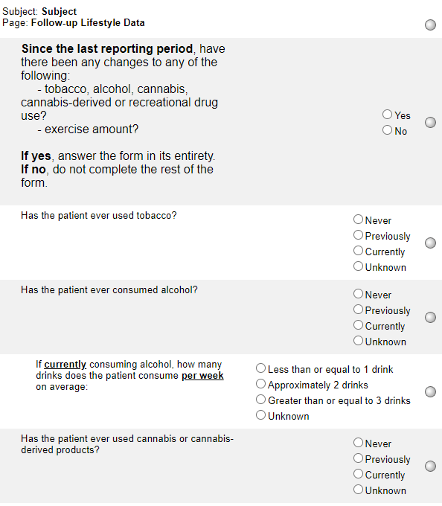
Follow-up Lifestyle Data
This form asks about any changes since the last reporting period. For accurate reporting, compare to how the Lifestyle Data form was completed during the previous reporting period.
If the first question is answered Yes, complete the rest of the form.
If the first question is answered No, do not complete the rest of the form.

Slide 69
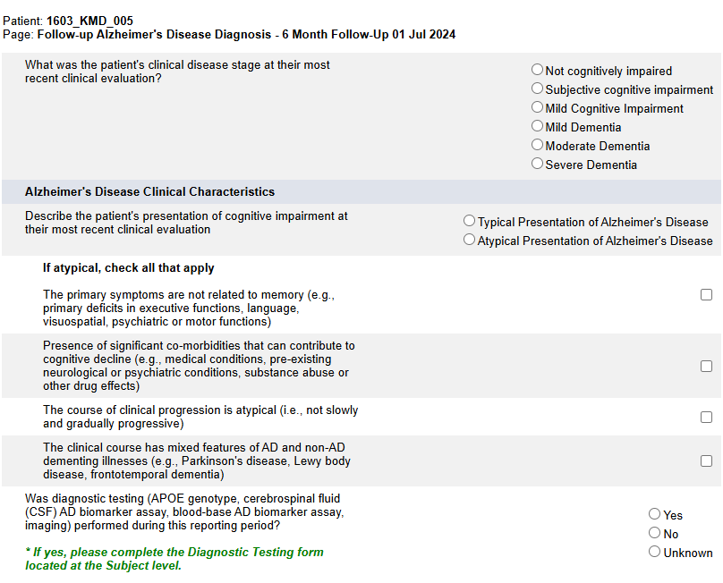
Follow-up Alzheimer's Disease Diagnosis
Complete this form in its entirety.
Note that the timeframe is the patient’s most recent clinical evaluation.
Answer Yes, No or Unknown.
If Yes, complete the Diagnostic Testing form located at the Subject level.

Slide 70
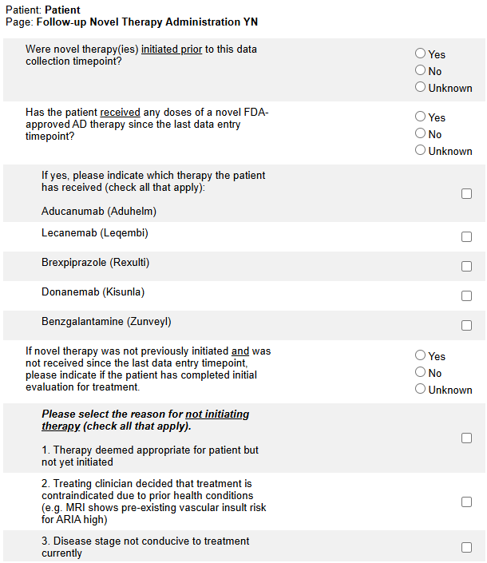
Follow-up Novel Therapy Administration YN
Answer Yes, No, or Unknown to the first question.
Note that this question is asking if novel therapies were initiated prior to this data collection time point.
Answer Yes, No, or Unknown to the second question.
Note that the timeframe is since the last data entry timepoint.
If answered Yes, selected the type of novel therapy(ies) and hit Save.
The list of novel therapies will be updated as new therapies become available.

Slide 71
Follow-up Novel Therapy Administration YN
Prior to the INITIAL initiation of Aducanumab, Lecanemab and Donanemab, an MRI and either an Amyloid PET/CT or CSF collection is expected.
Please report imaging on Diagnostic Testing form (see specific instructions on this form).
Please report CSF collection on the Diagnostic Testing form as appropriate.
Please report ALL imaging on the Imaging Log on the ALZ-NET Portal.

Slide 72
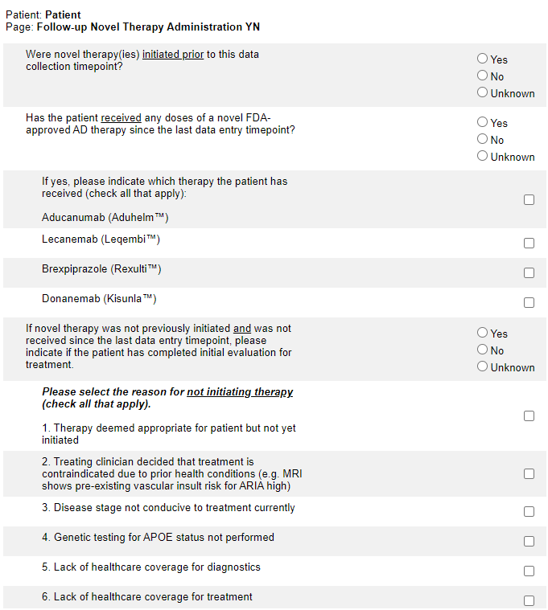
Follow-up Novel Therapy Administration YN
The circled question is only required to be completed if novel therapy was not initiated previously and if novel therapy was not received since the last data entry timepoint.

Slide 73
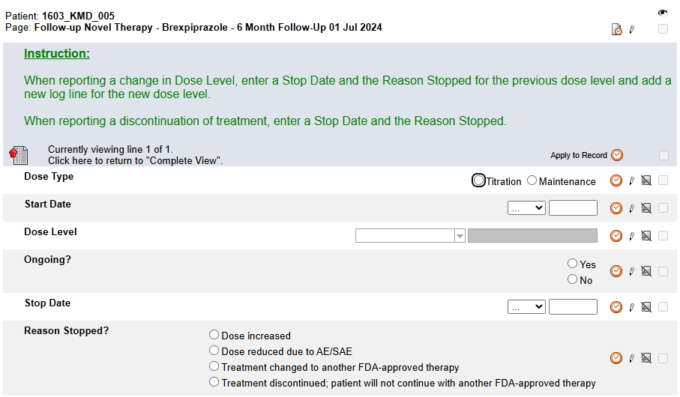
Follow-up Novel Therapy - Brexpiprazole
This form only becomes visible and available for data entry when Brexpiprazole is selected on the Follow-up Novel Therapy Administration YN form.
Any dose levels previously reported as Ongoing are automatically pulled forward into this form. Update the log line (Ongoing? or Stop Date) for each dose pulled forward. Add a new log line to report any new dose levels.

Slide 74
Folder Structure in Rave
Enrollment
Baseline
Follow-up
Patient Level

Slide 75
Patient Level folders
Each patient level folder has a single form within it.

Slide 76
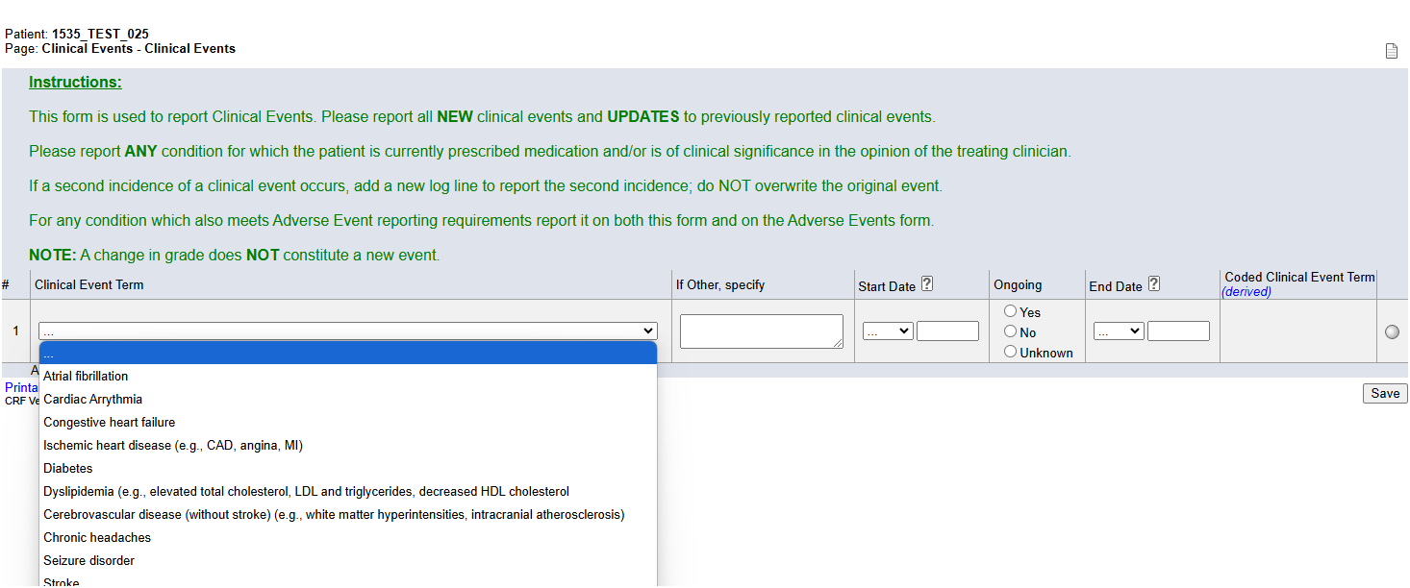
Clinical Events
Always enter this form prior to entering data on the Concomitant Medications form.

Slide 77
Clinical Events
Pay close attention to the Instructions in the header in Rave.
The diagnosis of MCI/AD is not reported on this form; it is reported on the Alzheimer's Disease Diagnosis form.

Slide 78
Clinical Events
Note – complete the ‘specify’ for all ‘Other, specify’ conditions reported

Slide 79
Diagnostic Testing
Add and complete a log line for each diagnostic test to be reported.
Pay close attention to the Instructions.

Slide 80
Diagnostic Testing
If diagnostic testing type is APOE genotype, enter Date performed and APOE result.

Slide 81
Diagnostic Testing
If diagnostic testing type is Cerebrospinal fluid (CSF) AD biomarker assay or Blood-base AD biomarker assay, enter Date performed and Blood/CSF/Imaging result.

Slide 82
Diagnostic Testing
If diagnostic testing type is Imaging, enter Date performed and Type of Imaging.
In addition, all imaging reported on this form must also be reported on the Imaging Log on the ALZ-NET Portal.

Slide 83
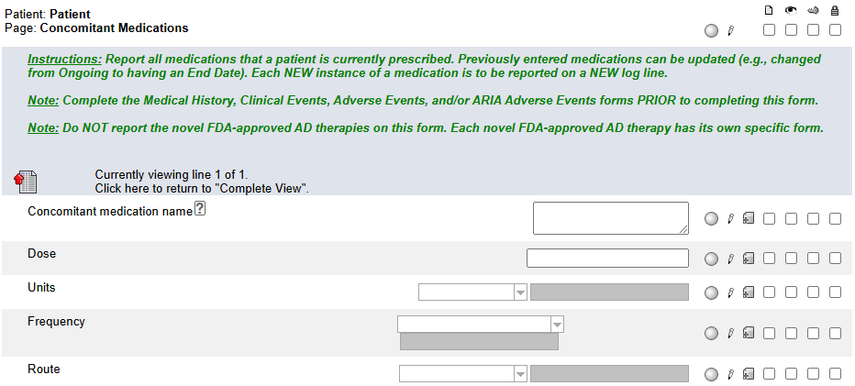
Concomitant Medications
Pay close attention to the Instructions.
Always complete this form after completing the Medical History, Clinical Events, Adverse Events, and/or ARIA Adverse Events forms.
After entering the Indication, hit Save. Then select the appropriate condition for which the medication is used.

Slide 84
Concomitant Medications
If the drug reported is used for a condition on the Medical History, Clinical Events, Adverse Events, and/or ARIA Adverse Events forms, do NOT use an Indication of “Other (condition)”.
Always report as much of a date as is known!
As a very last resort, fully unknown Start Dates can be reported. Click on the ? icon for HelpText.

Slide 85
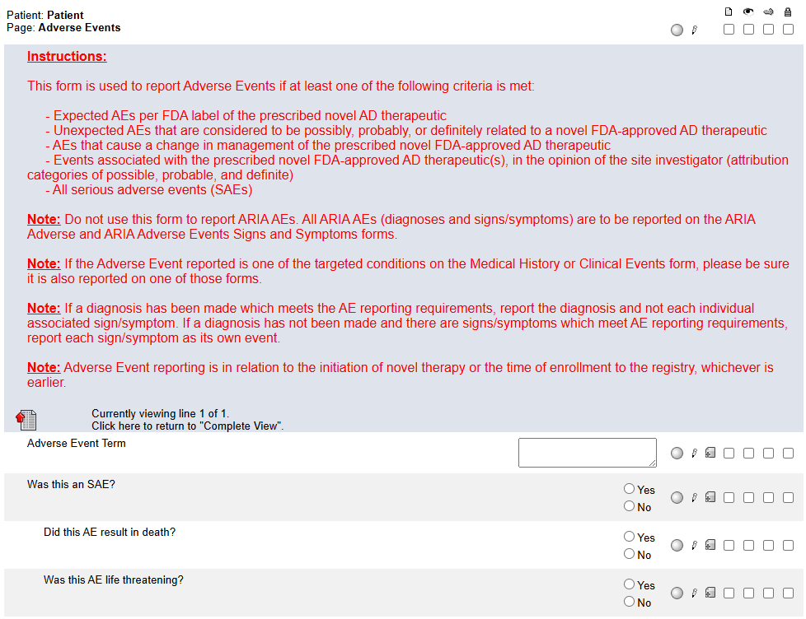
Adverse Events
Adverse events for ALZ-NET are in relation to the initiation of novel therapy or enrollment to the registry – whichever is first.
Refer to protocol sections 16.1 and 16.2 for the AE and SAE reporting criteria. This information can also be found on Slide 32 of the ALZ-NET Protocol Training Module on alz-net.org.

Slide 86
Adverse Events
Always enter this form prior to entering data on the Concomitant Medications form.
Pay close attention to the Instructions.
Note: this form is a “portrait log” style. It can be opened by clicking on the header in the log line and closed by clicking on “Complete View”.

Slide 87
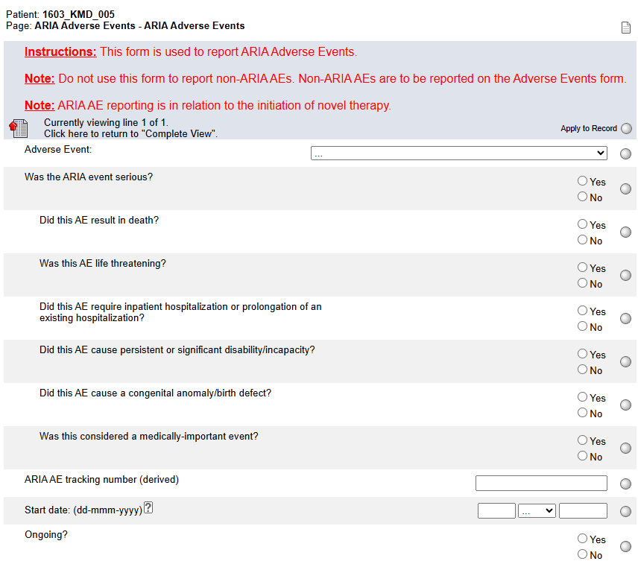
ARIA Adverse Events
ARIA adverse events for ALZ-NET are in relation to the initiation of novel therapy.
Always enter this form prior to entering data on the Concomitant Medications form.

Slide 88
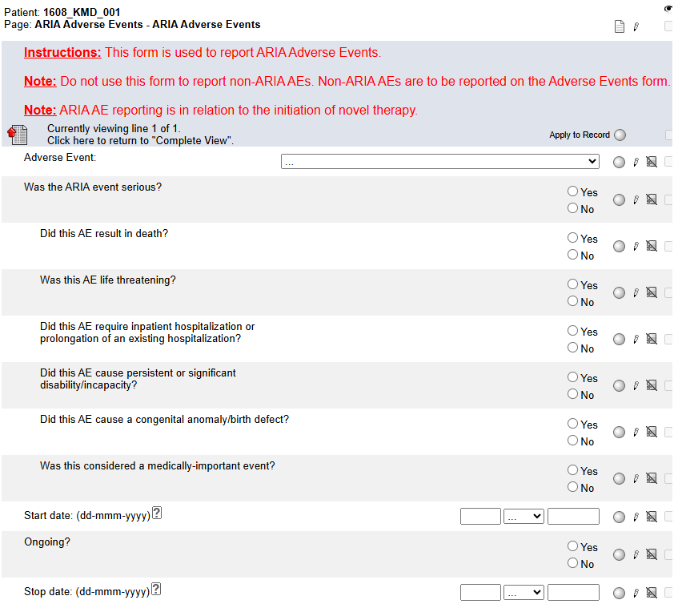
ARIA Adverse Events
Submit imaging that corresponds to the Start date and/or the End date to TRIAD.
Report imaging that corresponds to the Start date and/or the End date on the Imaging Log on the ALZ-NET Portal.

Slide 89
ARIA Adverse Events
Be sure that the reporting on this form aligns with the reporting of vascular lesions on the Clinical Features form for the same timepoint.
Note: this form is a “portrait log” style. It can be opened by clicking on the header in the log line and closed by clicking on “Complete View”.

Slide 90
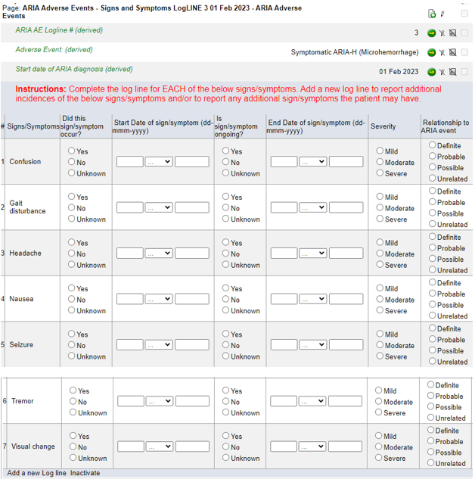
ARIA Adverse Events Signs and Symptoms
When a Symptomatic ARIA is reported on the ARIA Adverse Events form, this form rolls out to capture any associated signs and symptoms.
Note that each ARIA Adverse Events Signs and Symptoms form is ‘linked’ to a specific logline on the ARIA Adverse Events form.

Slide 91
ARIA Adverse Events Signs and Symptoms
Report ALL associated signs and symptoms for each symptomatic ARIA AE.
For each of the 7 signs/symptoms listed, indicate if it occurred and complete the rest of the log line as appropriate.
Add a new log line to report additional instances of the 7 signs/symptoms listed and/or to report any other symptoms.

Slide 92
Death Details
The Death Details form becomes visible and available for data entry when the Outcome is reported as Fatal on the Adverse Events or ARIA Adverse Events form. It will be at the Subject Level.

Slide 93
Clinical Imaging Submission
All imaging is reported via the ALZ-NET Portal. This data is then pushed to Rave.
The Clinical Imaging Submission form in Rave is read-only. Data will be reviewed and queried on in Rave. Any update must be entered via the ALZ-NET Portal.

Slide 94
Imaging Submission Log
This form is view-only to the Site.
It summarizes all the imaging files uploaded to TRIAD for the patient.
Each log line represents a submission to TRIAD and a corresponding log line MUST be entered in the Imaging Log on the ALZ-NET Portal.

Slide 95
Add Event forms
Forms that are completed for specific protocol events can be added at any time point by using the Add Event feature located at the bottom of each patient’s homepage.

Slide 96
Withdrawal of Consent
Pay close attention to the Instructions.
In the future, ALZ-NET plans to have additional optional components to which a patient may consent. The Level of withdrawal choices will be updated as these other registry-related activities become available.
Note that the Demography form captures whether or not the patient previously consented to being contacted for other research opportunities.

Slide 97
Optional Components Reconsent
Pay close attention to the Instructions.
In the future, ALZ-NET plans to have additional optional components to which a patient may consent. The choices for “Which component?” will be updated as these other registry-related activities become available.
Note that the components to which the patient has reconsented must align with those components previously reported as withdrawn from on the Withdrawal of Consent form.

Slide 98
Lost to Follow-up
Patients are considered lost to follow-up if they miss 3 consecutive data collection timepoints.
Complete this form only after the three contact attempts and the determination have been made.
**Refer to protocol section 11.8.2 for additional information***

Slide 99
Protocol Deviation
Complete a new log line for each Protocol Deviation.
Complete each log line in its entirety.

Slide 100
Please send any data related questions to:
alznet-data@acr.org

Slide 101
Thank You!

