Slide 1
ALZ-NET (4709) eCRF Training
Migration #8 Phase III - Updates
Kathleen Donahue – Senior Clinical Data Manager
Autumn Rolack – Clinical Data Manager
January 2025

Slide 2
Form Roll-out in Follow-Up Folders
After Migration 8, Phase II, it was discovered that the following forms were not rolling out as expected within the Follow-Up folders –
Follow-up Concurrent Study Enrollment
Additional Measures

Slide 3
Form Roll-out in Follow-Up Folders
These forms should now be appearing in the Follow-up for those patients whose reporting periods came due between 25NOV2024 and 06JAN2025.
Please review those cases and complete these two forms as necessary.

Slide 4
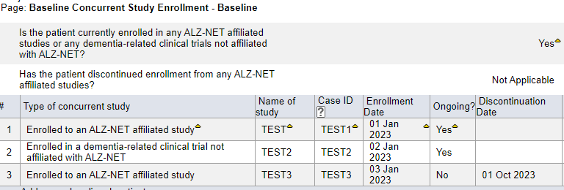
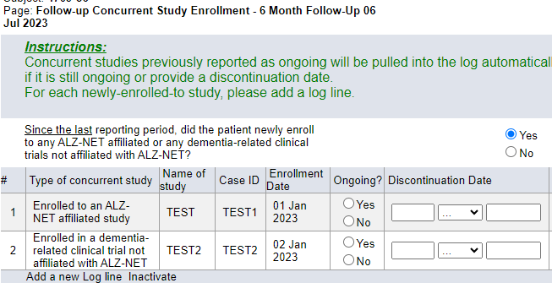
Follow-up Concurrent Study Enrollment
The Follow-up Concurrent Study Enrollment form ‘pulls forward’, to the current data collection timepoint, any concurrent studies which were reported as “Ongoing” during the previous (most recent) data collection timepoint.
If previously reported “Ongoing” studies are not being ‘pulled forward’, please do the following:

Slide 5
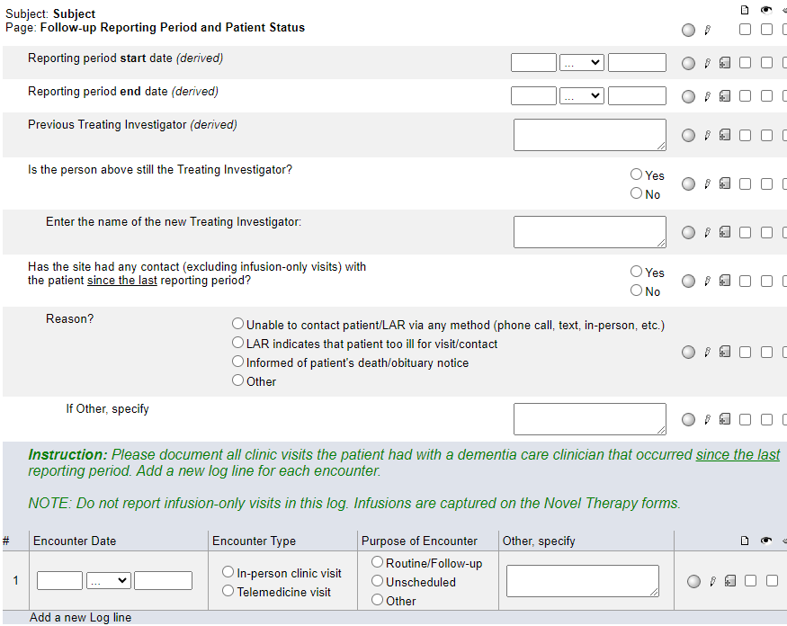
Follow-up Concurrent Study Enrollment
On the corresponding Follow-up Reporting Period and Patient Status form, ‘toggle’ the answer to this question.
That is, if you originally entered No, change the answer to Yes and hit Save. Then, change the answer back to No and hit Save.
This should ‘trigger’ the programming and the Ongoing studies will be ‘pulled forward’ into the current Follow-up Concurrent Study Enrollment form.

Slide 6
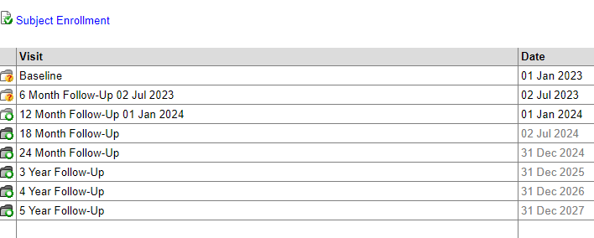
Date Appended to Follow-up Folders
After Migration 8, Phase II, it was discovered that the reporting period end dates were no longer being appended to the Follow-Up folders.
This should now be working for those patients whose reporting periods came due between 25NOV2024 and 06JAN2025.

Slide 7
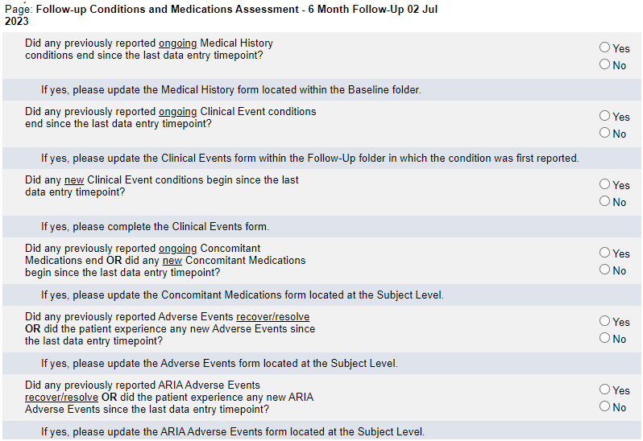
Follow-up Conditions and Medications Assessment
After Migration 8, Phase II, it was discovered that Clinical Events form was not rolling out for some patients when “Did any new Clinical Event conditions begin since the last data entry timepoint?” was answered Yes.

Slide 8
Follow-up Conditions and Medications Assessment
If the Clinical Events form does not roll-out, please do the following:
‘Toggle’ the answer to this question.
That is, change the answer to No and hit Save. Then, change the answer back to Yes and hit Save.
This should ‘trigger’ the programming and the Clinical Events form will roll-out.

Slide 9
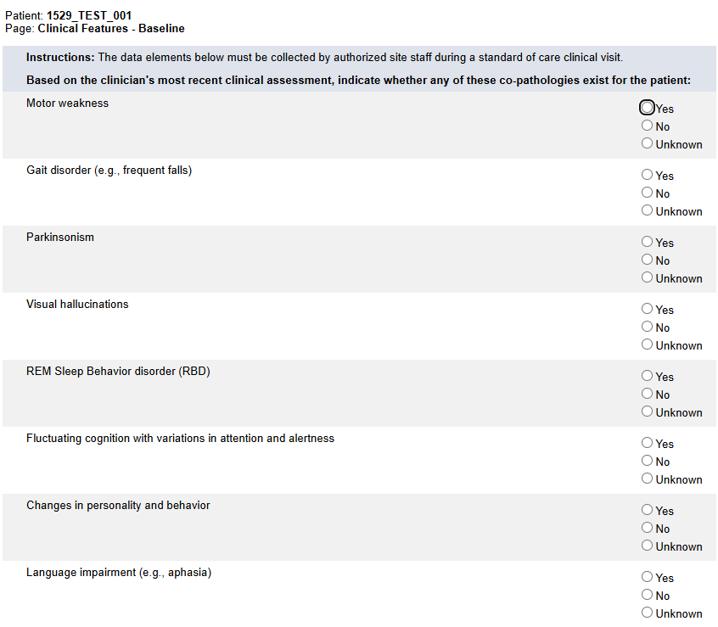
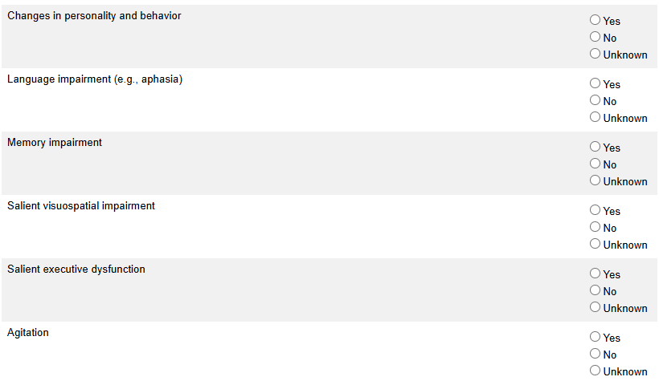
Clinical Features
The Clinical Features of Co-Pathology form has been re-titled to Clinical Features.
Questions combined with questions previously on the Baseline/Follow-up Alzheimer’s Disease Diagnosis form.
Questions moved from Baseline/Follow-up Alzheimer’s Disease Diagnosis form.

Slide 10
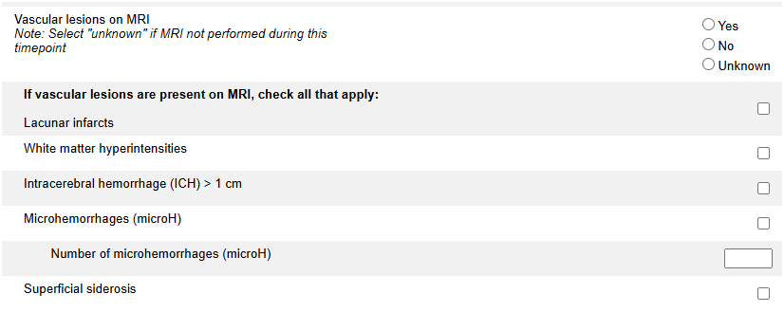
Clinical Features
New options have been added for vascular lesions:
Intracerebral hemorrhage (ICH) > 1 cm
Superficial siderosis
“Number of microhemorrhages (microH)” added.
Complete whenever a microhemorrhage (microH) is selected.

Slide 11
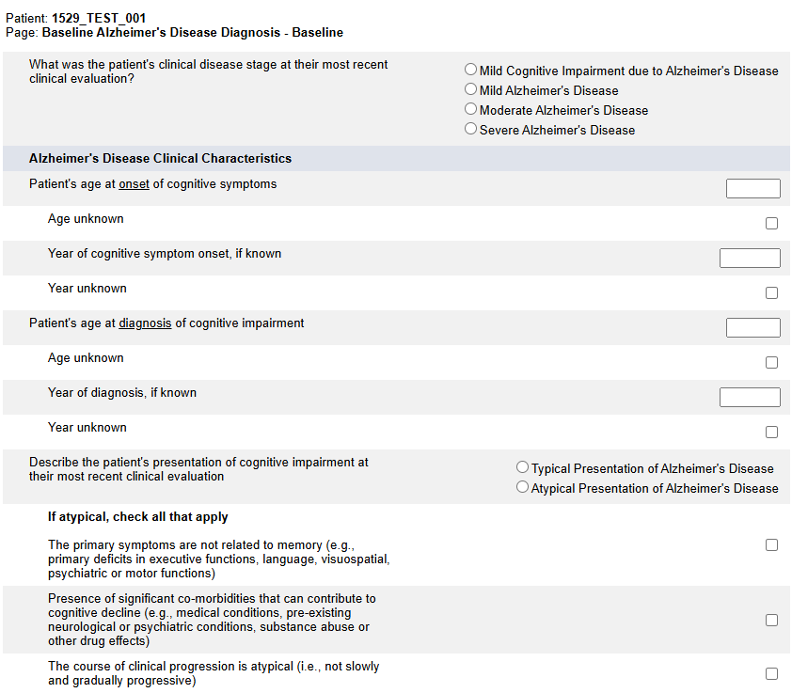
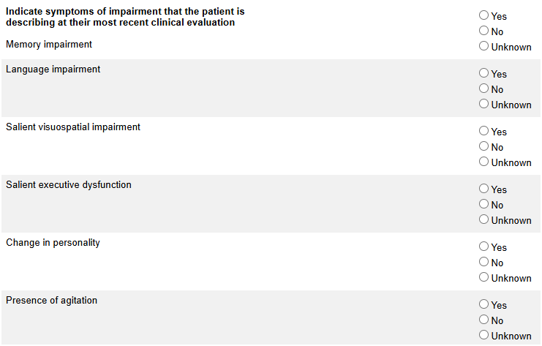
Baseline Alzheimer’s Disease Diagnosis
Questions moved to and/or combined with questions on the Clinical Features form.

Slide 12
Baseline Alzheimer’s Disease Diagnosis
New required question added.
Answer Yes, No or Unknown.
If Yes, complete the new Diagnostic Testing form located at the Subject level.

Slide 13
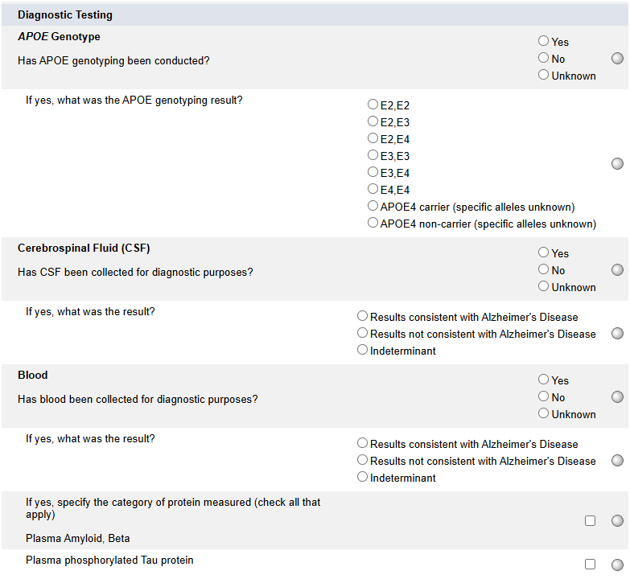
Baseline Alzheimer’s Disease Diagnosis
Questions moved to the new Diagnostic Testing form.

Slide 14
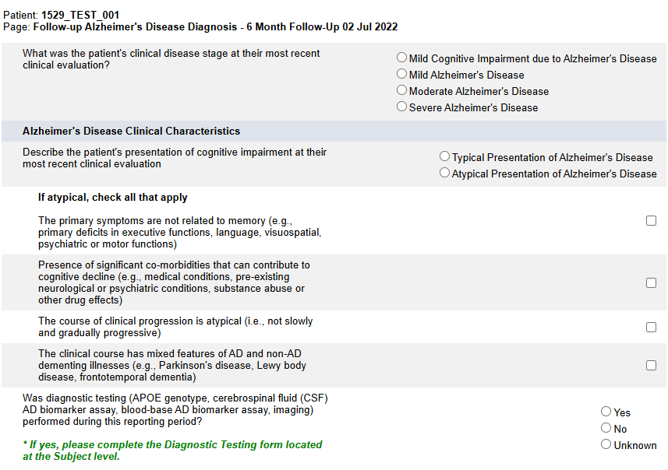
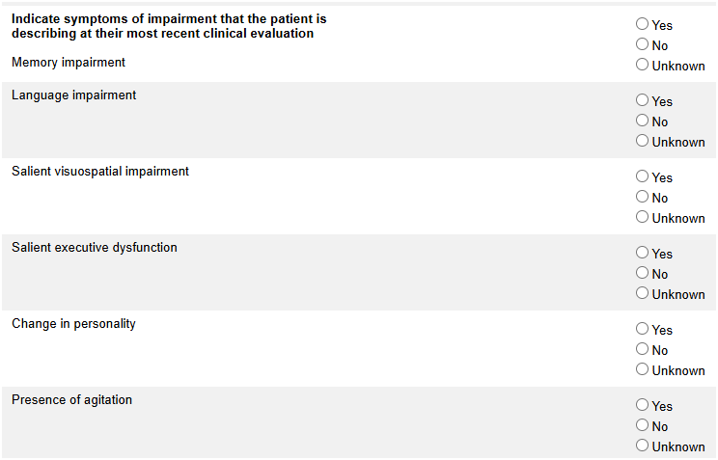
Follow-up Alzheimer’s Disease Diagnosis
Questions moved to and/or combined with questions on the Clinical Features form.

Slide 15
Follow-up Alzheimer’s Disease Diagnosis
New required question added.
Answer Yes, No or Unknown.
If Yes, complete the new Diagnostic Testing form located at the Subject level.

Slide 16
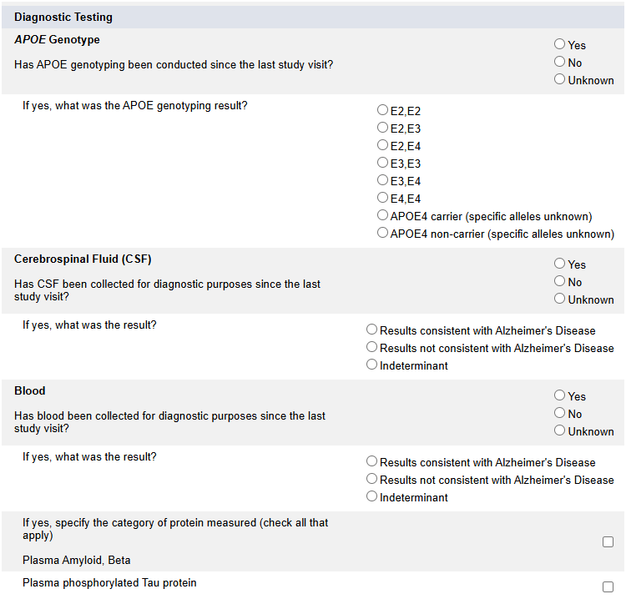
Follow-up Alzheimer’s Disease Diagnosis
Questions moved to the new Diagnostic Testing form.

Slide 17
Diagnostic Testing
NEW form at the Subject level.
Add and complete a log line for each diagnostic test to be reported.

Slide 18
Diagnostic Testing
If diagnostic testing type is APOE genotype, enter Date performed and APOE result

Slide 19
Diagnostic Testing
If diagnostic testing type is CSF or blood-based AD biomarker assay, enter Date performed and Blood/CSF/Imaging result.

Slide 20
Diagnostic Testing
If diagnostic testing type is Imaging, enter Date performed, Blood/CSF/Imaging result, and Type of Imaging.
Any imaging

Slide 21
Please send any data related questions to:
alznet-data@acr.org

Slide 22
Thank You!

