Slide 1
ALZ-NET (4709) eCRF Training
Migration #5 - Updates
Kathleen Donahue – Senior Clinical Data Manager
January 2024

Slide 2
Form Roll-out in Follow-Up Folders
After Migration 4, it was discovered that the following forms were not rolling out as expected within the Follow-Up folders –
Clinical Events
Follow-up Concurrent Study Enrollment
Additional Measures
This has since been fixed.

Slide 3
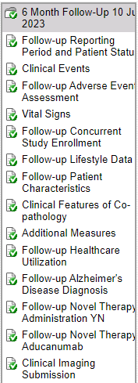
Form Roll-out in Follow-Up Folders
These forms should now appear in the corresponding folder when the Follow-up Reporting Period and Patient Status form is completed in its entirety and saved.

Slide 4
Form Roll-out in Follow-Up Folders
Please double-check that these 3 forms are appearing in each accessible Follow-Up folder.
Please complete these 3 forms for ALL patients for whom the data collection timepoint came due after August 2023.

Slide 5
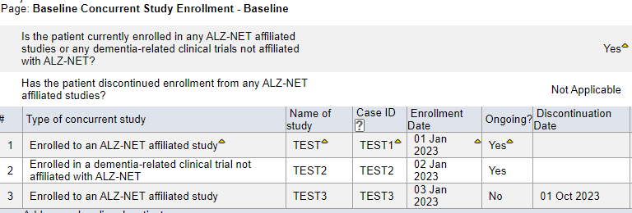
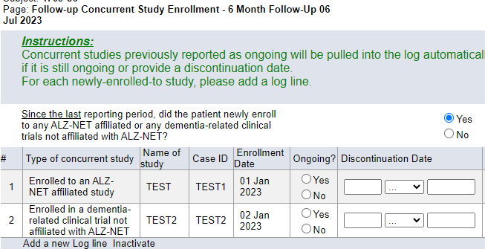
Follow-up Concurrent Study Enrollment
The Follow-up Concurrent Study Enrollment form ‘pulls forward’, to the current data collection timepoint, any concurrent studies which were reported as “Ongoing” during the previous (most recent) data collection timepoint.
If previously reported “Ongoing” studies are not being ‘pulled forward’, please do the following:

Slide 6
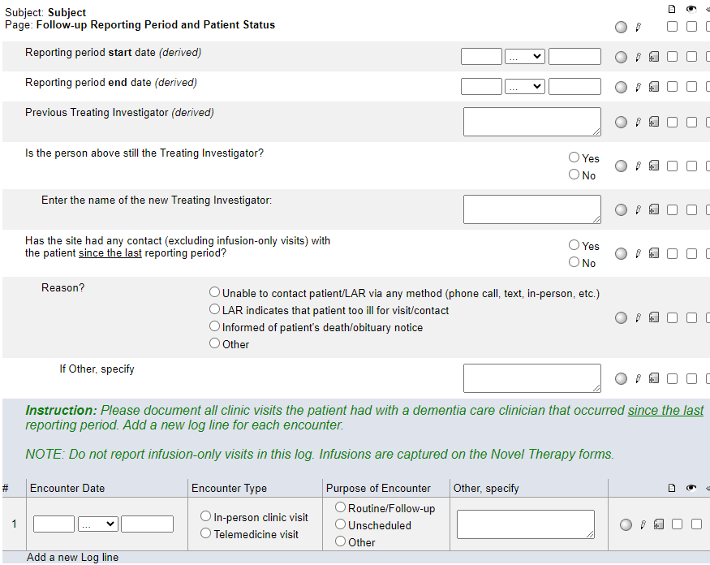
Follow-up Concurrent Study Enrollment
On the Follow-up Reporting Period and Patient Status form, ‘toggle’ the answer to this question.
That is, if you originally entered No, change the answer to Yes and hit Save. Then, change the answer back to No and hit Save.
This should ‘trigger’ the programming and the Ongoing studies will be ‘pulled forward’ into the current Follow-up Concurrent Study Enrollment form.

Slide 7
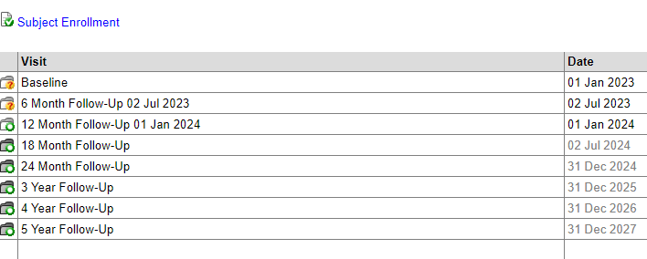
Date Appended to Follow-up Folders
After Migration 4, it was discovered that the reporting period end dates were no longer being appended to the Follow-Up folders.
This has since been fixed.

Slide 8
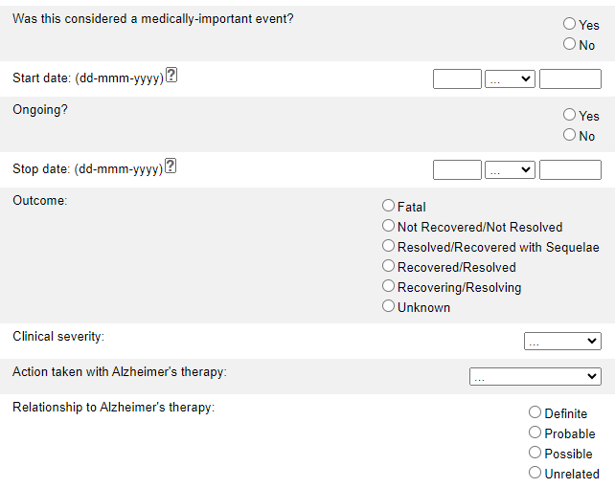
ARIA Adverse Events
Two updates have been made to this form:
“Radiological severity” has been updated to “Clinical severity”
The answer choices for “Relationship to Alzheimer’s therapy” have been updated to remove “Unlikely”

Slide 9
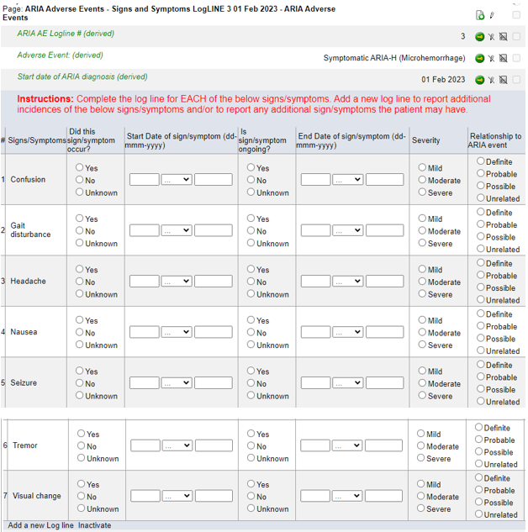
**NEW FORM**
ARIA Adverse Events Signs and Symptoms
When a Symptomatic ARIA is reported on the ARIA Adverse Events form, this new form rolls out to capture the associated signs and symptoms.
Note that each ARIA Adverse Events Signs and Symptoms form is ‘linked’ to a specific logline on the ARIA Adverse Events form.

Slide 10
**NEW FORM**
ARIA Adverse Events Signs and Symptoms
Report ALL associated signs and symptoms for each symptomatic ARIA AE.
For each of the 7 signs/symptoms listed, indicate if it occurred and complete the rest of the log line as appropriate.
Add a new log line to report additional instances of the 7 signs/symptoms listed and/or to report any other symptoms.

Slide 11
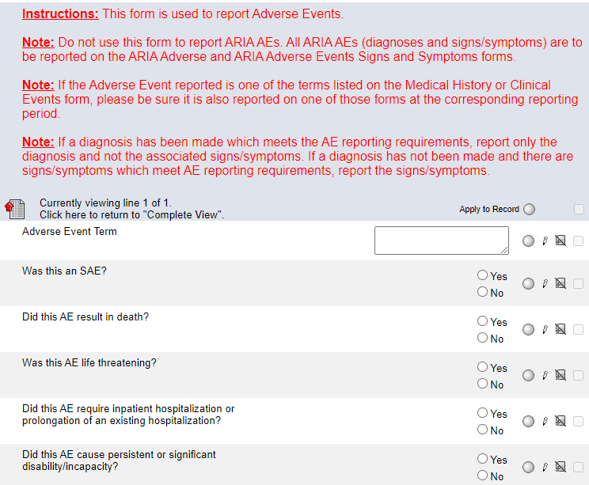
Adverse Events
Two updates have been made to this form:
The first Note in the instructions has been updated to include reference to the new ARIA Adverse Events Signs and Symptoms form.
The answer choices for “Relationship to Alzheimer’s therapy” have been updated to remove “Unlikely”.

Slide 12
Please send any data related questions to:
alznet-data@acr.org

Slide 13
Thank You!

