Slide 1
ALZ-NET (4709) eCRF Training
All Forms
Kathleen Donahue – Senior Clinical Data Manager
February 2024

Slide 2
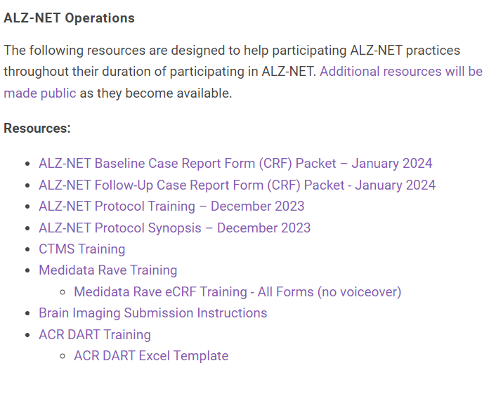
First things first…
Prior to entering data into the eCRFs, a patient must be enrolled, and Rave access must be granted.
Please take the CTMS and the Medidata Rave trainings located under Resources on ALZ-NET.org

Slide 3
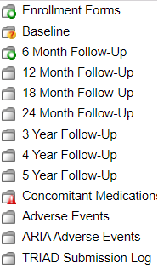
Folder Structure in Rave
Enrollment Forms
Baseline
Follow-up
Patient Level

Slide 4
Enrollment Forms folder

Slide 5
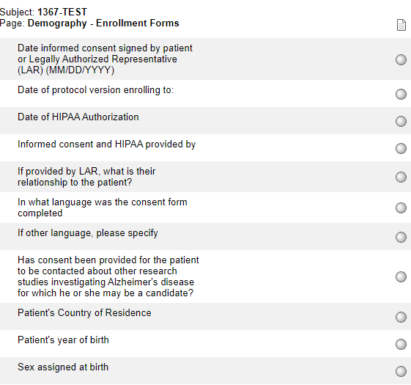
Demography
When a patient is registered to ALZ-NET via the ACR Clinical Trial Web Application (aka CTMS), some of the data is automatically loaded into the Demography form in Rave.
**Sites cannot update this eCRF**

Slide 6
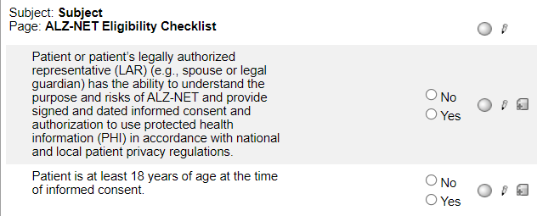
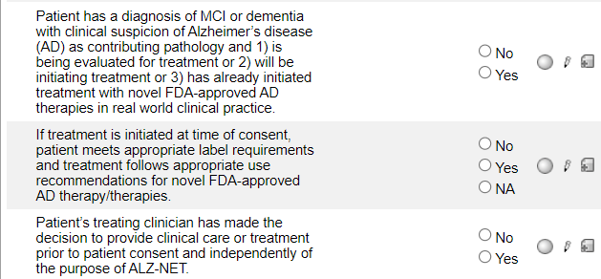
ALZ-NET Eligibility Checklist
When a patient is registered, the responses to the inclusion criteria are automatically loaded into the ALZ-NET Eligibility Checklist form in Rave.
**Sites cannot update this eCRF**

Slide 7
Folder Structure in Rave
Enrollment Forms folder
Baseline folder
Follow-up folder
Patient Level folders

Slide 8
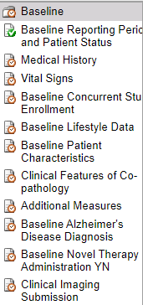
Baseline folder

Slide 9
Baseline Reporting Period and Patient Status
Complete this form prior to completing any other forms within the folder.
The derived end date is the date of the patient’s enrollment to the registry and cannot be changed.
Indicate the most recent type of visit.

Slide 10
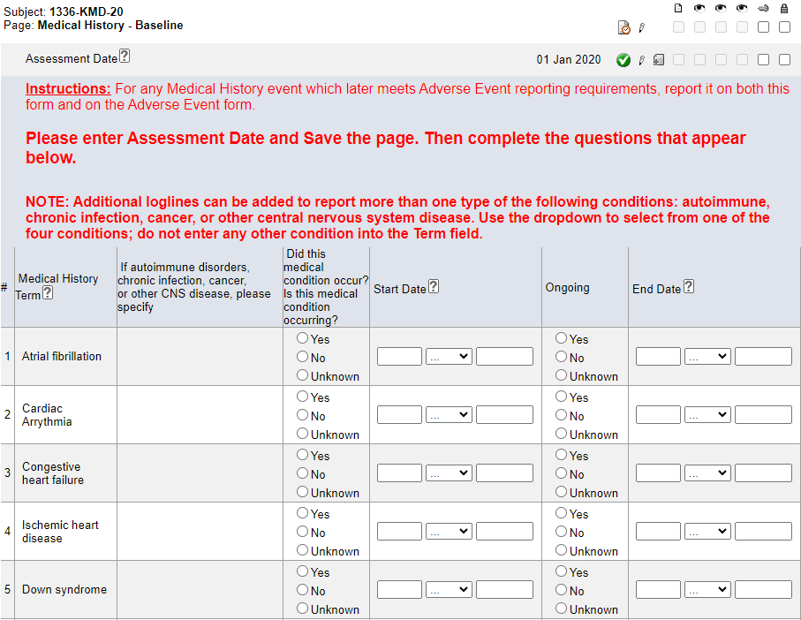
Medical History
Always enter this form prior to entering data on the Concomitant Medications form.
Enter the Assessment Date and hit Save. The rest of the form will open to allow for data entry.
Pay close attention to the Instructions in the header in Rave.

Slide 11
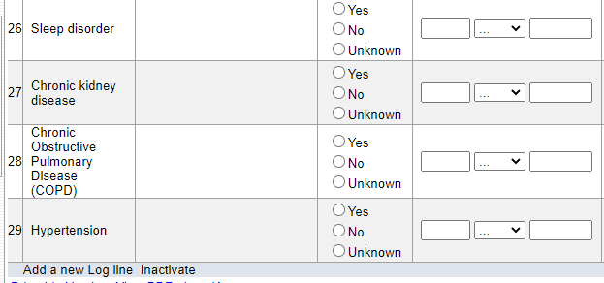
Medical History
To report on additional types of autoimmune disorders, chronic infections, cancer, or other CNS disease, use the Add a new Log line feature and select from the drop down.
Note – complete the ‘specify’ for each additional condition added.
Do not enter any other conditions into the additional log lines

Slide 12
Medical History
Only report on those targeted conditions listed. Refer to the NOTE: and Help Text for clarification.
The diagnoses of MCI/AD is not reported on this form; it is reported on the Alzheimer's Disease Diagnosis form.

Slide 13
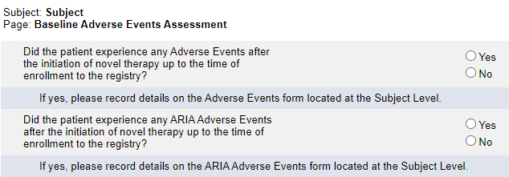
Baseline Adverse Events Assessment
Complete this form in its entirety.
Note the timeline.
If Yes is reported to either question, complete a log line on the Adverse Events or ARIA Adverse Events form located at the Subject Level.

Slide 14
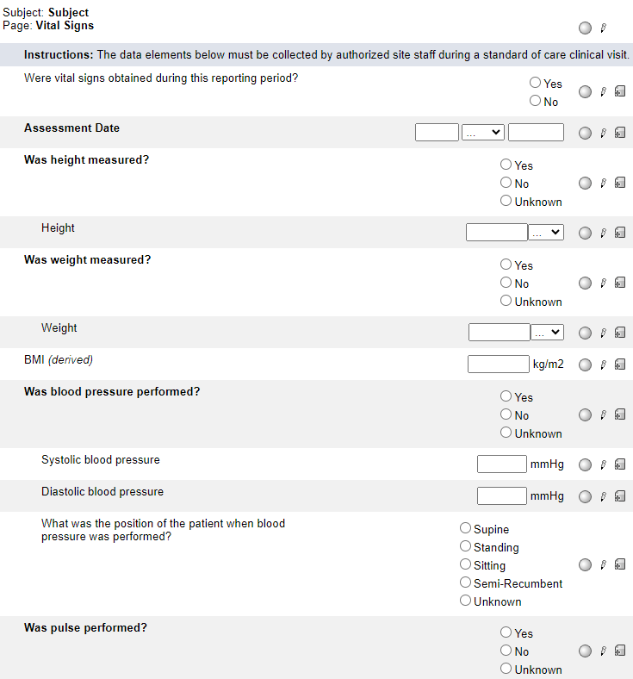
Vital Signs
At Baseline, answer the first question Yes and enter the most recent vital signs obtained – up to and including the day of enrollment to the registry.

Slide 15
Baseline Concurrent Study Enrollment
If either of the two leading questions are answered Yes, complete a log line for each study to which the patient enrolled or discontinued.

Slide 16
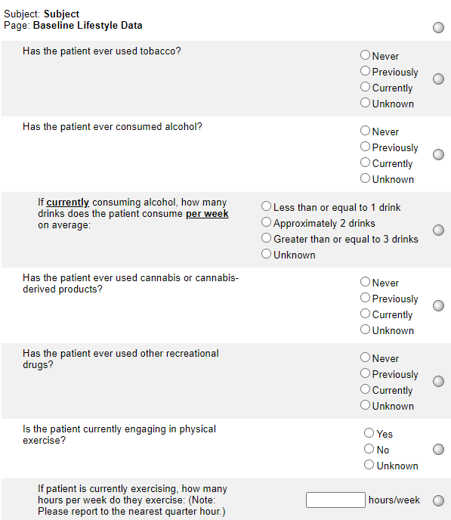
Baseline Lifestyle Data
Complete this form in its entirety.

Slide 17
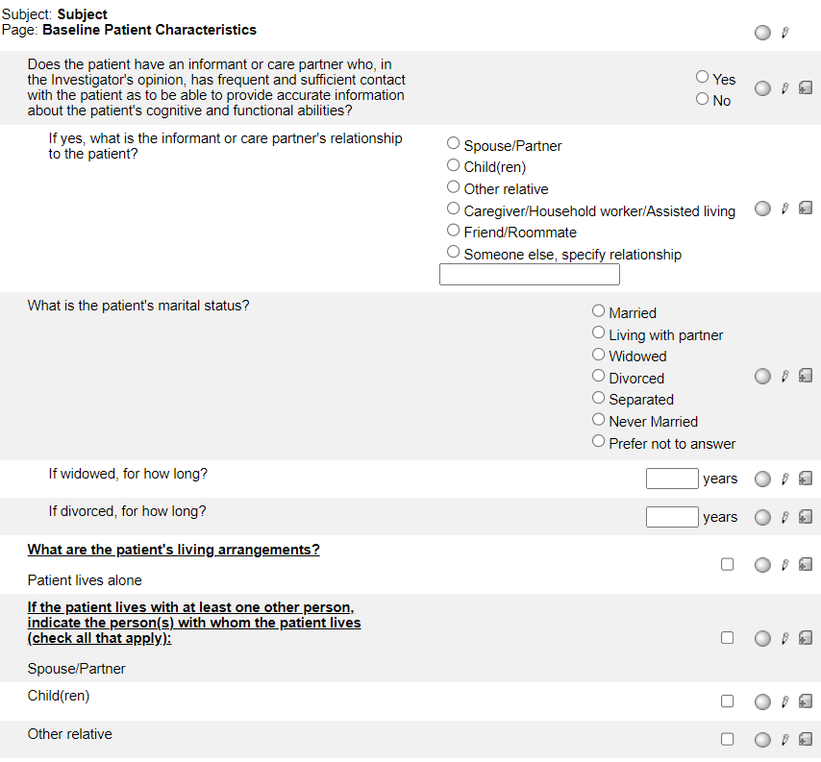
Baseline Patient Characteristics
Complete this form in its entirety.

Slide 18
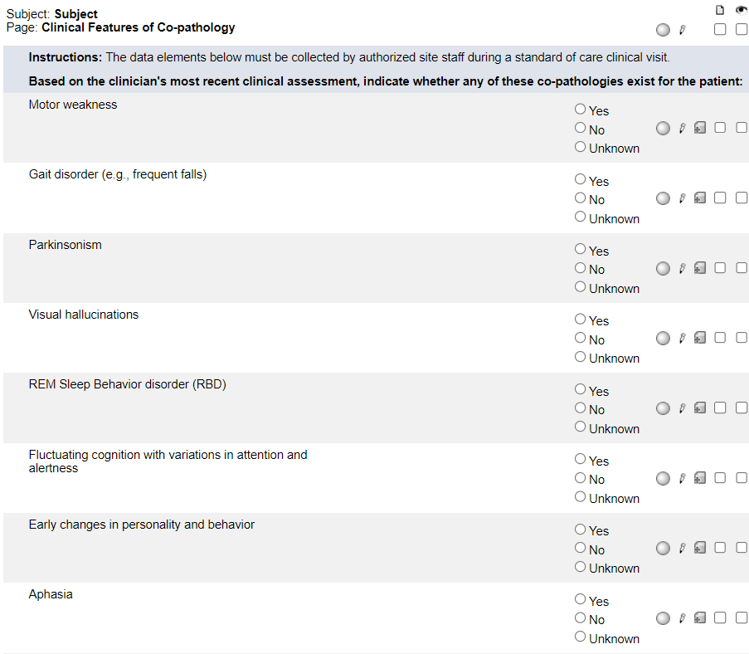
Clinical Features of Co-Pathology
Complete this form in its entirety.

Slide 19
Additional Measures
For each assessment type, indicate whether or not it was performed. If the assessment was performed, complete the log line in its entirety. See instructions for Baseline and Follow-up reporting.
If additional assessments were performed, use the “Add a new Log Line” feature.

Slide 20
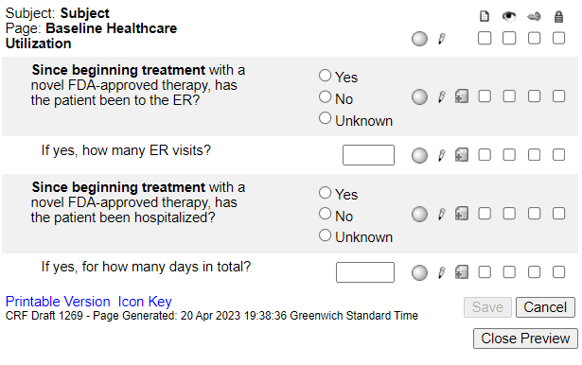
Baseline Healthcare Utilization
The form only becomes visible and available for data entry when “Has the patient received any doses of a novel FDA-approved AD therapy prior to their enrollment in the registry?” on the Baseline Novel Therapy Administration YN has been answered Yes.

Slide 21
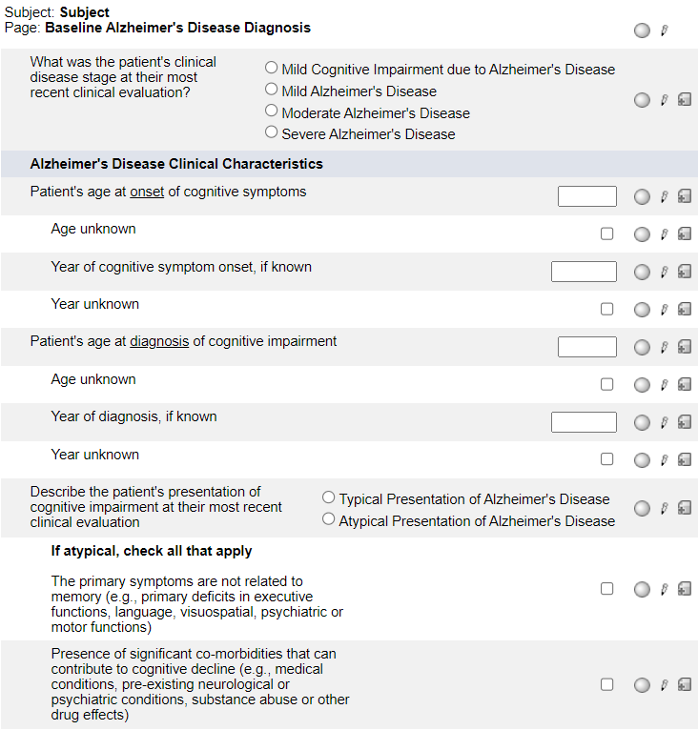
Baseline Alzheimer's Disease Diagnosis
For both onset of cognitive symptoms and diagnosis of cognitive impairment, either the actual or the unknown age and either the actual or the unknown year must be entered.

Slide 22
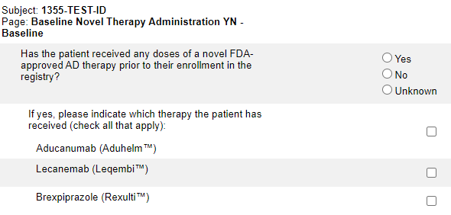
Baseline Novel Therapy Administration YN
If the patient is on novel therapy, answer Yes, indicate which type and hit Save.
The list of novel therapies will be updated as new therapies become available.
Note that the timeframe is prior to the patient’s enrollment to ALZ-NET.

Slide 23
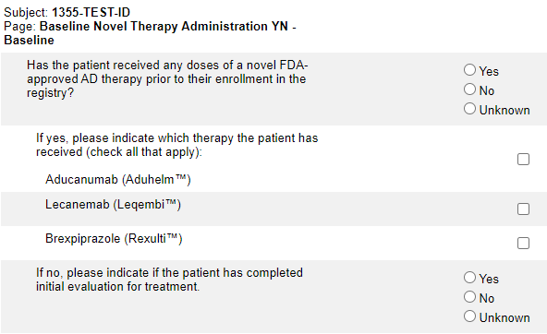
Baseline Novel Therapy Administration YN
If the first question is answered No, indicate if the patient has completed the initial evaluation for treatment.
If the initial evaluation has not been completed, select No and hit Save.

Slide 24
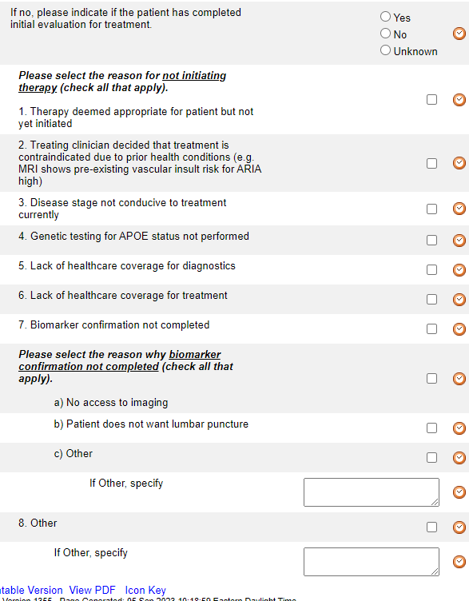
Baseline Novel Therapy Administration YN
If the initial evaluation has been completed, select Yes and indicate the reasons for not initiating therapy and hit Save.
Note that there are 8 general choices (numbered 1-8) and 3 biomarker-specific choices (lettered a-c)
If Other is selected for either, please specify.

Slide 25
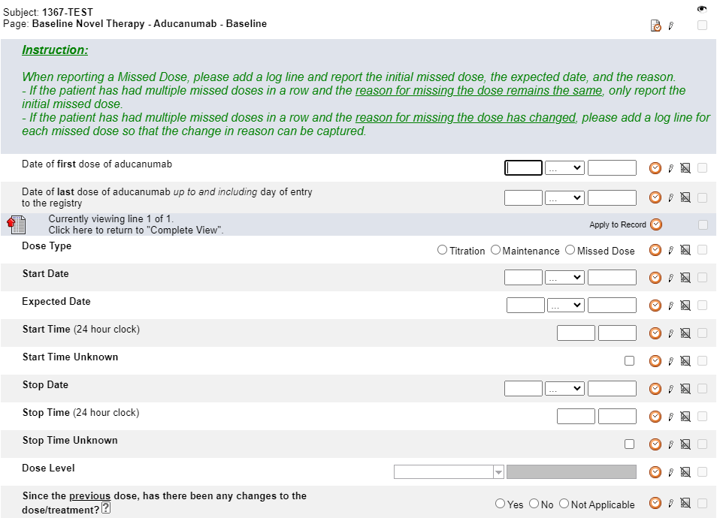
Baseline Novel Therapy - Aducanumab
This form only becomes visible and available for data entry when Aducanumab is selected on the Baseline Novel Therapy Administration YN form.
Complete a log line for each dose taken between the date of first dose and the date of last dose reported.
Note: this form is a “portrait log” style. It can be opened by clicking on the header in the log line and closed by clicking on “Complete View”.

Slide 26
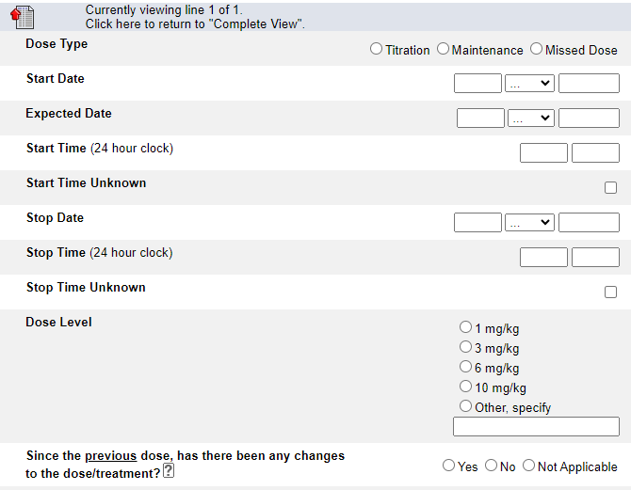
Baseline Novel Therapy - Aducanumab
Pay close attention to the Instructions when reporting a Missed Dose.
When reporting a Missed Dose, enter the Expected Date.
See Help Text for clarification on when to use Not Applicable.

Slide 27
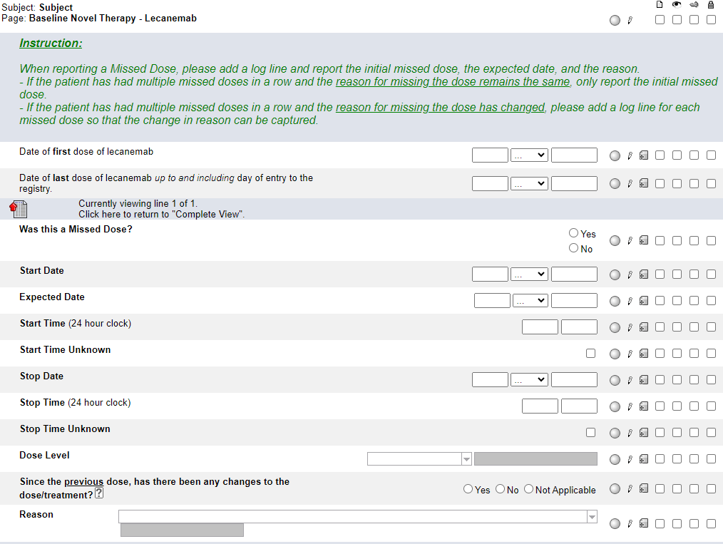
Baseline Novel Therapy - Lecanemab
This form only becomes visible and available for data entry when Lecanemab is selected on the Baseline Novel Therapy Administration YN form.
Complete a log line for each dose taken between the date of first dose and the date of last dose reported.
Note: this form is a “portrait log” style. It can be opened by clicking on the header in the log line and closed by clicking on “Complete View”.

Slide 28
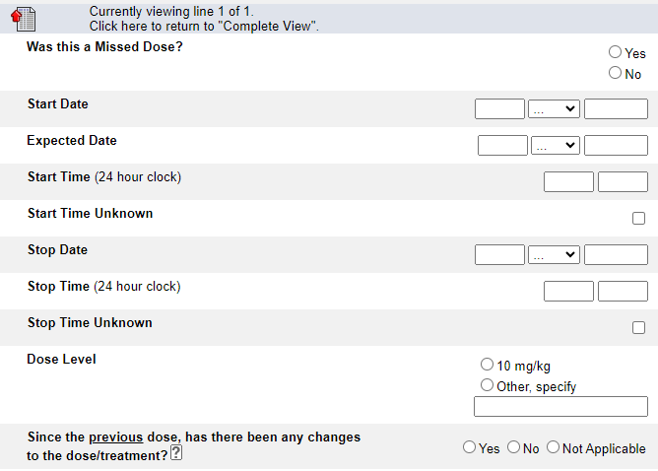
Baseline Novel Therapy - Lecanemab
Pay close attention to the Instructions when reporting a Missed Dose.
When reporting a Missed Dose, enter the Expected Date.
See Help Text for clarification on when to use Not Applicable.

Slide 29
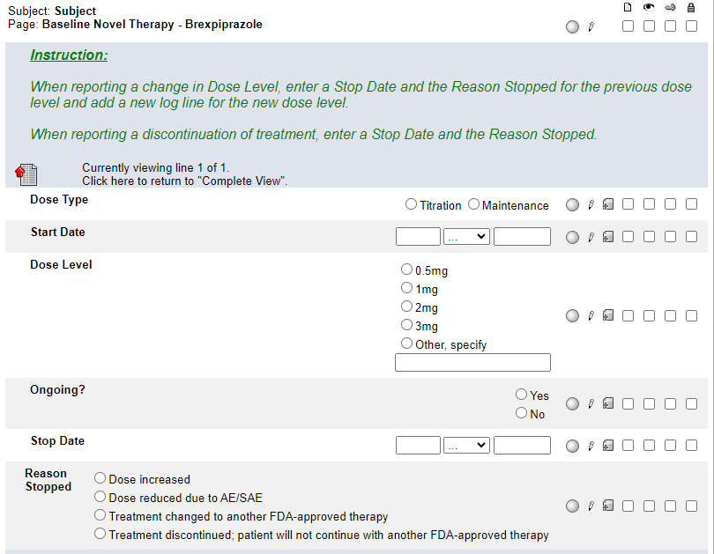
Baseline Novel Therapy - Brexpiprazole
This form only becomes visible and available for data entry when Brexpiprazole is selected on the Baseline Novel Therapy Administration YN form.
Pay close attention to the Instructions. Report new Dose Levels and changes to Dose Levels. Do not report each individual dose.
Note: this form is a “portrait log” style. It can be opened by clicking on the header in the log line and closed by clicking on “Complete View”.

Slide 30
Clinical Imaging Submission
Enter a log line for each image submitted.
If the modality is MRI, select Not Applicable for Type of PET Performed.
Only enter details about contrast if modality is MRI.

Slide 31
Folder Structure in Rave
Enrollment Forms
Baseline
Follow-up
Patient Level

Slide 32
Follow-Up folders
Complete the Follow-up Reporting Period and Patient Status form to roll-out the remaining follow-up forms.
NOTE:
You may see an inactivated Baseline Reporting Period and Patient Status form as the first form in the follow-up folders. Ignore this form!

Slide 33
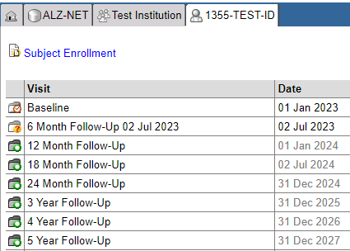
Patient Home Page
All Follow-Up folders become visible as soon as the patient is enrolled to the registry.
However, each Follow-Up folder only becomes accessible for data entry at the END of the data collection time point. Until that point, the date in the Date column is grayed out and the folder, while visible, cannot be opened.

Slide 34
Patient Home Page
Once a folder is accessible, the END date of the data collection time point is appended to the name of the folder, the date in the Date column is no longer grayed out, and the folder can be opened.

Slide 35
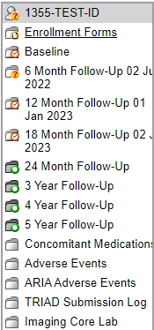
Folder Navigation
Note, too, that the appended date will be visible for each accessible folder within the Folder Navigation panel.

Slide 36
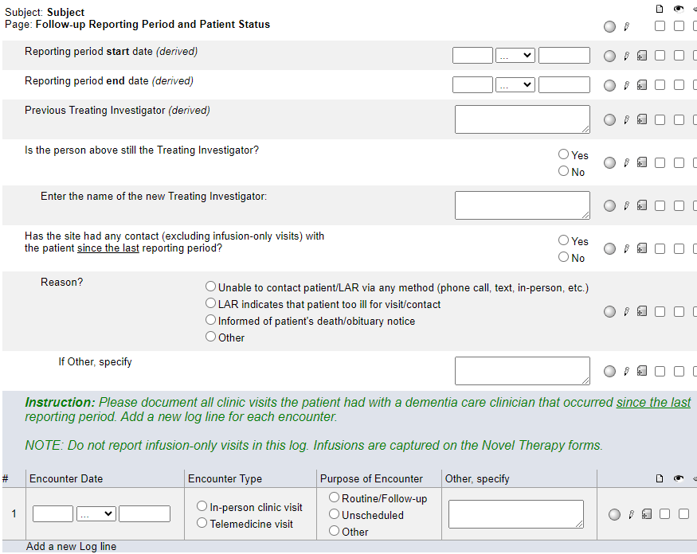
Follow-up Reporting Period and Patient Status
During follow-up, this is the only form which appears when a folder is first opened.
The derived start date is one day after the end date of the previous data collection time point.
The derived end date is derived from the registration date plus the corresponding data collection time point (6 month, 12 month, 24 month etc.)
These derived dates cannot be changed.

Slide 37
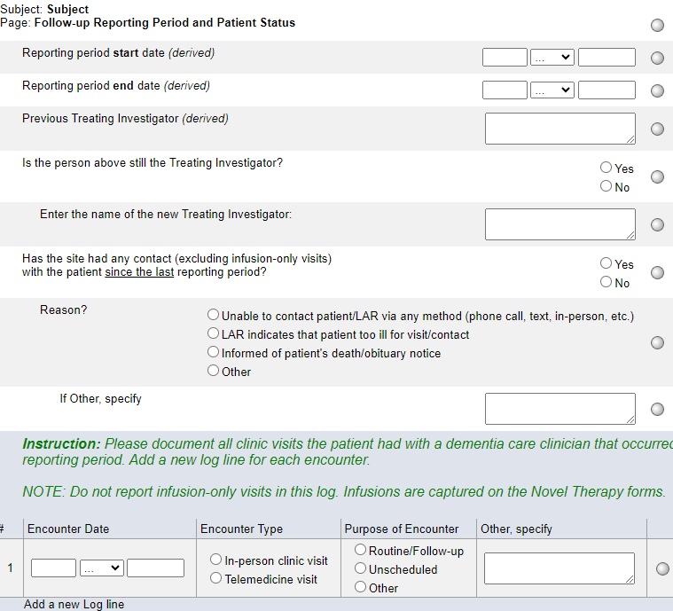
Follow-up Reporting Period and Patient Status
Beginning at the 6-month data collection time point, the Treating Investigator reported at the time of registration will be derived to the Previous Treating Investigator (derived) field.
Answer “Is the person above still the Treating Investigator?”
If Yes, the previous Treating Investigator will be derived forward to the next data collection time point.
If No, enter the name of the new Treating Investigator into the open text box. This new Treating Investigator will be derived forward to the next data collection time point.

Slide 38
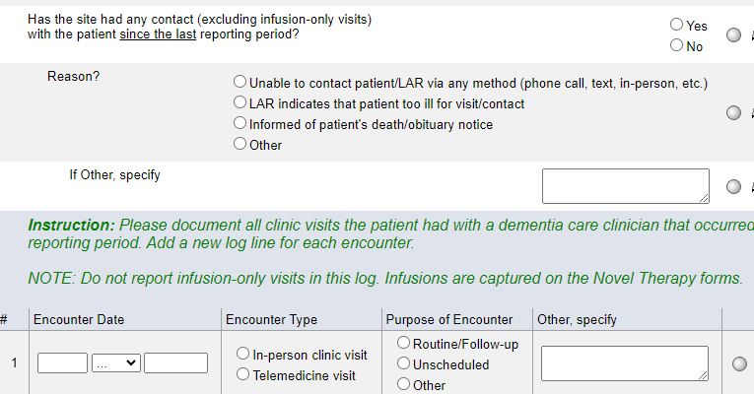
Follow-up Reporting Period and Patient Status
Answer “Has the site had any contact (excluding infusion-only visits) with the patient since the last reporting period?
If Yes, complete a log line for each in-person clinic or telemedicine visit.
NOTE: Infusion-only visits do not need to be reported as a log line. Infusion visits are captured on the Novel Therapy forms.
If No, indicate the reason.

Slide 39
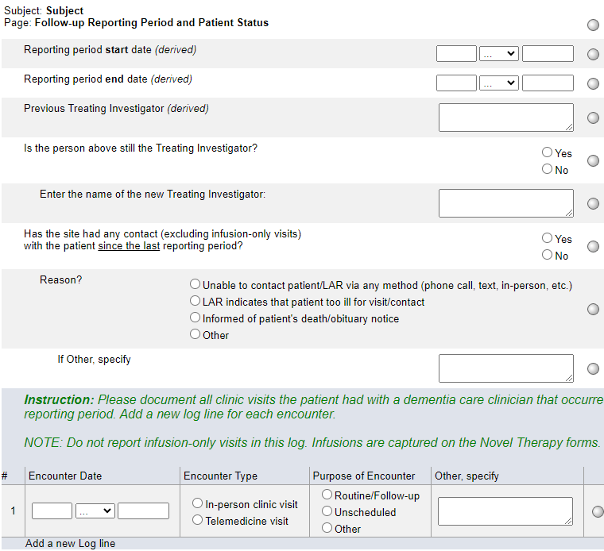
Follow-up Reporting Period and Patient Status
If the site has been unable to contact the patient and the patient is considered lost to follow-up (refer to the protocol for the definition), please use the Add Event feature to select and complete the Lost to Follow-up form.
If it’s reported that there has been no contact and the Reason is “death/obituary notice”, the Death Detail form will become visible and available for data entry at the Patient Level.

Slide 40
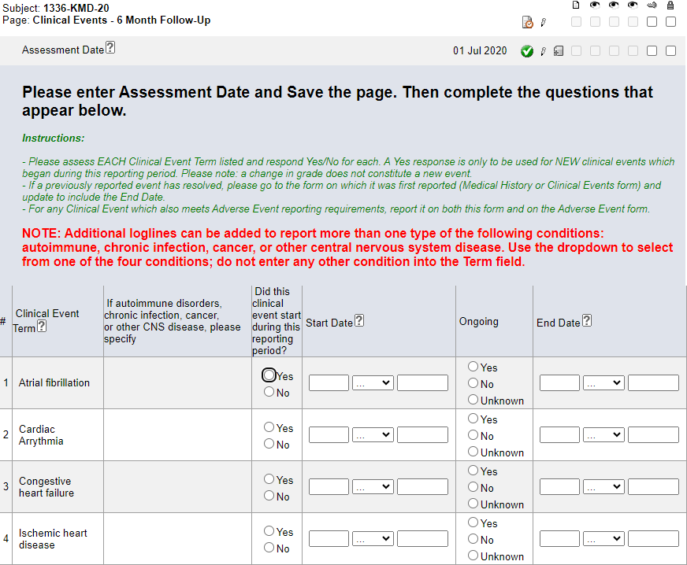
Clinical Events
Always enter this form prior to entering data on the Concomitant Medications form.
Enter the Assessment Date and hit Save. The rest of the form will open to allow for data entry.
Pay close attention to the Instructions in the header in Rave.

Slide 41
Clinical Events
Only report on those targeted conditions listed. Refer to the NOTE: and Help Text for clarification.
The diagnosis of MCI/AD is not reported on this form; it is reported on the Alzheimer's Disease Diagnosis form.

Slide 42
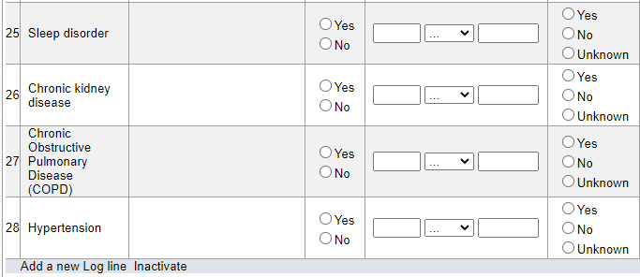
Clinical Events
To report on additional types of autoimmune disorders, chronic infections, cancer, or other CNS disease, use the Add log line feature and select from the drop down.
Do not enter any other conditions into the additional log lines.
Note – complete the ‘specify’ for each additional condition added.

Slide 43
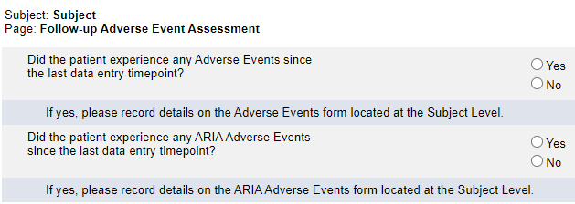
Follow-up Adverse Event Assessment
Complete this form in its entirety at each time point.
Note the timeline.
If Yes is reported to either question, complete a log line on the Adverse Events or ARIA Adverse Events form located at the Subject Level.

Slide 44
Vital Signs
During Follow-up –
If vital signs were obtained, answer Yes to the first question and complete the rest of the form.
If vital signs were not obtained, answer No to the first question and do not complete the rest of the form.
If vital were obtained multiple times during an applicable data collection time period, enter the data from the most recent vital sign assessment.

Slide 45
Follow-up Concurrent Study Enrollment
Any concurrent studies to which the patient enrolled to previously and were indicated as ongoing, will automatically be pulled forward into this form. Update the log line for each study pulled in.
If the patient newly enrolled to a study, use the “Add a new Log Line” feature and complete a log line for each new study.

Slide 46
Follow-up Concurrent Study Enrollment
If previously reported “Ongoing” studies are not being ‘pulled forward’, please do the following:
On the Follow-up Reporting Period and Patient
Status form, ‘toggle’ the answer to this question.
That is, if you originally entered No, change the answer to Yes and hit Save. Then, change the answer back to No and hit Save.
This should ‘trigger’ the programming and the Ongoing studies will be ‘pulled forward’ into the current Follow-up Concurrent Study Enrollment form.

Slide 47
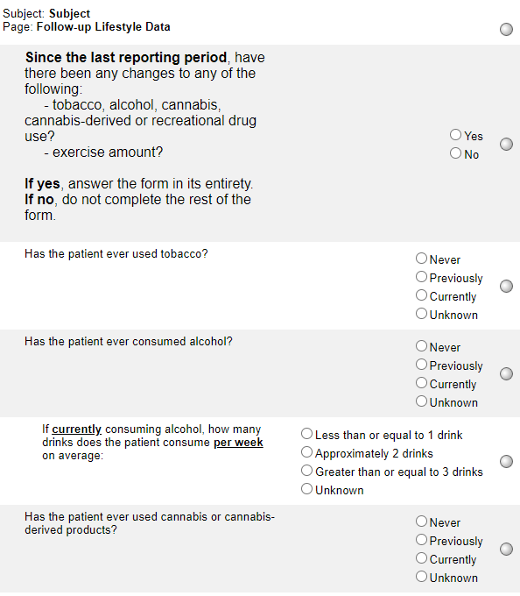
Follow-up Lifestyle Data
This form asks about any changes since the last reporting period. For accurate reporting, compare to how the Lifestyle Data form was completed during the previous reporting period.
If the first question is answered Yes, complete the rest of the form.
If the first question is answered No, do not complete the rest of the form.

Slide 48
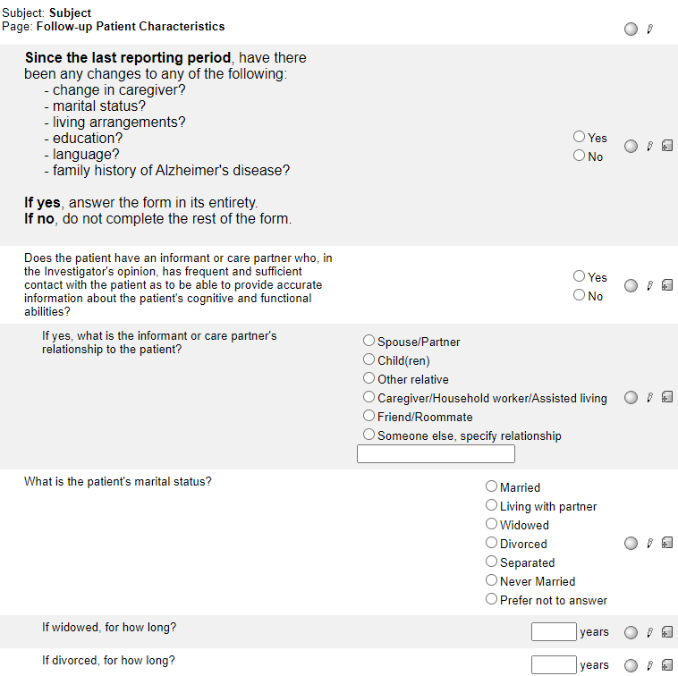
Follow-up Patient Characteristics
This form asks about the changes since the last reporting period. For accurate reporting, compare to how the Patient Characteristics form was completed during the previous reporting period.
If the first question is answered Yes, complete the rest of the form.
If the first question is answered No, do not complete the rest of the form.

Slide 49
Clinical Features of Co-Pathology
Complete this form in its entirety.

Slide 50
Additional Measures
For each assessment type, indicate whether or not it was performed. If the assessment was performed, complete the log line in its entirety. See instructions for Baseline and Follow-up reporting.
If additional assessments were performed, use the “Add a new Log line” feature.

Slide 51
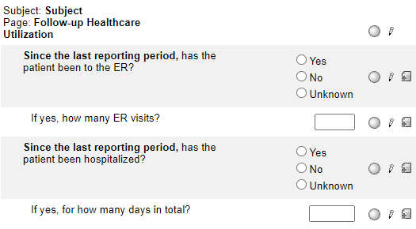
Follow-up Healthcare Utilization
Complete this form in its entirety.
Note that the timeframe is since the last reporting period.

Slide 52
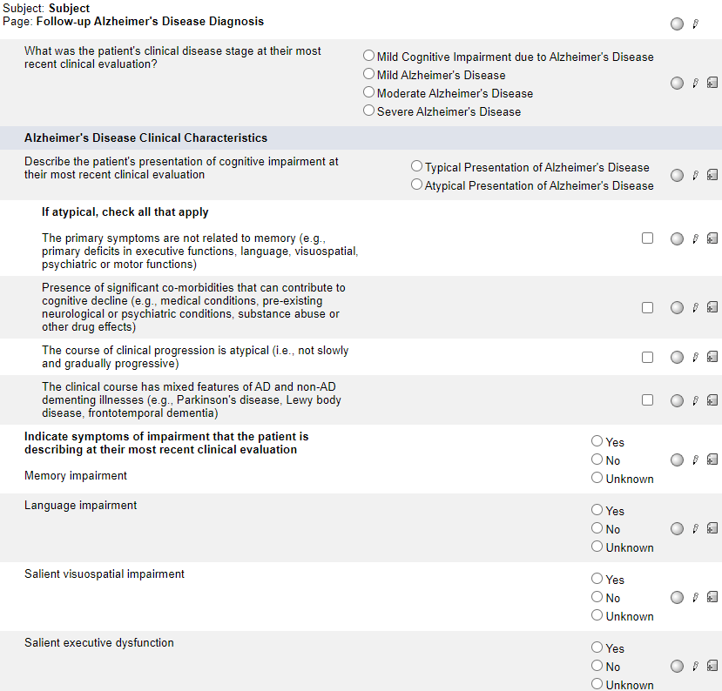
Follow-up Alzheimer's Disease Diagnosis
Complete this form in its entirety.
Note that the timeframe is the patient’s most recent clinical evaluation.

Slide 53
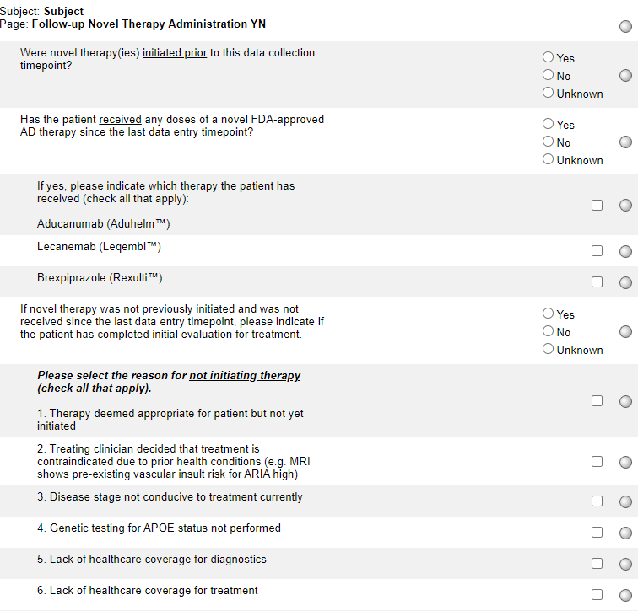
Follow-up Novel Therapy Administration YN
Answer Yes, No, or Unknown to the first question.
Note that this question is asking if novel therapies were initiated prior to this data collection time point.
Answer Yes, No, or Unknown to the second question.
Note that the timeframe is since the last data entry timepoint.
If answered Yes, selected the type of novel therapy(ies) and hit Save.
The list of novel therapies will be updated as new therapies become available.

Slide 54
Follow-up Novel Therapy Administration YN
The circled question is only required to be completed if novel therapy was not initiated previously and if novel therapy was not received since the last data entry timepoint.

Slide 55
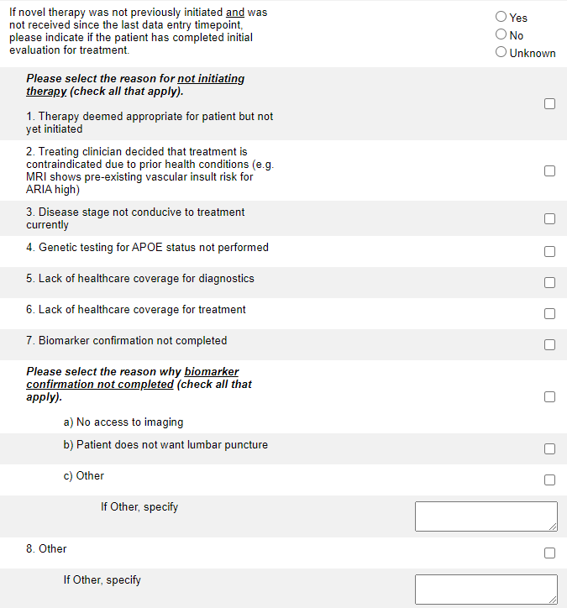
Follow-up Novel Therapy Administration YN
If the initial evaluation has been completed, select Yes and indicate the reasons for not initiating therapy and hit Save.
Note that there are 8 general choices (numbered 1-8) and 3 biomarker specific choices (lettered a-c)
If Other is selected, please specify.

Slide 56
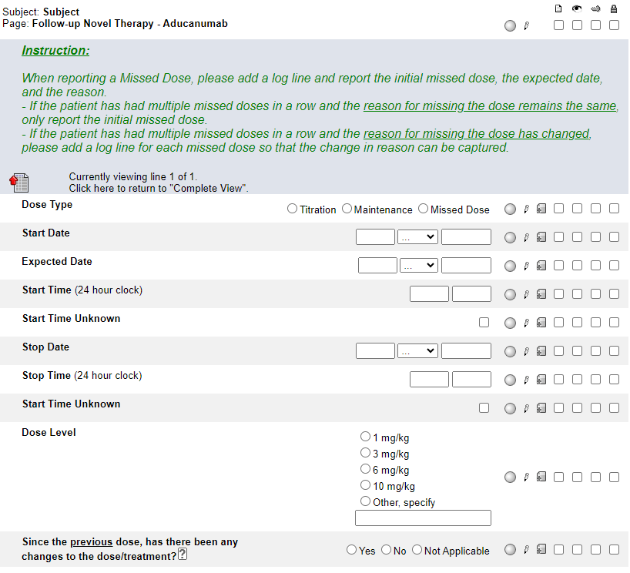
Follow-up Novel Therapy - Aducanumab
This form only becomes visible and available for data entry when Aducanumab is selected on the Follow-up Novel Therapy Administration YN form.
Note: this form is a “portrait log” style. It can be opened by clicking on the header in the log line and closed by clicking on “Complete View”.

Slide 57
Follow-up Novel Therapy - Aducanumab
Pay close attention to the Instructions when reporting a Missed Dose.
When reporting a Missed Dose, enter the Expected Date.
See Help Text for clarification on when to use Not Applicable.

Slide 58
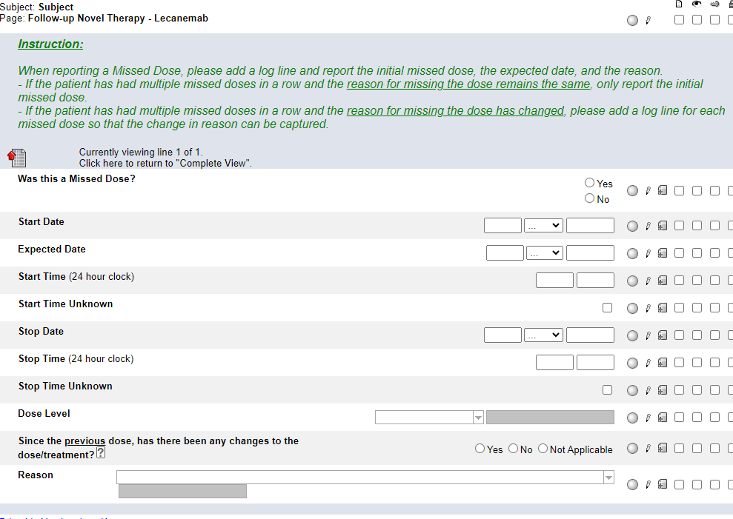
Follow-up Novel Therapy - Lecanemab
This form only becomes visible and available for data entry when Lecanemab is selected on the Follow-up Novel Therapy Administration YN form.
Note: this form is a “portrait log” style. It can be opened by clicking on the header in the log line and closed by clicking on “Complete View”.

Slide 59
Follow-up Novel Therapy - Lecanemab
Pay close attention to the Instructions when reporting a Missed Dose.
When reporting a Missed Dose, enter the Expected Date.
See Help Text for clarification on when to use Not Applicable.

Slide 60
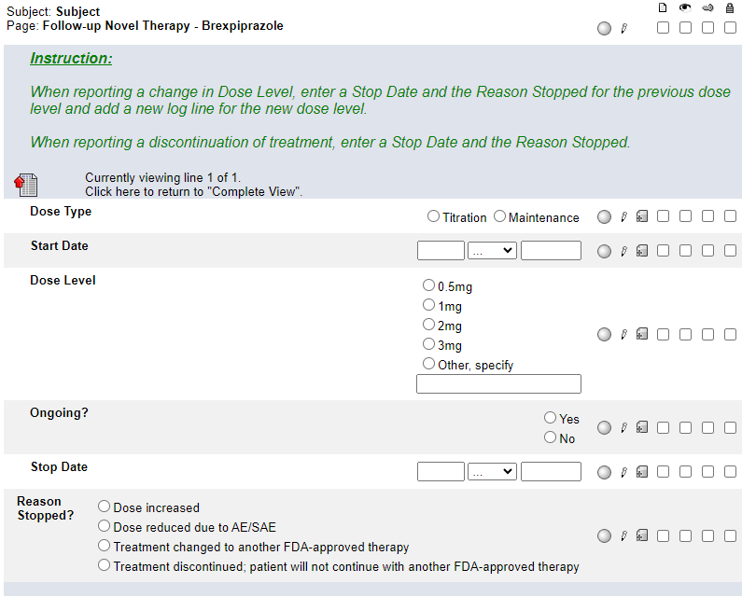
Follow-up Novel Therapy - Brexpiprazole
This form only becomes visible and available for data entry when Brexpiprazole is selected on the Follow-up Novel Therapy Administration YN form.
Any dose levels previously reported as Ongoing are automatically pulled forward into this form. Update the log line (Ongoing? or Stop Date) for each dose pulled forward. Add a new log line to report any new dose levels.
Pay close attention to the Instructions. Report new Dose Levels and changes to Dose Levels. Do not report each individual dose.
Note: this form is a “portrait log” style. It can be opened by clicking on the header in the log line and closed by clicking on “Complete View”.

Slide 61
Clinical Imaging Submission
Enter a log line for each image submitted.
If the modality is MRI, select Not Applicable for Type of PET Performed.
Only enter details about contrast if modality is MRI.

Slide 62
Folder Structure in Rave
Enrollment Forms
Baseline
Follow-up
Patient Level

Slide 63
Patient Level folders
Each patient level folder has a single form within it.

Slide 64
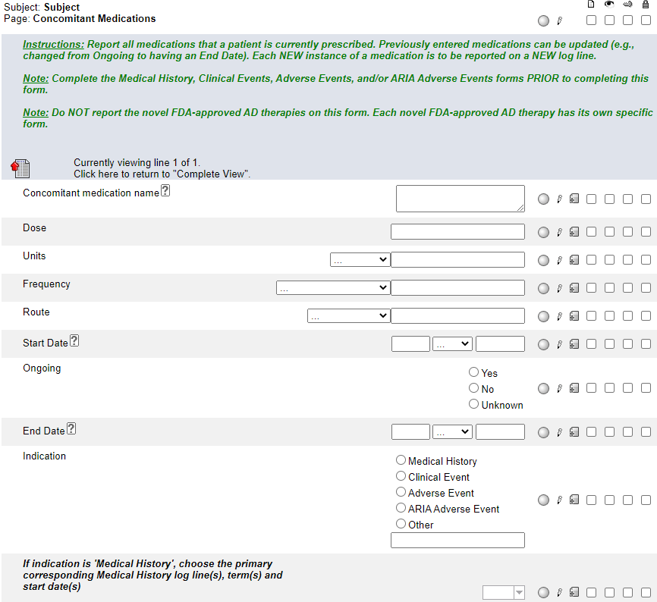
Concomitant Medications
Pay close attention to the Instructions.
Always complete this form after completing the Medical History, Clinical Events, Adverse Events, and/or ARIA Adverse Events forms.
Minimally, a year must be provided for Start and End dates.
After entering the Indication, hit Save. Then select the appropriate condition for which the medication is used.

Slide 65
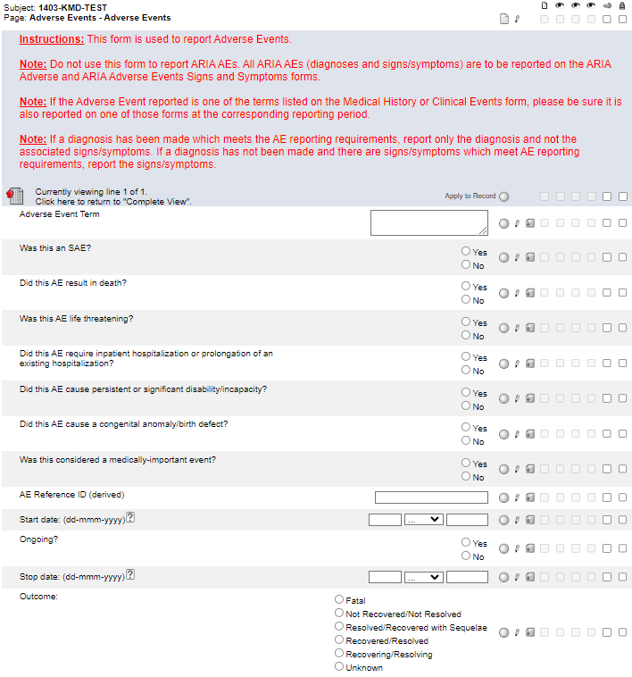
Adverse Events
Always enter this form prior to entering data on the Concomitant Medications form.
Pay close attention to the Instructions.
Note: this form is a “portrait log” style. It can be opened by clicking on the header in the log line and closed by clicking on “Complete View”.

Slide 66
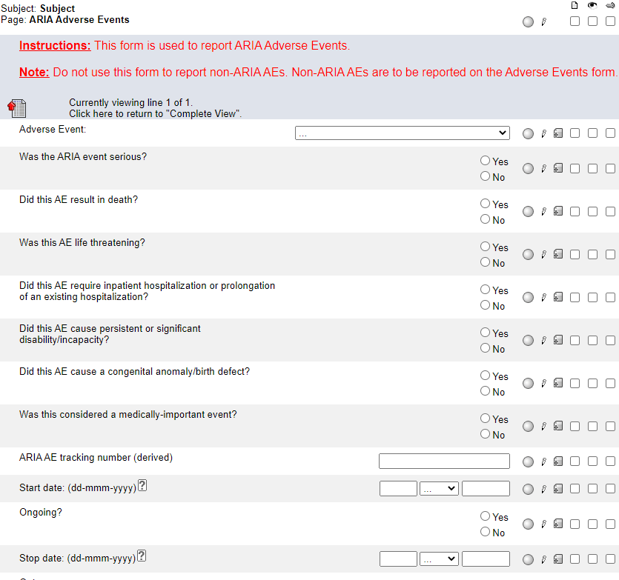
ARIA Adverse Events
Always enter this form prior to entering data on the Concomitant Medications form.
Pay close attention to the Instructions.
Note: this form is a “portrait log” style. It can be opened by clicking on the header in the log line and closed by clicking on “Complete View”.

Slide 67
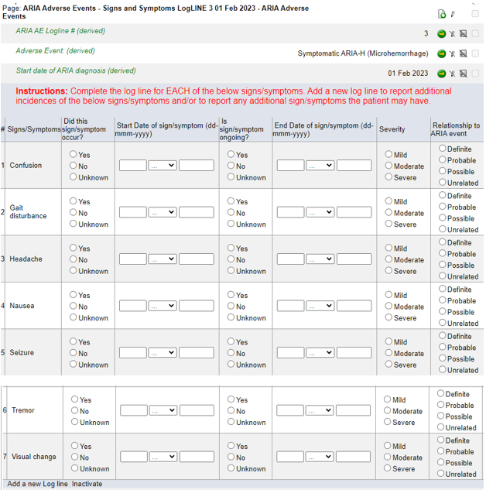
ARIA Adverse Events Signs and Symptoms
When a Symptomatic ARIA is reported on the ARIA Adverse Events form, this form rolls out to capture any associated signs and symptoms.
Note that each ARIA Adverse Events Signs and Symptoms form is ‘linked’ to a specific logline on the ARIA Adverse Events form.

Slide 68
ARIA Adverse Events Signs and Symptoms
Report ALL associated signs and symptoms for each symptomatic ARIA AE.
For each of the 7 signs/symptoms listed, indicate if it occurred and complete the rest of the log line as appropriate.
Add a new log line to report additional instances of the 7 signs/symptoms listed and/or to report any other symptoms.

Slide 69
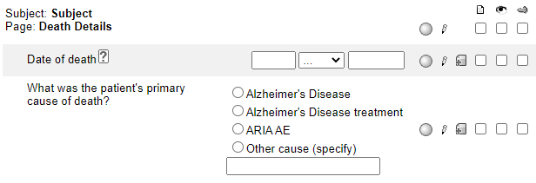
Death Details
The Death Details form becomes visible and available for data entry when the Outcome is reported as Fatal on the Adverse Events or ARIA Adverse Events form. It will be at the Patient Level.

Slide 70
TRIAD Submission Log
This form is view-only to the Site.
It summarizes all the imaging files uploaded to TRIAD for the patient.

Slide 71
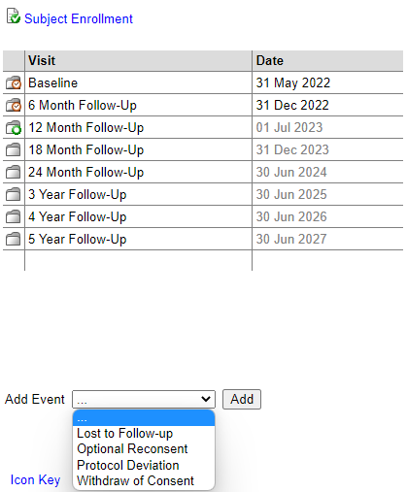
Add Event forms
Forms that are completed for specific protocol events can be added at any time point by using the Add Event feature located at the bottom of each patient’s homepage.

Slide 72
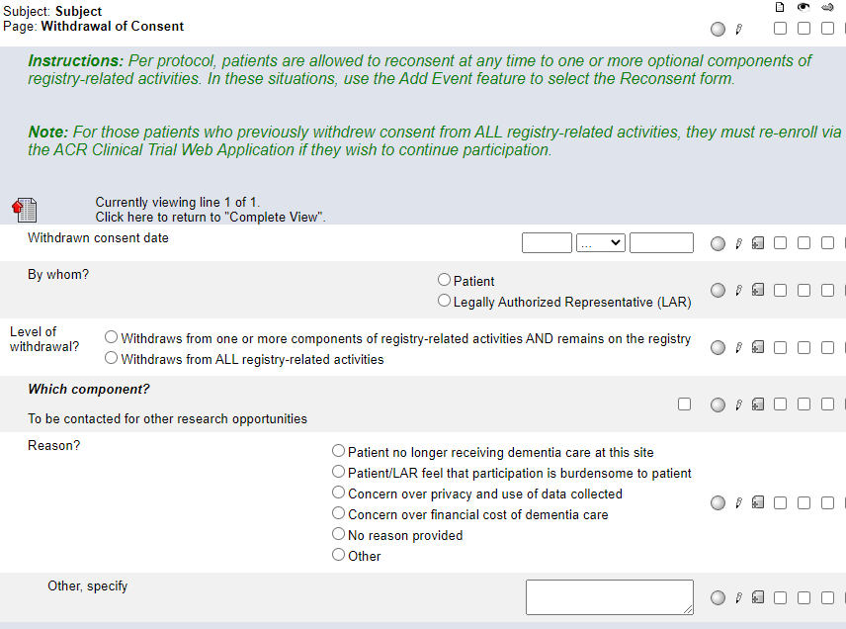
Withdrawal of Consent
Pay close attention to the Instructions.
In the future, ALZ-NET plans to have additional optional components to which a patient may consent. The Level of withdrawal choices will be updated as these other registry-related activities become available.
Note that the Demography form captures whether or not the patient previously consented to being contacted for other research opportunities.

Slide 73
Optional Components Reconsent
Pay close attention to the Instructions.
In the future, ALZ-NET plans to have additional optional components to which a patient may consent. The choices for “Which component?” will be updated as these other registry-related activities become available.
Note that the components to which the patient has reconsented must align with those components previously reported as withdrawn from on the Withdrawal of Consent form.

Slide 74
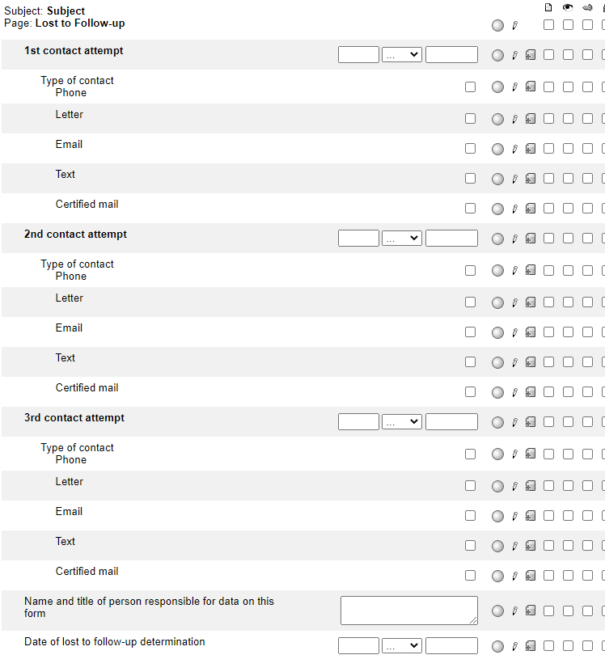
Lost to Follow-up
Complete this form only after the three contact attempts and the determination have been made. Refer to the protocol for the definition of lost to follow-up.

Slide 75
Protocol Deviation
Complete a new log line for each Protocol Deviation.
Complete each log line in its entirety.

Slide 76
Please send any data related questions to:
alznet-data@acr.org

Slide 77
Thank You!

